Slide 1
Promoting Regional Development by building the capacity of the VET system

Slide 2
Identifying innovative development solutions and expansion of knowledge

Slide 3
Disclaimer
The European Commission support for the production of this publication does not constitute an endorsement of the contents which reflects the views only of the authors, and the Commission cannot be held responsible for any use which may be made of the information contained therein.
Project Nº: 2021-1-RO01-KA220-VET-000028118

Slide 4
Consortium

Slide 5
01
Identifying innovative development solutions
02
Expansion of knowledge (sectoral, cross-sectoral, local)
03
Project management standard
Contetns
04
Project management standard
05
Project management book of knowledge

Slide 6
Chapter 1: Identifying innovative development solutions
Definition:
Identifying innovative development solutions in a region requires a systematic approach that involves:
research,
analysis,
and collaboration with local stakeholders.

Slide 7
Chapter 1: Identifying innovative development solutions
Some steps (1-2/6):
Conduct a needs assessment: Begin by identifying the key challenges and opportunities facing the region. This could involve analyzing data on economic, social, and environmental indicators, as well as conducting surveys or focus groups with local stakeholders.
Research best practices: Look for examples of successful development solutions in similar regions or industries. This could involve reviewing case studies, academic literature, or consulting with experts in the field.

Slide 8
Chapter 1: Identifying innovative development solutions
Some steps (3-4/6):
Engage with local stakeholders: Work closely with local government officials, community leaders, and other stakeholders to better understand their needs and priorities. This could involve holding public meetings or workshops, conducting surveys or interviews, or engaging with local media.
Foster partnerships: Identify potential partners, including local businesses, NGOs, and academic institutions, that could help you to develop and implement innovative solutions.

Slide 9
Chapter 1: Identifying innovative development solutions
Some steps (5-6/6):
Pilot and test solutions: Once you have identified potential solutions, pilot and test them in a small-scale setting to assess their effectiveness and feasibility. This could involve working with a small group of stakeholders or launching a pilot project in a specific neighborhood or industry.
Scale up successful solutions: If the pilot is successful, work to scale up the solution to a larger scale, and measure its impact on the region. Be sure to continue engaging with local stakeholders throughout the process to ensure that the solution remains relevant and effective.

Slide 10
Chapter 1: Identifying innovative development solutions
Local stakeholders
Local stakeholders are individuals, groups, or organizations that have an interest or stake in a particular geographic area or region. They are individuals or groups who are directly affected by the decisions made in the region, and therefore, have a vested interest in its development and progress.
Engaging with local stakeholders is critical to understanding the unique challenges and opportunities facing a region, and to developing innovative solutions that are tailored to its specific needs.

Slide 11
Chapter 1: Identifying innovative development solutions
Local stakeholders (1/2)
Local stakeholders can include:
Community members: These are the individuals who live and work in the region, including residents, workers, and business owners.
Local government officials: This includes elected officials, city planners, and other municipal employees who are responsible for overseeing the development of the region.
Non-governmental organizations (NGOs): These are non-profit organizations that work on issues related to the development of the region, such as economic development, social services, and environmental protection.

Slide 12
Chapter 1: Identifying innovative development solutions
Local stakeholders (2/2)
…
Academia: This includes universities and research institutions that may have expertise in areas related to the region's development, such as urban planning, environmental studies, or economic development.
Private sector: This includes businesses and corporations that operate in the region and may have a stake in its development and growth.
Engaging with local stakeholders is critical to understanding the unique challenges and opportunities facing a region, and to developing innovative solutions that are tailored to its specific needs.

Slide 13
Chapter 1: Identifying innovative development solutions
Focus groups (1/3)
Focus groups are a qualitative research method that involves a group discussion led by a trained moderator to collect in-depth information about a particular topic. The moderator guides the discussion, encouraging participants to share their opinions, attitudes, and experiences on the topic under study.
Focus groups are typically composed of 6-12 participants who share some common characteristics, such as demographics or experiences. They may be conducted in person or online and are usually audio or video recorded for analysis.

Slide 14
Chapter 1: Identifying innovative development solutions
Focus groups (2/3)
Focus groups are useful for exploring complex topics and gaining insights into people's attitudes, beliefs, and behaviors. They can be used in a variety of contexts, including market research, social science research, and public opinion research.
Focus groups have some limitations, including the potential for groupthink, the influence of the moderator, and the potential for biased responses. Therefore, careful planning, design, and execution of focus groups are essential for obtaining valid and reliable data.

Slide 15
Chapter 1: Identifying innovative development solutions
Focus groups (2/3)
Some of the benefits of using focus groups include:
Rich data: Focus groups allow for in-depth, qualitative data collection, providing a more nuanced understanding of the topic under study.
Group dynamics: Focus groups capitalize on group dynamics, allowing participants to build on each other's ideas and to challenge assumptions.
Flexibility: Focus groups can be adapted to suit different research questions and contexts.
Efficient: Focus groups can be conducted relatively quickly and cost-effectively compared to other research methods, such as individual interviews.

Slide 16
Chapter 2: Expansion of knowledge (sectoral, cross-sectoral, local)
Expanding knowledge can be achieved in several ways depending on the area of interest. Here are some ways to expand knowledge in various sectors:
Sectoral Knowledge:
To expand your knowledge in a particular sector, you can:
Attend industry conferences, workshops, and seminars to learn about new trends, technologies, and best practices in the sector
Read industry publications, research reports, and news articles to stay up-to-date with the latest developments
Connect with industry experts, peers, and mentors through networking events, professional organizations, or online forums
Take courses or earn certifications in the field to deepen your knowledge and skills.

Slide 17
Chapter 2: Expansion of knowledge (sectoral, cross-sectoral, local)
Cross-Sectoral Knowledge
To expand your knowledge across different sectors, you can:
Look for opportunities to collaborate with professionals from other industries and learn about their perspectives and practices.
Attend interdisciplinary conferences or events to learn about emerging trends and innovations that cut across different sectors.
Read cross-disciplinary publications, research reports, or news articles that explore the intersection of different fields.
Participate in cross-sectoral initiatives or projects that aim to tackle complex social or environmental challenges.

Slide 18
Chapter 2: Expansion of knowledge (sectoral, cross-sectoral, local)
Local Knowledge
To expand your knowledge about a particular locality, you can:
Connect with local experts, policymakers, or community leaders to learn about the history, culture, and challenges facing the community.
Participate in community events or volunteer projects to gain firsthand experience and insights into local issues and needs.
Read local news publications or social media feeds to stay informed about local developments and initiatives.
Conduct field research or surveys to collect data on local trends, attitudes, or behaviors.
By combining these strategies, you can expand your knowledge and skills in a variety of sectors and contexts, allowing you to better understand complex challenges and find innovative solutions.

Slide 19
Chapter 3: Project management standard
Approach to:
Identification of innovative development solutions,
Expansion of knowledge (sectoral, cross-sectoral, local) and
Identification of the common elements between the smart specialization niches of each sector and major regional challenges
as a project.
Further slides will give a participant insight into project:
management standards,
PMBOK as example of project management methodology and
OpenProject as an free and open software solution to manage projects

Slide 20
Chapter 3: Project management standard
Project management methodology provides a guideline for managing the projects and it is one of the important factors for successful completion of the projects.
The most widely used project management methodologies in the world are:
Project Management Body of Knowledge (PMBOK)
PRojects IN Controlled Environment Version 2 (PRINCE2)
Decision on the project management methodology depends:
1. The overall organization strategy, i.e. how competitive we are as a regional development agency
2. The size of the project team and/or scope to be managed;
3. The priority of the project;
4. How critical the project is to the company;
5. How flexible the methodology and its components are.

Slide 21
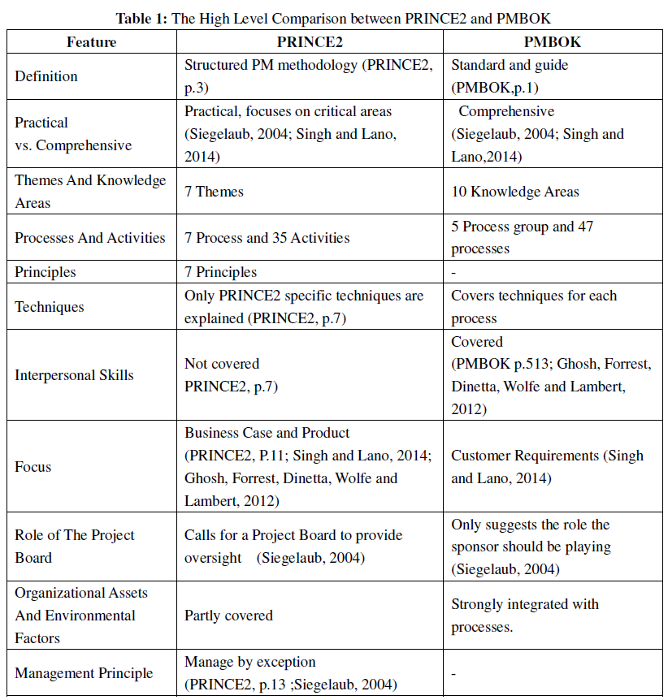
Chapter 3: Project management standard
Comparison: PRINCE2 vs. PMBOK (1)
Ref: Ersin Karaman, Murat Kurt (2015)

Slide 22
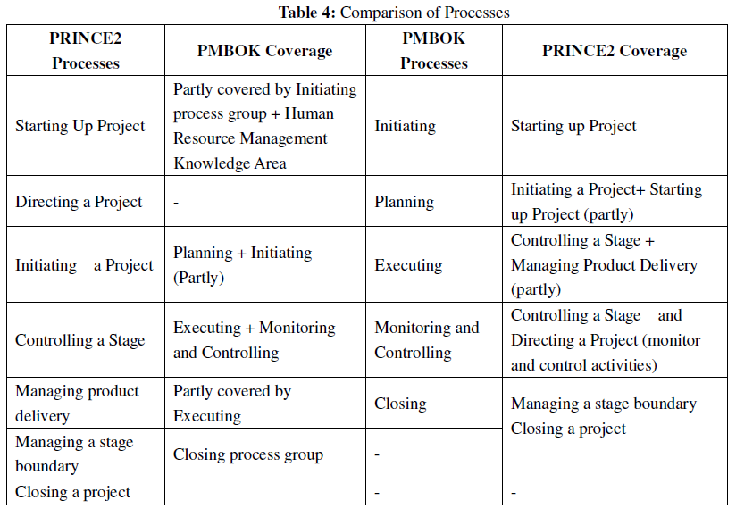
Chapter 3: Project management standard
Comparison: PRINCE2 vs. PMBOK (4)
Ref: Ersin Karaman, Murat Kurt (2015)

Slide 23
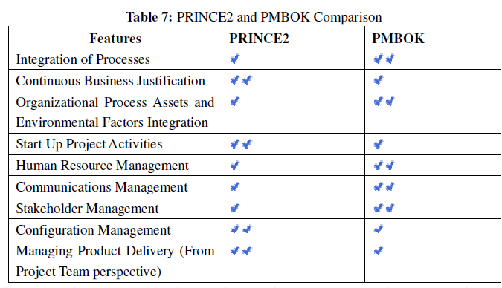
Chapter 3: Project management standard
Comparison: PRINCE2 vs. PMBOK (5)
Ref: Ersin Karaman, Murat Kurt (2015)

Slide 24
Chapter 3: Project management book of knowledge
The Project Management Book of Knowledge (PMBOK) is a guidebook published by the Project Management Institute (PMI) that provides a set of standard terminology, guidelines, and practices for project management.
Overall, the PMBOK provides a framework for managing projects that can be adapted to various industries and project types. It emphasizes the importance of effective communication, stakeholder engagement, risk management, and continuous improvement.
The PMBOK is organized into 10 knowledge areas, 5 process groups and 49 processes.

Slide 25
Chapter 4: Project management book of knowledge
PMBOK 10 knowledge areas. Each of these knowledge areas is broken down into several processes, which are used to initiate, plan, execute, monitor and control, and close out projects. These processes include inputs, tools and techniques, and outputs.
1. Project Integration Management | 6. Project Resource Management
2. Project Scope Management | 7. Project Communication Management
3. Project Schedule Management | 8. Project Risk Management
4. Project Cost Management | 9. Project Procurement Management
5. Project Quality Management | 10. Project Stakeholder Management

Slide 26
Chapter 4: Project management book of knowledge
PMBOK has 5 process groups.
1. Initiating: This process group includes processes that are performed to define a new project or a new phase of an existing project. It involves identifying stakeholders, developing a project charter, and conducting a feasibility study.
2. Planning: This process group includes processes that are performed to establish the scope of the project, define objectives, and develop the course of action required to attain those objectives. It involves creating a detailed project plan, including a project schedule, budget, and resource plan.

Slide 27
Chapter 4: Project management book of knowledge
PMBOK has 5 process groups.
3. Executing: This process group includes processes that are performed to execute the project plan by coordinating people and resources, managing project deliverables, and monitoring progress against the plan.
4. Monitoring and Controlling: This process group includes processes that are performed to track, review, and regulate the progress and performance of the project. It involves monitoring project activities, identifying variances from the plan, and taking corrective action as needed.

Slide 28
Chapter 4: Project management book of knowledge
PMBOK has 5 process groups.
5. Closing: This process group includes processes that are performed to finalize all project activities, obtain formal acceptance of the project deliverables from the customer or sponsor, and hand over the completed project to the relevant stakeholders. It involves archiving project records, conducting a project review, and documenting lessons learned.
PMBOK has further 49 processes.

Slide 29
Chapter 5: Project management book of knowledge
PMBOK processes in Initiating Process Group:
Develop Project Charter
Identify Stakeholders

Slide 30
Chapter 5: Project management book of knowledge
PMBOK processes in Planning Process Group (1/2):
Develop Project Management Plan
Plan Scope Management
Collect Requirements
Define Scope
Create WBS (Work Breakdown Structure)
Plan Schedule Management
Define Activities
Sequence Activities
Estimate Activity Durations
Develop Schedule
Plan Cost Management

Slide 31
Chapter 5: Project management book of knowledge
PMBOK processes in Planning Process Group (2/2):
Estimate Costs
Determine Budget
Plan Quality Management
Plan Resource Management
Estimate Activity Resources
Plan Communications Management
Plan Risk Management
Identify Risks
Perform Qualitative Risk Analysis
Perform Quantitative Risk Analysis
Plan Risk Responses
Plan Procurement Management
Plan Stakeholder Engagement

Slide 32
Chapter 5: Project management book of knowledge
PMBOK processes in Executing Process Group:
Direct and Manage Project Work
Perform Quality Assurance
Acquire Resources
Develop Team
Manage Team
Manage Communications
Conduct Procurements
Manage Stakeholder Engagement

Slide 33
Chapter 5: Project management book of knowledge
PMBOK processes in Monitoring and Controlling Process Group:
Monitor and Control Project Work
Perform Integrated Change Control
Validate Scope
Control Scope
Control Schedule
Control Costs
Control Quality
Control Resources
Monitor Communications
Control Risks
Control Procurements
Monitor Stakeholder Engagement

Slide 34
Chapter 5: Project management book of knowledge
PMBOK processes in Closing Process Group:
Close Project or Phase
Close Procurements

Slide 35
Chapter 5: Project management book of knowledge
Best practices recommended by PMBOK (1/4)
The Project Management Book of Knowledge (PMBOK) recommends a number of best practices for managing projects, which include:
Defining project objectives: Clearly defining project objectives and success criteria is important to ensure everyone involved understands what the project is meant to achieve.
Developing a project plan: Developing a comprehensive project plan that includes a project schedule, budget, and resource plan is critical to ensure the project stays on track and is completed on time and within budget.

Slide 36
Chapter 5: Project management book of knowledge
Best practices recommended by PMBOK (2/4)
The Project Management Book of Knowledge (PMBOK) recommends a number of best practices for managing projects, which include:
Communicating effectively: Effective communication is crucial to ensuring everyone involved in the project is informed, engaged, and working together toward the same goals.
Managing risks: Identifying, assessing, and managing risks throughout the project lifecycle can help mitigate potential problems and ensure the project stays on track.

Slide 37
Chapter 5: Project management book of knowledge
Best practices recommended by PMBOK (3/4)
The Project Management Book of Knowledge (PMBOK) recommends a number of best practices for managing projects, which include:
Engaging stakeholders: Engaging stakeholders throughout the project can help ensure their needs and expectations are understood and addressed, which can lead to greater support and buy-in for the project.
Monitoring and controlling project performance: Continuously monitoring project performance against the project plan and adjusting as needed can help ensure the project stays on track and is completed successfully.

Slide 38
Chapter 5: Project management book of knowledge
Best practices recommended by PMBOK (4/4)
The Project Management Book of Knowledge (PMBOK) recommends a number of best practices for managing projects, which include:
Continuous improvement: Documenting lessons learned and making improvements to project processes and procedures can help improve future projects and avoid similar problems or challenges.

Slide 39
Chapter 5: Project management book of knowledge
Example of regional development project guided by PMBOK (1/2)
One example is the Southeast Michigan Council of Governments (SEMCOG) Regional Transit Authority project.
SEMCOG is a council of local governments in southeast Michigan that works to improve transportation, land use, and economic development in the region. In 2012, SEMCOG received funding from the federal government to establish a regional transit authority that would oversee and coordinate public transportation across several counties in the region.

Slide 40
Chapter 5: Project management book of knowledge
Example of regional development project guided by PMBOK (2/2)
To manage this project, SEMCOG used the PMBOK framework to develop a project plan, identify stakeholders, manage risks, and monitor and control project performance. The project plan included a detailed timeline and budget, as well as strategies for engaging stakeholders and managing communication throughout the project.
By following the PMBOK principles and processes, SEMCOG was able to successfully establish the regional transit authority and improve public transportation in the region. This project is a good example of how the PMBOK can be used to manage complex regional development projects and achieve successful outcomes.

Slide 41
Thank you!
@Regio.Digi.Hub

