Slide 1
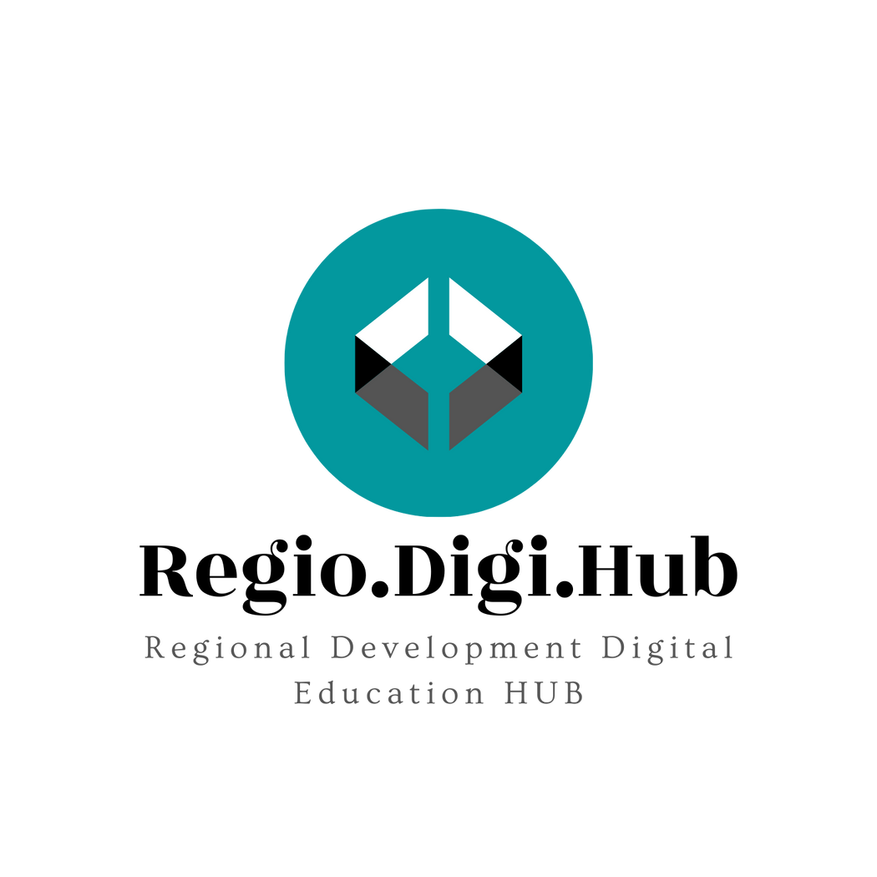
Promoting Regional Development by building the capacity of the VET system

Slide 2
Lifelong learning for reskilling/upskilling, rapid adjustment to the needs of the market

Slide 3
Disclaimer
The European Commission support for the production of this publication does not constitute an endorsement of the contents which reflects the views only of the authors, and the Commission cannot be held responsible for any use which may be made of the information contained therein.
Project Nº: 2021-1-RO01-KA220-VET-000028118

Slide 4
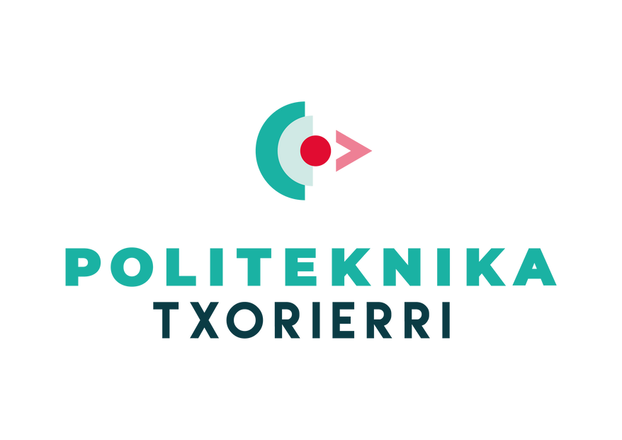
Consortium

Slide 5
01
LIFELONG LEARNING
02
LIFELONG LEARNING GOOGLE TOOLS
03
RESKILLING
Contents
04
UPSKILLING
05
COMPANIES INVESTING IN RESKILLING/UPSKILLING
06
RESKILLING/UPSKILLING WORKFORCE

Slide 6
01 -What is Lifelong Learning
Ιt is widely known that the world around us is developing at a rapid pace and in order to keep up with this reality, we should cultivate a philosophy of continuous development and improvement. All of us need to be lifelong learners in the 21st century. To maintain a competitive advantage in everything we do, we need constantly keep our knowledge fresh and sharp.
Source: pixabay

Slide 7
01 - What is Lifelong Learning (Video)
.
Video Reference: https://www.youtube.com/watch?v=NljvcJUoNt4

Slide 8
01 – Importance of Lifelong Learning
“If you plan next year, raise corn, if you plan next decade, raise tree, if you plan the future life, educate human “ – Guanzi, Chinese Philosopher and Politician
Everyone is a Lifelong Learner! Kids learn how to talk or walk. Adults learn how to use a tablet or how to sew a dress.
Lifelong Learning is built on a few fundamental components which are:
Continuity
Creativity
Learning how to learn by yourself
Lifelong learning can assist us in achieving personal fulfillment and pleasure, whether we are following personal interests and hobbies or professional goals.
Lifelong Learning is the level that people have attained today as a result of their involvement in the educational system. People need to be adapted in today’s conditions and changes.
By paying attention to the ideas and objectives that motivate us, it encourages us to better our own quality of life and feeling of self-worth. It acknowledges that humans have a natural desire to explore, learn, and grow.

Slide 9
01 – Benefits of Lifelong Learning
Boosts productivity and skillset
Participating in lifelong learning can increase curiosity, which has an effect on an employee’s working attitude
Increases mental health and self-confidence
the more people learn and challenge themselves, the more their self-confidence is boosted
Improves satisfaction of customers
Encouragement of lifelong learning not only increases employee motivation but also increases client satisfaction because the individual now has new perspectives on how to approach their profession.
Fostering a cooperative work environment
When given the opportunity to learn, employees frequently do so through getting to know one another's responsibilities at work. They gain a deeper understanding of departments other than their own as a result, and it promotes teamwork.
The level of employee loyalty rises
When a corporation invests time in its workers, it encourages them to work there for a longer period of time. Employees develop confidence and trust in their employers when they feel appreciated.
Video Reference: https://www.youtube.com/watch?v=QVysbQ82C8s

Slide 10
01 – Examples of Lifelong Learning
Learning a new Skill
Become a member of a team
Listen educational podcasts
Keeping a Reflective Journal
Get a short college course
Source: Pixabay

Slide 11
02 - Lifelong Learning Google tools
Did you know about Google’s learning initiatives before today?
Google offers a number of digital tools for discovery and curiosity suitable for lifelong learners.
Let’s explore some of them!

Slide 12
02 - Lifelong Learning Google tools
YouTube gives you the opportunity to discover a variety of videos to fuel lifelong learning.
It gives you the ability to learn anything from anywhere!
Explore YouTube

Slide 13
02 - Lifelong Learning Google tools
With daily translations of more than 100 billion words, Google Translate aids in communication.
Explore Google Translate

Slide 14
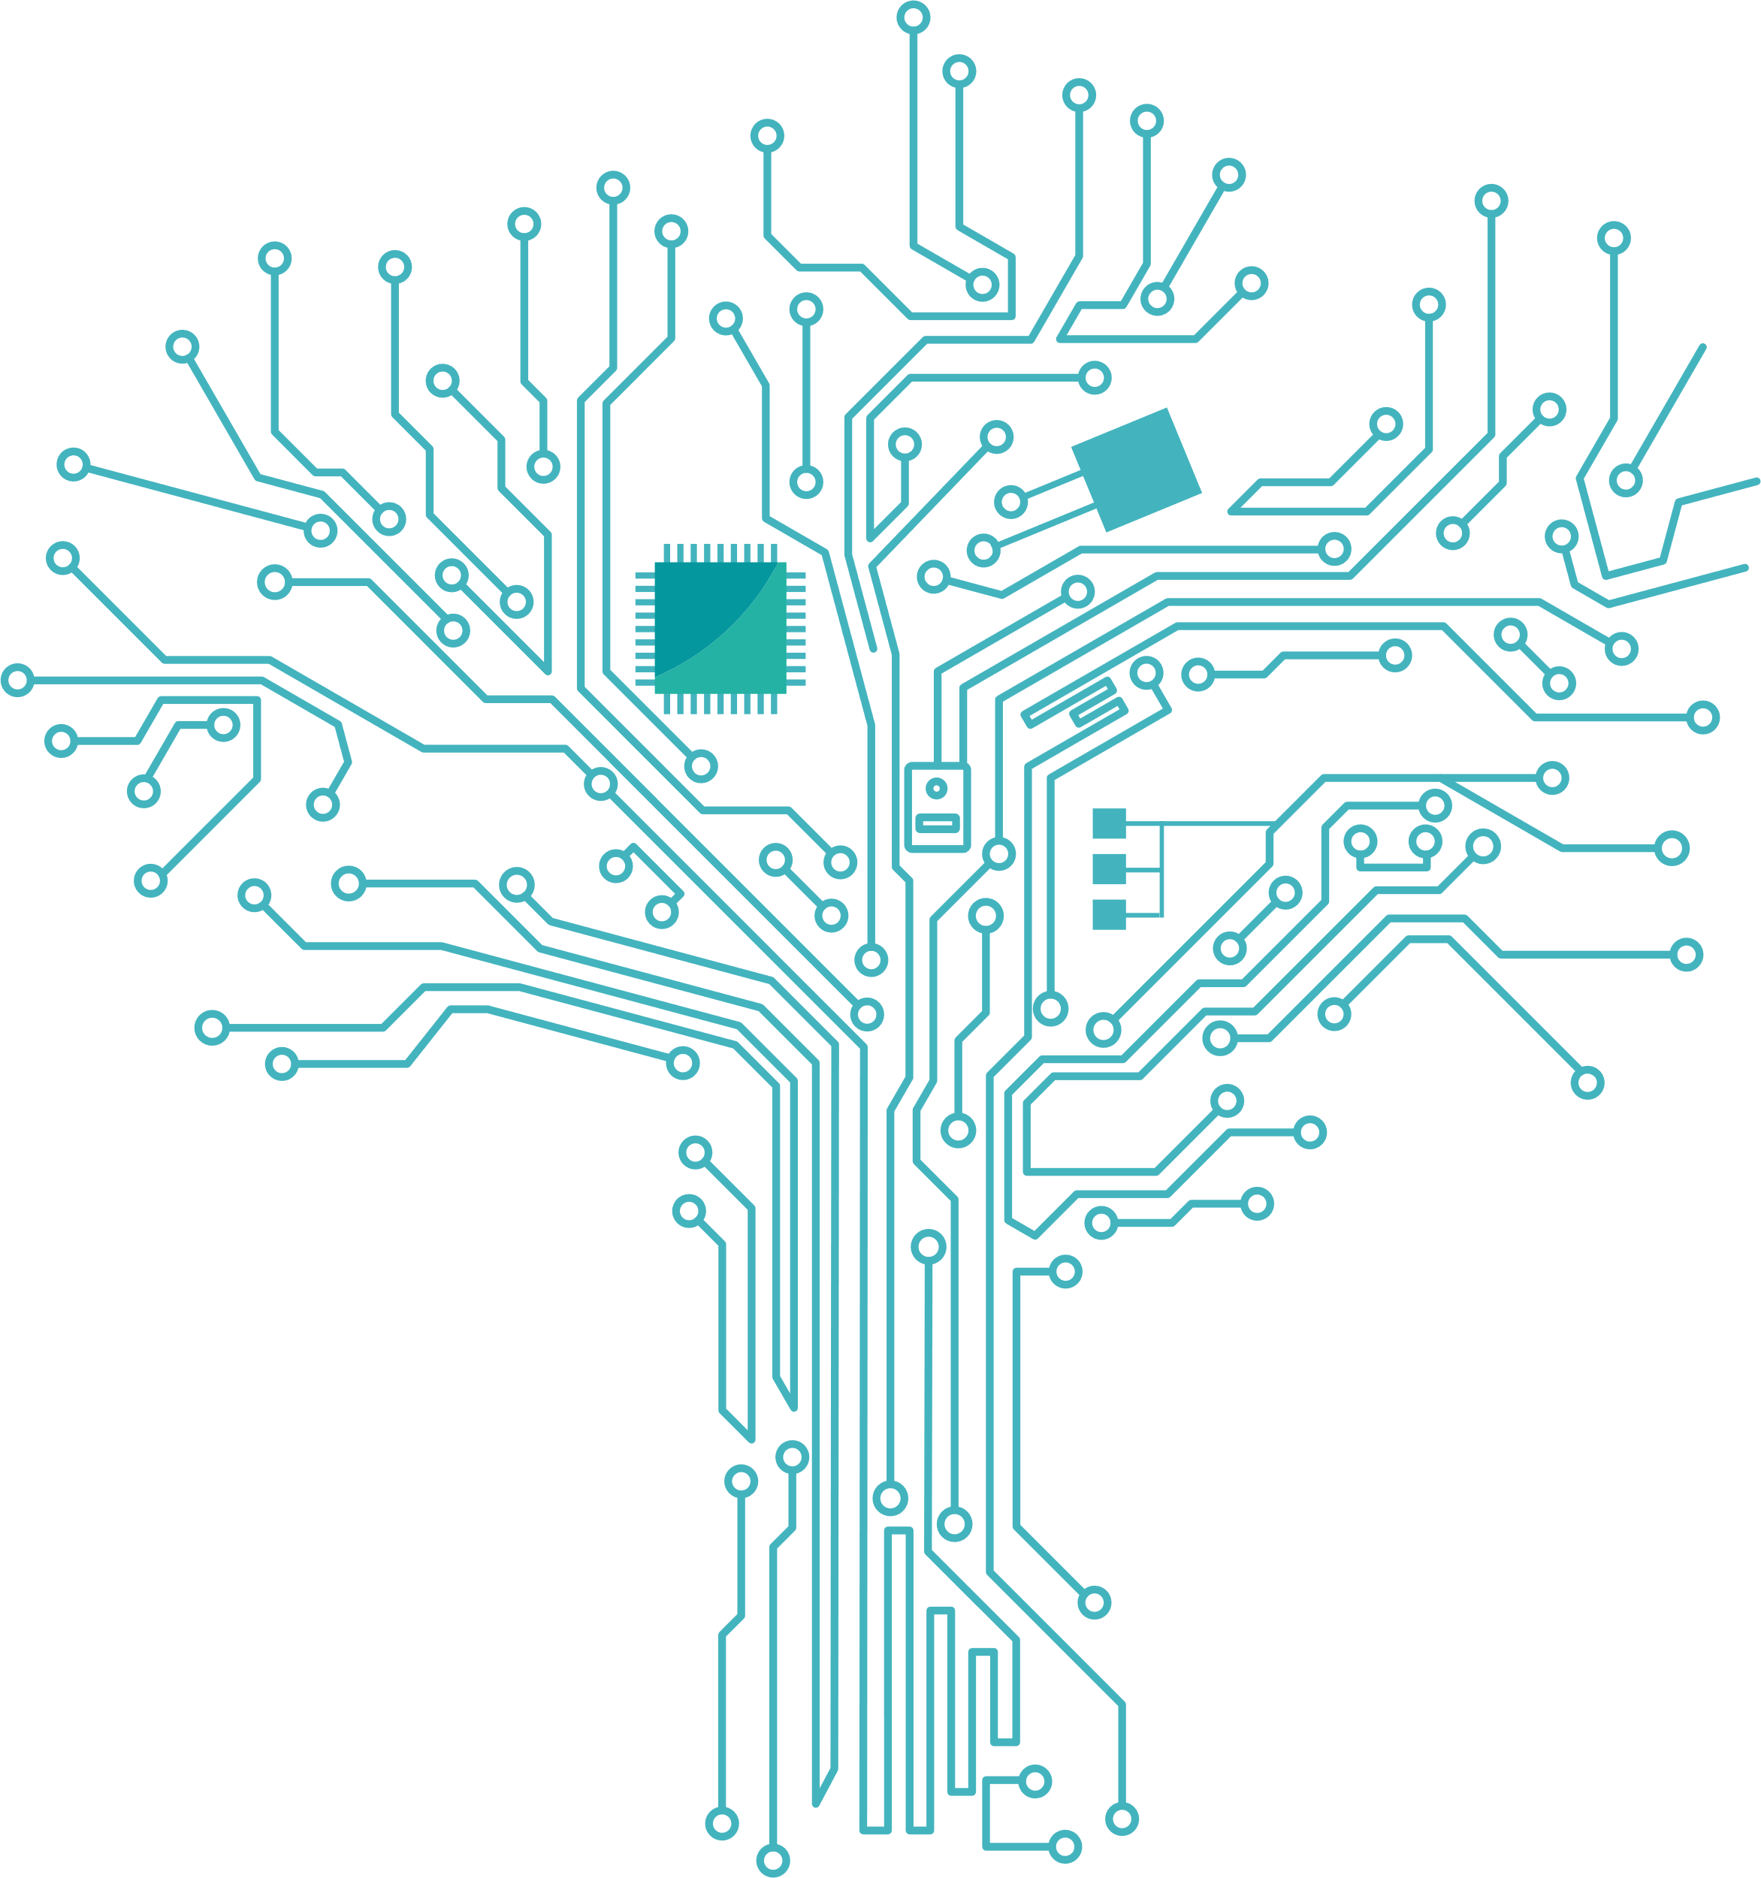
02 - Lifelong Learning Google tools
This Photo by Unknown Author is licensed under CC BY-NC-ND
You can explore all the world using the Google Earth.
Explore Google Earth

Slide 15
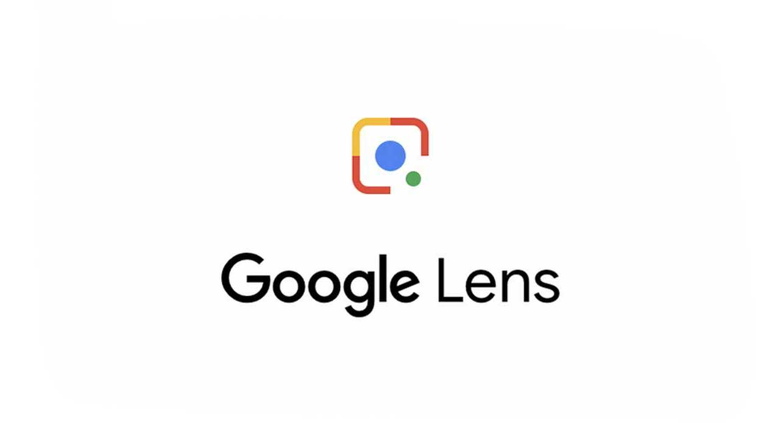
02 - Lifelong Learning Google tools
This Photo by Unknown Author is licensed under CC BY-NC-ND
If you face difficulties to describe something in words, Google Lens helps you, using your camera or an image to search.
Explore Google Lens

Slide 16
02 - Lifelong Learning Google tools
Become a lifelong learner and browse the world's largest collection of full-text books while relaxing at home.
Explore Google Books

Slide 17
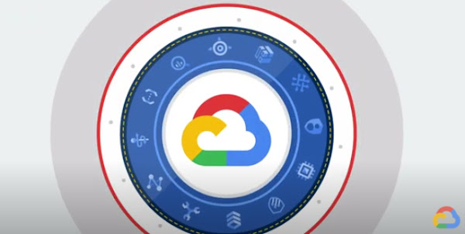
02 - Lifelong Learning Google tools
Boost analytics and AI using pre-built solutions, datasets, powered by BigQuery, Cloud Storage, Earth Engine and more.
Explore Public Datasets

Slide 18
02 - Lifelong Learning Google tools
This Photo by Unknown Author is licensed under CC BY-SA-NC
The best way to find scientific articles and search for scholarly literature on any topic.
Explore Google Scholar

Slide 19
02 - Lifelong Learning Google tools
Experiments with Google
Source: pixabay
Discover a collection of online experiments that you can use to create art, music, take virtual field trips, and more.
Explore Experiments with Google

Slide 20
02 -Lifelong Learning
Why Upskilling and Reskilling are important?
One of the most critical priorities of European policy-makers are Upskilling and Reskilling. Strong skill foundations and continuous updating and acquisition of new skills, knowledge, and competences are required due to rapidly changing labor markets and a variety of challenges, including digitalization and its impacts on the future of work, technological advancements, the environment, overaged societies, and social inclusion.
Video Reference: https://www.youtube.com/watch?v=J6_8Bqg3P8I

Slide 21
03 - Reskilling
Definition: Reskilling is a procedure where workers developing new skills to move into a different job role within the organization or to fulfill the new requirements of a current role. It often happens when an employee's previous duties or responsibilities become irrelevant, frequently as a result of technological advancements or skills mismatch.
By 2030, more than a billion people would need to reskill, according to the World Economic Forum (WEF) for 2020. That represents one-third of all workforce.
When a production system switches from a manual to a mechanical one, that is an example of reskilling the workforce. The manual workers will have to be reskilled to learn how to operate and maintain the new machinery.
Businesses will need to restructure and set new priorities as a result. They'll also need to reskill their staff if they want to reduce costs and maximize the talent they already have.

Slide 22
03 -Benefits of Reskilling for Organizations
1. Reducing the cost of employee training
2. Retain company procedures and knowledge
3. Addressing upcoming demand
4. Retain your best employees
5. Improved morale at work
6. Improve the competencies of your staff
7. More adaptable employees
8. Strengthens the company’s reputation

Slide 23
03- Benefits of Reskilling for Employees
Increased job security
Employees who reskill feel more secure in their employment since it raises their worth to the organization. It demonstrates that their company is ready to invest in them and that their work calls for specialized knowledge and abilities.
Acquire new abilities to boost your career Re-skilling aids workers who want to change their professional pathways on their own in achieving their objectives. This is crucial now more than ever as automation and AI displace numerous jobs and the pace of digital change accelerates.
Option for internal mobility
Since new abilities make a person more qualified for flexible or higher-level tasks within the organization, reskilling gives employees a better likelihood of sticking with the company. Employees who reskill have a head start on expanding their skill sets and moving up the corporate ladder in the future, in addition to keeping their job within the organization..

Slide 24
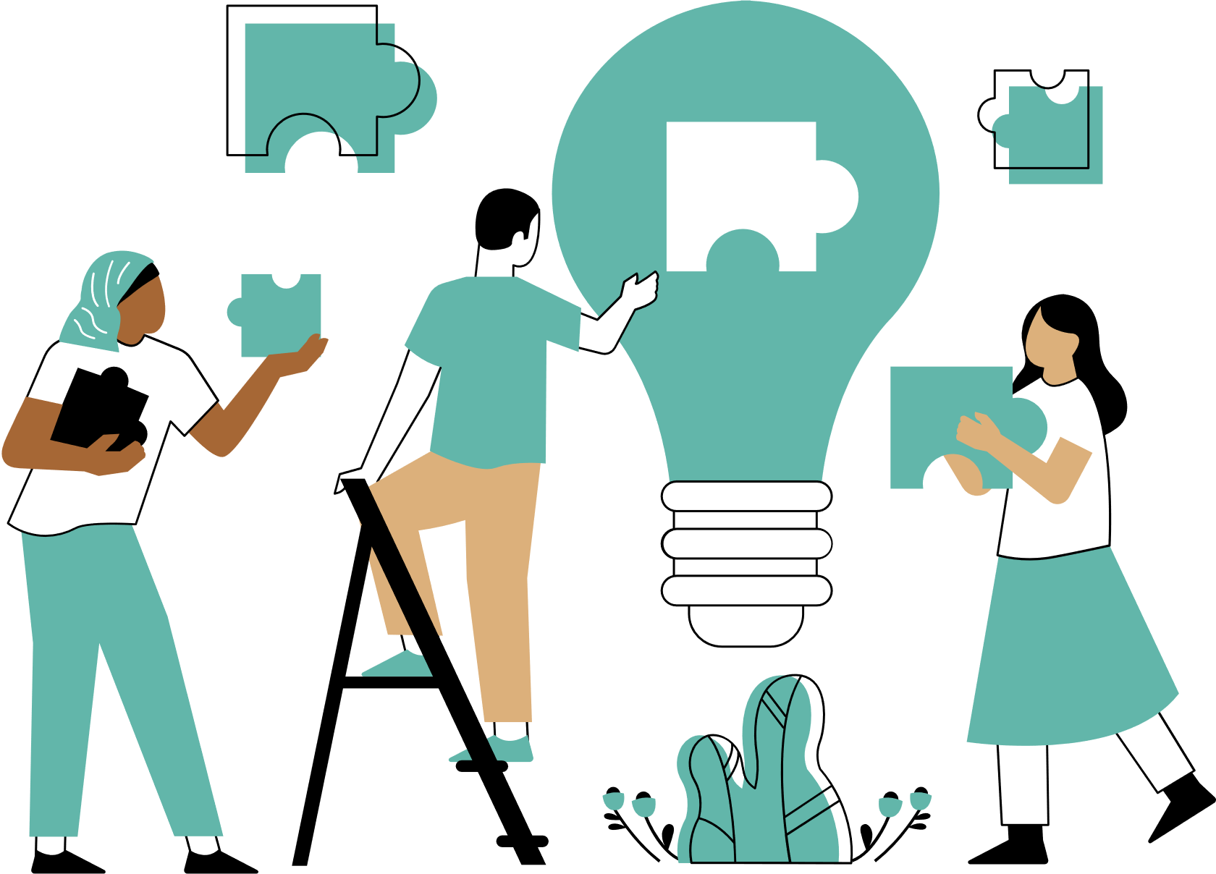
04 - Upskilling
Definition: Upskilling is the process that involves educating staff members in new skill sets so they can advance in their existing positions and benefit the company. The development of a person in their chosen career path is frequently strongly tied to upskilling. Upskilling primarily pertains to workers who are experts in their field. These workers typically have previous experience with the business as well as the industry.
The World Economic Forum also says upskilling is crucial to post-Covid economic recovery; By 2030, it could increase the global GDP by nearly $6 trillion and add 5.3 million new jobs.
Upskilling is linear. It begins with already-developed skills and honed them. For instance, a programmer can advance their skills to become a systems analyst. As work changes to take advantage of digital transformation, reskilling equips employees to move laterally or into newly developed jobs.

Slide 25
04- Benefits of Upskilling for Organizations
1. Increase employee retention
2. Find and fill any skills gaps in your organization.
3. Improve your readiness for contingencies
4. Promote a culture of learning
5. Atrack new talents
6. Boost the effectiveness and productivity of your staff
7. Boost the motivation and satisfaction of your staff members
8. Increasing client retention and satisfaction
9. Save money
10. Promote a culture of learning

Slide 26
04 -Benefits of Upskilling for Employees (a)
Find new areas of interest
You can connect with new topics and areas that can excite your interest by learning new abilities. Since industries are constantly changing, you might learn new techniques that you haven't used before that will help you rekindle your passion for what you do.
Secure your job
By expanding your knowledge and expertise on the topics and tools related to your professional role, learning new skills will help you be more effective and adept at carrying out your responsibilities. If you outperform yourself each year, your job stability is more likely to increase.
Getting ready for the future
You can better prepare yourself for future careers by upskilling.

Slide 27
04 - Benefits of Upskilling for Employees (b)
Fill the skill gap
The development of new job titles and functions has increased along with the development of new tools and technologies. For instance, there is a growing demand for new employment positions such as app developers, cloud computing specialists, website developers
Increase your awareness and discipline
Developing new talents benefits both your professional and personal development. While learning a new talent, you will also gain discipline, which could have a favorable effect on other areas of your life.
Professional development
Gaining new skills will increase your employment opportunities and support you climb up the job ladder. You can apply for higher-level employment with better compensation, a nicer working environment, and more responsibility if you have the necessary abilities.

Slide 28
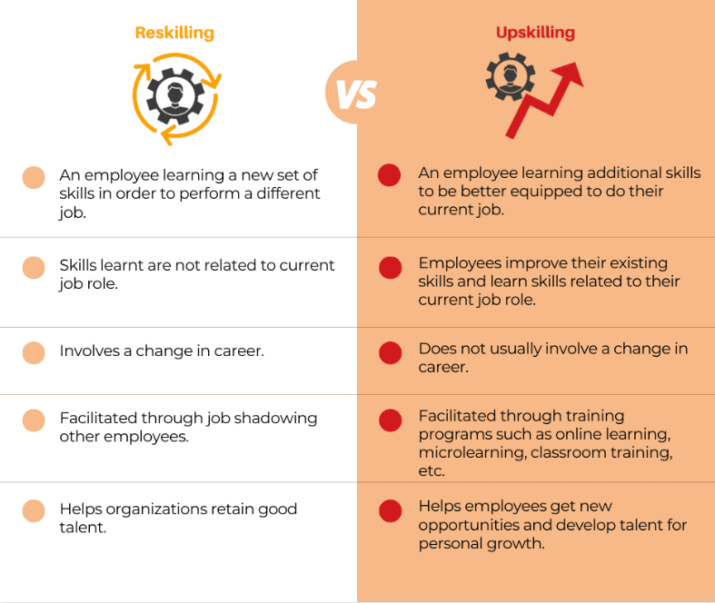
Reskilling vs Upskilling
Source: whitely

Slide 29
Why Reskilling & Upskilling are important – Reason 1
1
The impact of COVID-19
The pandemic has caused unemployment rates to soar, while job security has experienced the reverse trend. This has hurt people's ability to make a living and caused a major decline in the world economy.
However, as history demonstrates, a big natural disaster or pandemic is typically followed by a time of prosperity. The world is about to experience a post-pandemic boom, according to research, despite the fact that COVID is still present.
Learning new skills will put you in a better position to benefit from a stronger economy given all this development and hope.
Smart Specialization

Slide 30
Why Reskilling & Upskilling are important – Reason 2
2
Expanding innovation and digital technology
Although the digital economy was already growing before COVID, the epidemic has sped up this process. The workplace has seen some significant changes as a result of this. These consist of:
Digital transformation: While companies had previously been hesitant to convert their conventional systems to digital ones, the pandemic practically forced them to do so by pressing for their digitization. As a result, the creation of new apps, systems, and software has dramatically increased. Employers have to retrain their workers to use this technology as a result.
New job roles : New job positions that weren't there ten years ago are emerging as a result of digitalization. These are frequently linked to utilizing and creating technology, including: app developers, cloud computing experts, social media managers, and user experience managers. As a result, more people are looking to acquire these talents and find employment in the expanding tech industry.
Automation: The BBC reports that “Up to 20 million manufacturing jobs around the world could be replaced by robots by 2030.” workers are being forced to reskill or upgrade their skills when their jobs become redundant in order to find other employment.
Smart Specialization

Slide 31
Why Reskilling & Upskilling are important – Reason 3
3
Skills gap
Additionally, as a result of digitalization, there is a growing need for new skills, which is problematic. A worldwide lack of skills related to emerging technology-based jobs is currently present.
The top 10 in-demand skills for 2020 are as follows:
1. Complex problem solving
2. Critical thinking
3. Creativity
4. People management
5. Coordinating with others
6. Emotional intelligence
7. Decision making
8. Service orientation
9. Negotiation
10. Cognitive flexibility
Smart Specialization

Slide 32
Reskilling & Upskilling Video
Video Reference: https://www.youtube.com/watch?v=J6_8Bqg3P8I

Slide 33
05 -Companies investing in personnel reskilling/upskilling
The largest private company in the United States, Walmart, declared in 2021 that it will spend almost $1 billion over the following five years to give its staff free access to higher education and skill development. Through its Live Better U (LBU) education program, the company will pay 100% of college tuition and book fees for all participating associates.

Slide 34
05- Companies investing in personnel reskilling/upskilling
Verizon's upskilling project, Skill Forward, offers free technical and soft skill training to get the American worker ready for professions in technology. Participants can choose from a range of 10- to 15-week programs in roles such as: Cybersecurity Analyst; IT Support Specialist; Junior Web Developer; Junior Full Stack Java Developer; Junior Cloud Practitioner; and Digital Marketing Analyst. Verizon's $44 million commitment to train 500,000 individuals for in-demand technology jobs by 2030 includes Verizon Skill Forward.

Slide 35
05- Companies investing in personnel reskilling/upskilling
McDonald's Archways to Opportunity is a broad educational project comprising a number of programs intended to widen employees' access to higher education and employment prospects. The program offers participants the chance to advance their English language abilities, obtain a high school diploma free of charge, pursue a college degree with the help of financial aid, and take use of free educational and career guidance services.

Slide 36
05- Companies investing in personnel reskilling/upskilling
Google offers online training in fundamental and sophisticated IT concepts, including hands-on projects, as well as access to career assistance through its revolutionary program with interactive content.

Slide 37
05- Companies investing in personnel reskilling/upskilling
Marriott International offers two staff development programs and is consistently rated as the best employer in the Asia Pacific area. Recent university graduates are trained in the Global Voyage Leadership Development program to become future leaders within the company.

Slide 38
06 -How to Upskill and Reskill your Workforce for the Digital Age
Video reference: https://www.youtube.com/watch?v=3sdm65O_2jI

Slide 39
References
https://www.sciencedirect.com/science/article/pii/S1877042811030023
https://www.valamis.com/hub/lifelong-learning#importance-of-lifelong-learning
https://www.guykat.com/blog/5-benefits-of-promoting-lifelong-learning-in-the-workplace
https://whatfix.com/blog/reskilling/
https://www.betterup.com/blog/reskilling
https://edyoucated.org/blog/benefits-of-upskilling-your-staff
https://www.skillsyouneed.com/rhubarb/upskilling-professional-life.html
https://www.eseibusinessschool.com/3-reasons-why-upskilling-or-reskilling-is-important-in-2021/
ttps://www.docebo.com/learning-network/blog/upskill-reskill-employees-covid-19/
https://goi.mit.edu/2022/04/21/five-companies-investing-in-upskilling-the-workforce/
https://learning.google/life/

Slide 40
Thank you!
@Regio.Digi.Hub

