Slide 1
Promoting Regional Development by building the capacity of the VET system

Slide 2
Leadership and motivaton

Slide 3
Disclaimer
The European Commission support for the production of this publication does not constitute an endorsement of the contents which reflects the views only of the authors, and the Commission cannot be held responsible for any use which may be made of the information contained therein.
Project Nº: 2021-1-RO01-KA220-VET-000028118

Slide 4
Consortium

Slide 5
01
MOTIVATION
02
THEORIES OF MOTIVATION
03
LEADERSHIP
04
THEORIES OF LEADERSHIP
Contents
05
MOST RELEVANT LEADERS AND MOTIVATIONAL FIGURES
06
RELEVANT TRAINING MATERIALS (Best Practices)
07
ARTICLE
08
QUESTIONS

Slide 6
1.Motivation

Slide 7
1- What is motivation?
Motivation is the conjuction of internal and external factors that stimulate desire and energy in people to be continually interested and committed to a job, role or subject, or to make an effort to attain a goal.

Slide 8
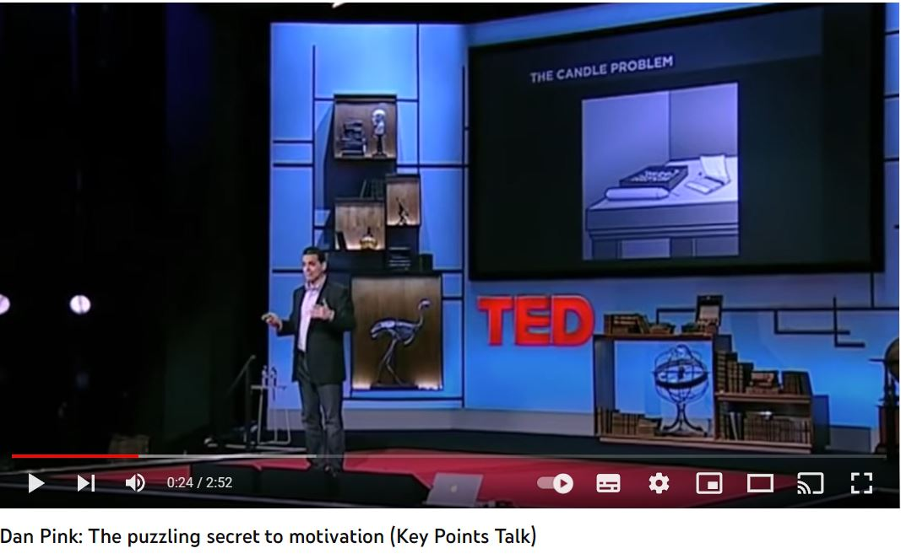
2- People who motivate people: MOTIVATORS
Intrinsic Motivators: A person’s internal desire to do something, due to such things as interests, challenge, and personal satisfaction.
Extrinsic Motivators: Motivation that comes from outside the person and includes such things as pay, bonuses, and other tangible rewards.
https://www.youtube.com/watch?v=wE5ZV7HfrXU

Slide 9
2. Theories
of
Motivation

Slide 10
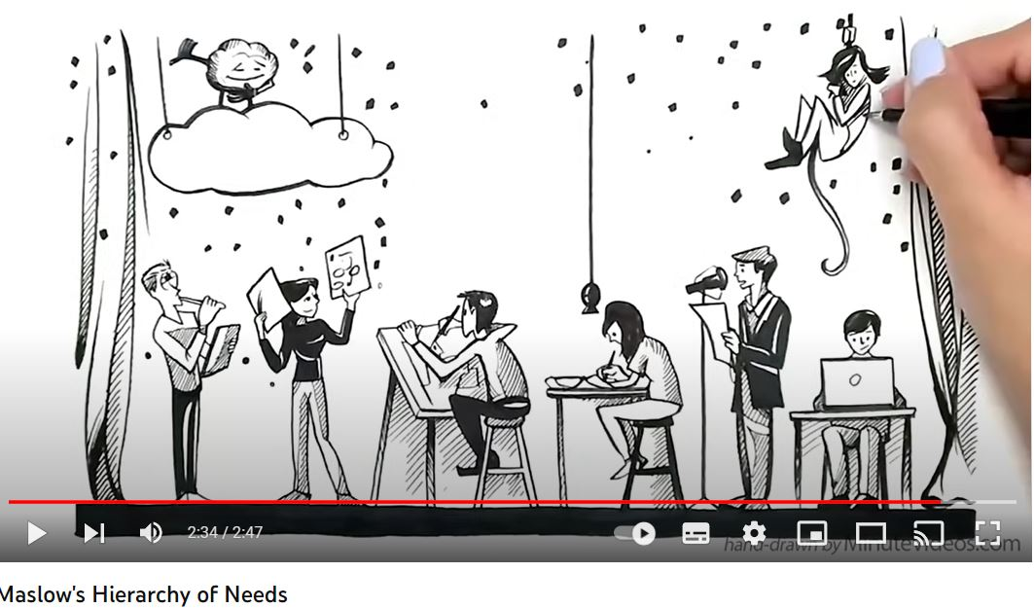
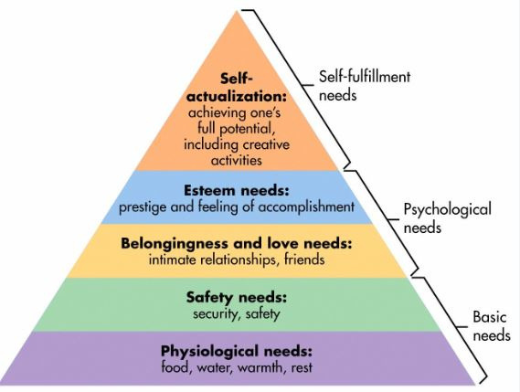
The basic idea is that individuals have needs that, when unsatisfied, will result in motivation.
Maslow's Hierarchy of Needs
Maslow believes that there is a hierarchy of five needs; as each need is substantially satisfied, the next need becomes DOMINANT. He argues that lower-order needs must be satisfied before on progresses to higher-order needs.
https://www.youtube.com/watch?v=O-4ithG_07Q

Slide 11
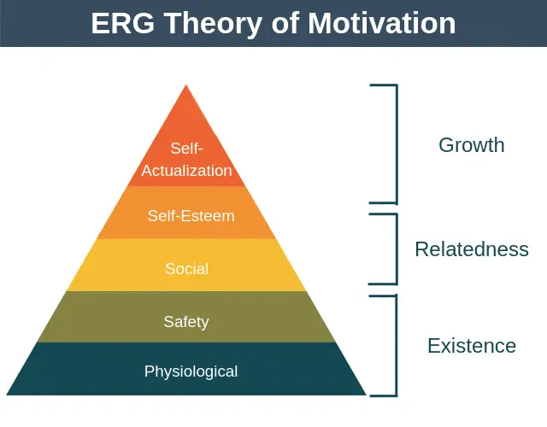
Alderfer's ERG theory
Alderfer states that more than one need can be important at the same time. He explains that if a higher-order need is not being met, the desire to satisfy a lower-level need increases.
Compared to Maslow's pyramid:
Existence: Concerned with providing basic material existence requirements
Relatedness: Desire for maintaining important interpersonal relationships
Growth: Intrinsic desire for personal development

Slide 12
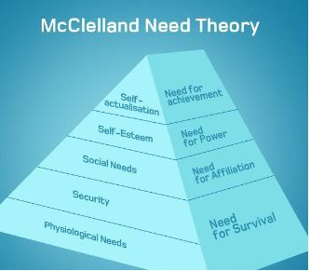
McClelland's theory
McClelland argues that people vary in the types of needs they have. He states that their motivation and how well they perform in a work situation are related to whether they have a need for achievement, affiliation, or power.
Compared to Maslow's pyramid:
Needs of achievement: The drive to excel, to achieve in relation to a set of standards, to strive to succeed
Need for power: The need to make others behave in a way that they would not have behaved otherwise
Need for affiliation: the desire for friendly and close interpersonal relationships

Slide 13
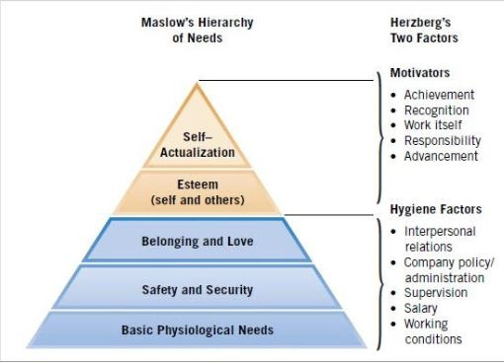
Herzberg's Motivation-Hygiene theory
Helzberg states that hygiene factors must be met if a person is not to be dissatisfied. He argues that they will not lead to satisfaction, However, motivators lead to satisfaction.
Hygiene factors - the source of dissatisfaction:
Extrinsic factors (context of work)
Company policy and administration
Unhappy relationship with employee's supervisor
Poor interpersonal relations with one's peers
Poor working conditions
Motivators - the source of satisfaction:
Intrinsic factors (the content of work)
Achievement
Recognition
Challenging, varied, or interesting work
Responsibility
Advancement

Slide 14
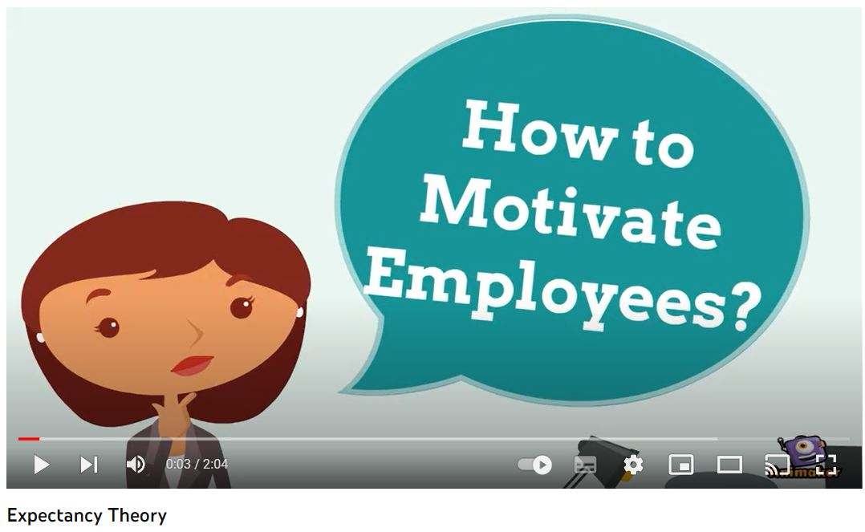
The actual process of motivation is based in two theories: expectancy and goal-setting theoriers.
Expectancy theory
The theory in which individuals act depending on wheter their effort will lead to good performance, wheter good performance will be followed by a given outcome, and whether that outcome is attractive to them.
https://www.youtube.com/watch?v=mnfHGPM3e8o

Slide 15
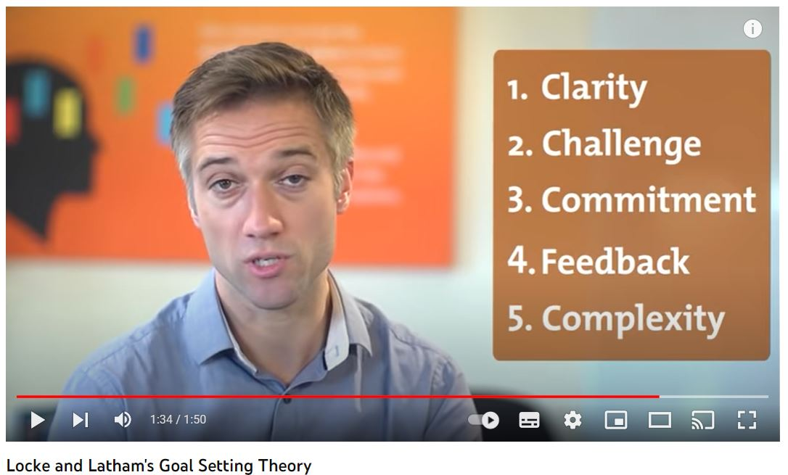
Goal-Setting theory
The theory that specific and difficult goals lead to higher performance.
Goals tell employees what needs to be done and how much effort will need to be expended
Specific goals increase performance
Difficult goals, when accepted, result in higher performance than do easy goals
Feedback leads to higher performance than does nonfeedback
https://www.youtube.com/watch?v=dWOt2HyjCno

Slide 17
3.Leadership

Slide 18
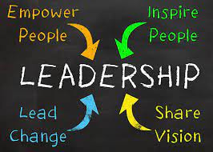
4- What is Leadership?
Motivation can be defined as the conjunction of internal and external factors that stimulate desire and energy in people to be continually interested and committed to a job, role or subject, or to make an effort to attain a goal. In other words, it is the intensity, direction, and persistance of effort a person shows in reaching a goal:
Intensity: how hard a person tries.
Direction: where effort is channelled.
Persistance: how long effort is maintained.

Slide 19
4.Theories
of
Leadership

Slide 20
Contingency theories
While trait and behavior theories do help us understand leadership, an important component is missing: the environment in which the leader exists
Contingency theory deals with this additional aspect of leadership effectiveness studies
https://www.youtube.com/watch?v=lCbDRM1IvZY

Slide 21
Fiedler's model
Effective group performance depends on the proper match between leadership style and the situation.
Assumes that the leadership style is fixed.
Considers three Situational Factors:
Leader-member relationship: degree of confidence and trust in the leader.
Task structure: degree of structure in the jobs
Position power: leader's ability to hire, fire, and reward.
For effective leadership: must change to a leader who fits the situation or change the situational variables to fit the current leader.
https://www.youtube.com/watch?v=1eO5j2w03uI

Slide 22
Contemporary theories
The focus is on the leader as a communicator
Leaders as individuals who inspire followers through their words, ideas, and behaviors
Four contemporary leadership theories:
Charismatic leadership
Transformational/Transactional
Authentic leadership
Servant leadership

Slide 23
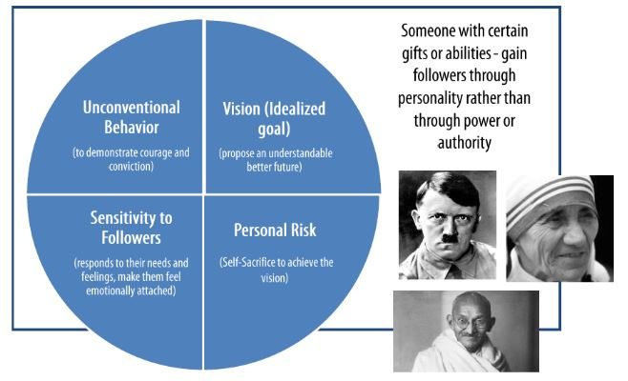
Charismatic Leadership

Slide 24
Transformational & Transactional leadership
Transactional leadership
Leaders who guide or motivate their followers in the direction of established goals by clarifying role and task requirements
Transformational leaders
Inspire followers to transcend their own self-interests for the good of the organization; they can have a profound and extraordinary effect on followers
Not opposing, but complementary approaches to leadership
Great transformational leaders must also be transactional; only one type is not enough for success
https://www.youtube.com/watch?v=ddt_IGMMOrI

Slide 25
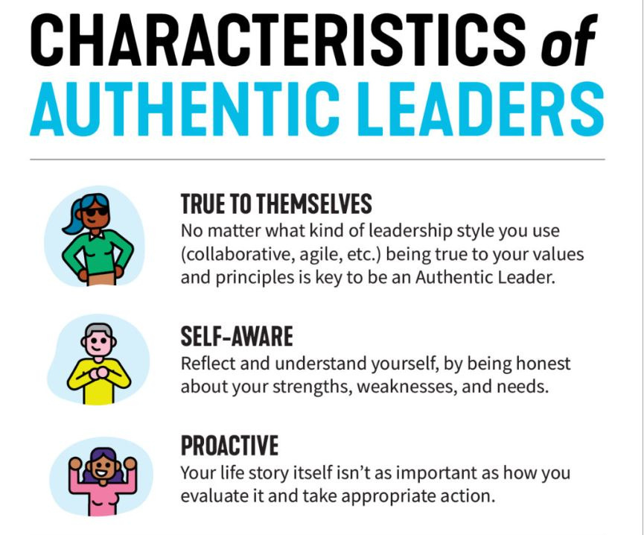
Authentic leadership
Authentic leaders accept their own mistakes, are selfless and honest, know who they are, what they believe in and value, and act upon those values and beliefs
Focus: Moral aspects of leadership
Related to Ethics and leadership
Leadership is not free from values. Martin Luther King =/= Hitler
Ethical leaders: Use charisma/power in a socially constructive way and serve others
Unethical leaders: Use charisma/power to enhance power over followers, directed towards self-serving ends

Slide 26
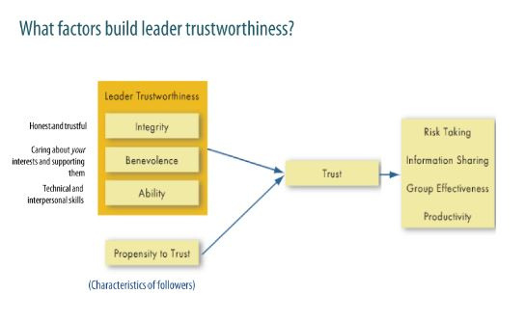
Trust
A physiological state that makes you agree to make yourself vulnerable to another because you have a positive expectation for how things are going to turn out
Key attribute associated with leadership (performance)
Confidence that my interests will not be abused - will align my actions and attitudes with the leader's behaviors/request

Slide 27
Challenges to leadership
Leadership is often an attribution people make about other individuals (stereotypes of leaders; focus on their appearance rather than their actual accomplishments)
Substitutes/Neutralizers of leadership
It is simplistic to think that leader's action is all: In many situations, a leader's actions make no difference in followers' outcomes (more important formal organizational goals, rigid rules, procedures, cohesive work groups, organizational rewards,...)
Online leadership
Trust and mutual understanding are particularly difficult without face-to-face interaction (writing skills to communicate support and trust are key here)

Slide 28
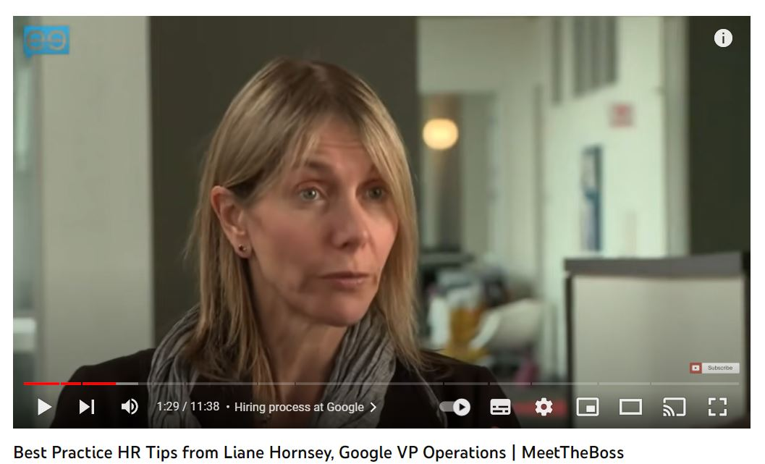
Can people be trained in the new leadership?
Can people be trained in the new leadership? People can be trained to adopt own leadership approaches
Leaders can devise improvement programs to address their weaknesses and work with trainers to develop their leadership skills
https://www.youtube.com/watch?v=FRsJbpppvEU

Slide 29
5. Most relevant leaders and motivational figures

Slide 30
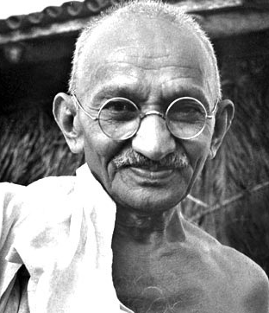
1. Mahatma Gandhi
The founding father of nonviolent protest and a staunch pursuer of peace, he also espoused many of the principles of intelligent leadership. He also:
Valued lifelong learning
Treated others well
Modeled discipline to followers
Had a strategy
Modeled the change he wanted to effect in the world
Gandhi connected with his followers through a peaceful mindset built upon simplicity

Slide 31
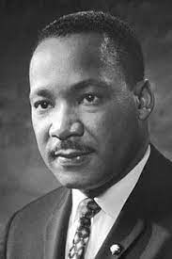
2. Martin Luther King Jr.
An iconic representative of the civil rights movement,
MLK inspired followers everywhere through his:
Intelligence
Respect
Creativity
Focus
Determination
Willingness to learn
His public speaking and communication skills were outstanding. He focused on positive language and avoided accusing others or inciting violence.

Slide 32
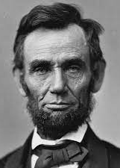
3. Abraham Lincoln
The 16th President of the United States, His short tenure, spanning from 1861 until his assassination
in 1865, saw him:
Lead a divided nation in and out of civil war
Abolish slavery
Preserve the union
Strengthen the federal government
Boost the US economy through modernization
He was the quintessential intelligent leader of his era, mastering skills like:
Empathy
Good communication
Outstanding social skills
The ability to persuade gently using emotional intelligence
Stirring emotion
Showing vulnerability by taking responsibility for mistakes

Slide 33
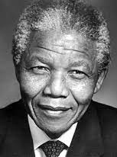
4.Nelson Mandela
Like other leaders on this list, Nelson Mandela refused to adapt to the world, choosing instead to shape it to his ideals.
What leadership skills made Mandela the larger-than-life leader he was?
Passion. Mandela understood the possible consequences of his fight, but he never wavered.
Humility. Mandela was never a flashy leader, but he won over the masses worldwide regardless.
Empathy
The willingness to learn
Excellent communication skills
Patience
Courage

Slide 34
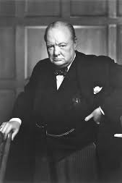
5. Winston Churchill
Arguably the most successful wartime leader in history.
His leadership strengths included:
Passion
Courage
The ability and willingness to learn from his mistakes
Perseverance
A staunch belief in his followers
Humor
Interestingly, Winston Churchill was not a natural speaker. He developed his communication skills with determination and intent, earning his place in history as someone who continues to inspire people facing adversity to this day.

Slide 35
6. Relevant training materials
(Best Practices)

Slide 36
Relevant training materials
(best practices)
In the following section, some cases of best practices carried out in Spain for boosting leadership and motivation among VET students will be shown as examples to follow or implement in the project.
1. Final e-FP contest
Final e-FP is a program that was supported by the Créate Foundation and the Spanish Chamber of Commerce and financed by the European Social Fund, aiming to promote Entrepreneurship and Innovation in VET education. In this act, the best projects of VET from the academic year 2021-2022 have been recognized.

Slide 37
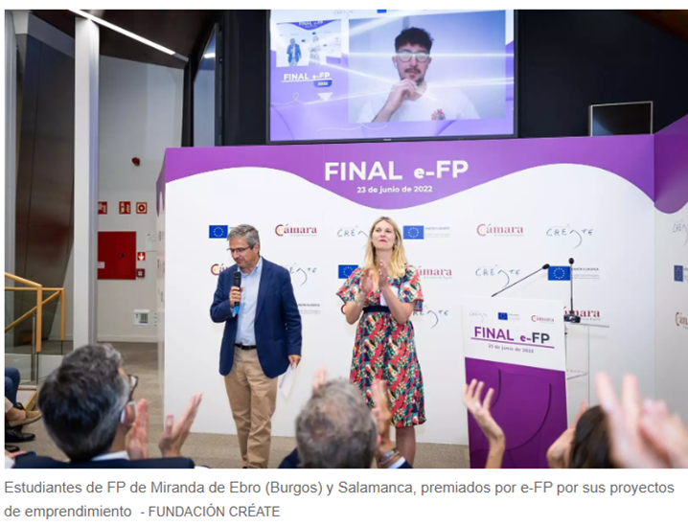
Relevant training materials
(best practices)
1. Final e-FP contest
The winners of the final participated in a seminar on learning and development of skills by experts in a guided visit to the building CentroCentro (a space of intercultural exchange for citizens in Madrid).
A contest of this type incentives the motivation of young VET students to become proactive and lead innovative projects.

Slide 38
Relevant training materials
(best practices)
2. Entrepreneurship ideas in video contest
It took place at the local level, in Txorierri (Derio, Basque Country). A contest of videos with entrepreneurial ideas was organized by EGAZ Txorierri, an Economic Promotion Service of the community of Txorierri and the Politeknika Ikastegia.
Aimed to motivate local students from the area of the school or Txorierri, so that they could take part by creating innovative business ideas that they had to present through a video presentation.

Slide 39
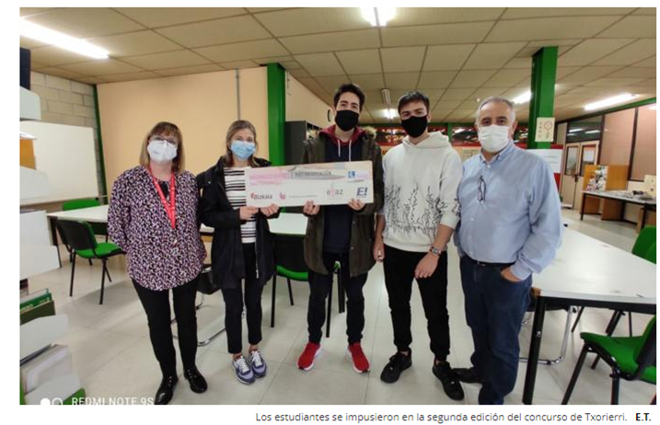
Relevant training materials
(best practices)
2. Entrepreneurship ideas in video contest
This practice took place at the regional level, specifically in the area of Txorierri, and not at the national level as in the case of Final e-FP. This is an alternative that requires less resources such as big funds from public or private entities and that is done closely with local young students, giving them a space in which they can feel safe and comfortable.

Slide 40
Relevant training materials
(Best Practices)
3. Leadership Program – Prat VET Centre
As previously mentioned, one VET Centre from Barcelona named Prat, developed a module on leadership for its students. This is a good example on how to specifically focus on this skill and develop a programme in which students can get to learn and adapt knowledge on a skill that they may not know much about it.
This way, VET students can boost the inner leader that they have and this way, develop innovative entrepreneurial projects that show their motivation for leading a group with the aim of achieving the same goals.

Slide 41
8. Activities

Slide 42
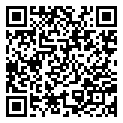
What leadership style best describes you?
Do you agree with the result?
If yes, why?

Slide 43
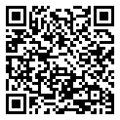
Which of These Historical Leaders Do you resemble?
Do you agree with the figure that supposedly represents you?
Can you think of another one that you believe suits you better?
If yes, which one and why?

Slide 44
Thank you!
@Regio.Digi.Hub

Slide 45
References
Barnett, Jim (2020): "Here’s What Happens When Leaders Get Employee Motivation Right". Retrive from: https://www.forbes.com/sites/jimbarnett/2020/01/06/heres-what-happens-when-leaders-get-employee-motivation-right/?sh=4f6fa7aa5c13
John mattone global, inc (2021): "The world’s #1 executive coaching and business coaching blog (2017-2021)". Retrived from: https://johnmattone.com/blog/historys-5-best-leaders/#:~:text=1.-,Mahatma%20Gandhi,example%20through%20word%20and%20deed.
Kruse, K. (2013): "What is leadership?" Retrieved from: http://www.professorpeaches.com/wp-content/uploads/2015/02/What-is-leadership-Forbes.pdf
What type of leader are you? Embracing your leadership style [Quiz]Retrive from: https://www.umassglobal.edu/news-and-events/blog/what-type-of-leader-are-you-quiz
Which of These Historical Leaders Are You? Retrieved from: https://brainfall.com/quizzes/which-of-these-historical-leaders-are-you/

