Slide 1
Promoting Regional Development by building the capacity of the VET system

Slide 2
Identify new trends and markets demands to produce new goods or services that appeal to its target audience and how they will affect your organization

Slide 3
Disclaimer
The European Commission support for the production of this publication does not constitute an endorsement of the contents which reflects the views only of the authors, and the Commission cannot be held responsible for any use which may be made of the information contained therein.
Project Nº: 2021-1-RO01-KA220-VET-000028118

Slide 4
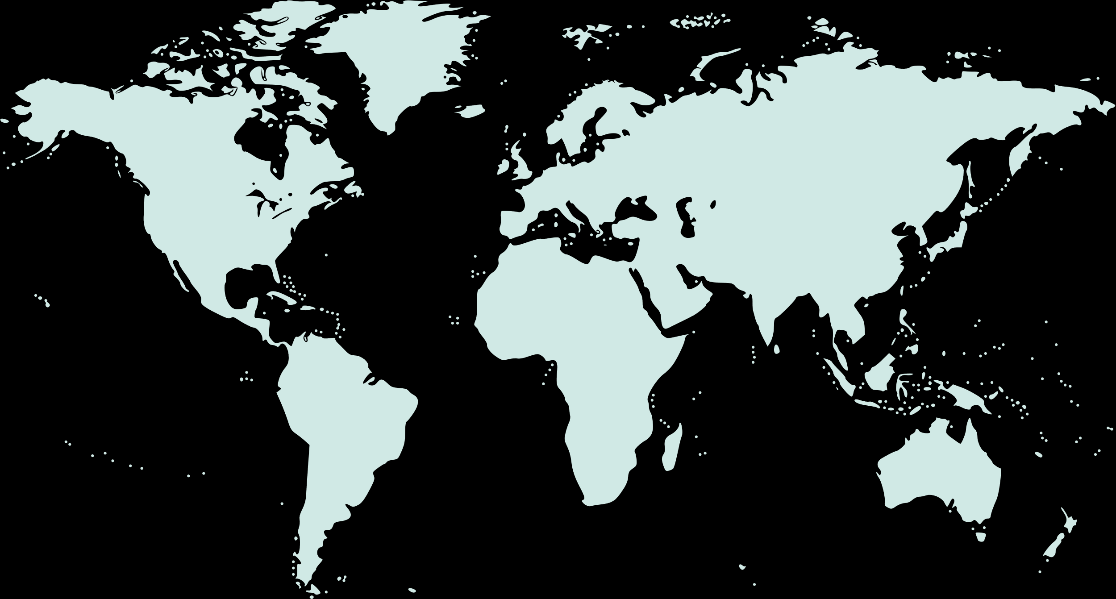
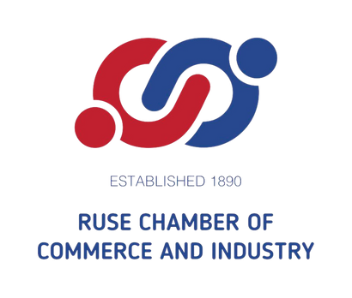
Consortium

Slide 5
01
MARKET
02
TARGET AUDIENCE
03
MARKET NICHE
04
MARKET TRENDS
Contents
05
INNOVATIONS / NEW GOODS
06
ENTRECOMP
07
EXAMPLES OF GOOD PRACTICE

Slide 6
Introduction
We live in a rapidly changing society where it is essential that everyone has the capacity to act upon opportunities and ideas, to work with others, to manage dynamic careers and shape the future for the common good.
To achieve these goals we need people, teams and organizations with an entrepreneurial mindset, in every aspect of life.

Slide 7
Market

Slide 8
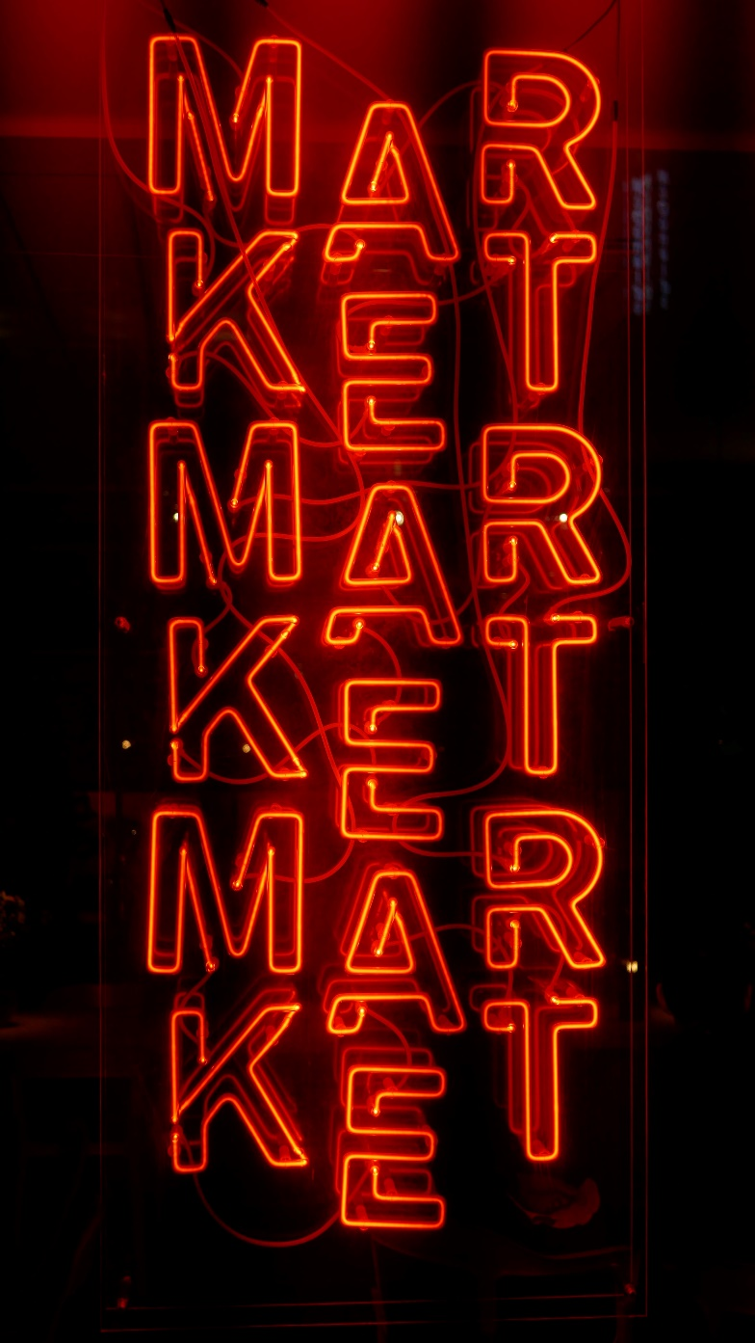
What is Market?
A market is a place where parties can gather to facilitate the exchange of goods and services. The parties involved are usually buyers and sellers. The market may be physical like a retail outlet, where people meet face-to-face, or virtual like an online market, where there is no direct physical contact between buyers and sellers. There are some key characteristics that help define a market, including the availability of an arena, buyers and sellers, and a commodity that can be purchased and sold.

Slide 9
Types of Markets
Physical Markets - Physical market is a set up where buyers can physically meet the sellers and purchase the desired merchandise from them in exchange of money. Shopping malls, department stores, retail stores are examples of physical markets.
Non-Physical Markets/Virtual markets - In such markets, buyers purchase goods and services through internet. In such a market the buyers and sellers do not meet or interact physically, instead the transaction is done through internet. Examples - Rediff shopping, eBay etc.
Auction Market - In an auction market the seller sells his goods to one who is the highest bidder.
Market for Intermediate Goods - Such markets sell raw materials (goods) required for the final production of other goods.
Black Market - A black market is a setup where illegal goods like drugs and weapons are sold.
Knowledge Market - Knowledge market is a set up which deals in the exchange of information and knowledge-based products.
Financial Market - Market dealing with the exchange of liquid assets (money) is called a financial market

Slide 10
Supply and Demand
Supply is created by the sellers, while demand is generated by buyers.
Markets try to find some balance in price when supply and demand are themselves in balance. But that balance can in itself be disrupted by factors other than price including incomes, expectations, technology, the cost of production, and the number of buyers and sellers participating.
To put it simply, the number of goods and services available is determined by what people want and how eager they are to buy. Sellers increase production when buyers demand more goods and services. Producers then increase their prices in order to realize a profit. When buyer demand decreases, companies have to drop their prices and, therefore, the number of goods and services they bring to market.

Slide 11
Market Segmentation
Demographic Segmentation
These are the main characteristics that define your target market. Everyone can be identified as belonging to a specific age group, income level, gender, occupation, and education level.
Psychographic Segmentation
The basis of such segmentation is the lifestyle of the individuals. The individual’s attitude, interest, value help the marketers to classify them into small groups.
Behavioristic Segmentation
The loyalties of the customers towards a particular brand help the marketers to classify them into smaller groups, each group comprising of individuals loyal towards a particular brand.
Geographic Segmentation
Geographic segmentation refers to the classification of market into various geographical areas. A marketer can’t have similar strategies for individuals living at different places.

Slide 12
Target Market
A target market is a group of people that have been identified as the most likely potential customers for a product because of their shared characteristics such as age, income, and lifestyle.
How to Define Product's Target Market? - Part of creating a new product is envisioning the consumers who will want it.
A new product must satisfy a need or solve a problem, or both. That need or problem is probably not universal unless it reaches the level of indoor plumbing. More likely, it is needed by a subset of consumers, such as environmentally-conscious vegetarians, or science nerds, or outdoor enthusiasts. It may appeal to a teenager or a middle-aged professional, a bargain-hunter or a snob.
Envisioning target market is part of the process of creating and refining a product, and informs decisions about its packaging, marketing, and placement.

Slide 13
Market research
Market research is the process of collecting, analyzing, and interpreting data about competitors, target markets, or an industry as a whole. Entrepreneurs can use market research to make well-informed decisions, as it takes some of the guesswork out of how to interact with customers and provides ideas for projects that have the most potential.
Companies use market research at various stages of growth for different reasons. Market research can be used to:
Identify new markets. Market research may help you discover a need for your product in markets you’ve never considered.
Stay on top of new market trends. Market research can show new trends and help you determine strategies to adapt to new market conditions.
Determine the demand for a new product or service. Focus groups and surveys can give you an idea of how useful your product will be for consumers.
Find an ideal product-market fit. Market research can help you discover the best time, place, and audience for your product.
Fortify your business. Any problem areas in your business can be identified early to prevent expensive disruptions later.
Improve brand reputation. Understanding how consumers perceive your brand can help you shape future brand management strategies.

Slide 14
Target audience

Slide 15
Target audience
A target audience is a group of people identified as being likely customers of a business. Target audiences share similar demographic traits including, but not limited to:
Age
Gender
Location
Education
Socioeconomic status
Identifying your target audience as a business can help craft marketing strategies and define your core customers. Instead of spending money and resources trying to cater to every consumer, defining a target audience allows for more intentional and personal outreach to those most likely to purchase your product or service.
Innovation Entrepreneurship

Slide 16
How to collect primary data
Interview potential or existing customers.
Send out a general market assessment survey.
Run a product trial.
Research your competitors.
If your business has existing customers, you can also use consumer data on past transactions, such as:
Surveys at purchase, online, at events, etc.
Past transactions, orders and communications.
Reviews and testimonials.
Data from customer appreciation events where you asked attendees to provide feedback on product samples.
Use your secondary data to augment your first-party data and check your assumptions. Remember, secondary data is an important resource for effective ad targeting. Since secondary data has been aggregated by an external source, it may not accurately reflect your target audience, so make sure to cherry-pick only the most relevant insights.

Slide 17
Practice: Defining Ideal Customer
WHO is your ideal customer?
Pretend you are a novel writer, and you have to describe the main character. Describe him/her:
how old is he/she?
is he/she employed or in school?
is he/she married?
does he/she have children?
how much does he/she earn?
what shows does he/she watch?
does he/she listen to the radio?
does he/she use social networks?
what kind of food does he/she eat?
what did he/she graduate from?
where does he/she work?
is he/she training?
where does he/she live: in a house/apartment, town/village?
...
Write down a complete description of your ideal customer.

Slide 18
How to reach target audience?
Step 1: Define Your Target Audience
Step 2: Create Useful and Relevant Content
Step 3: Leverage Influencers
Step 4: Use Targeted Advertising
Step 5: Referral Marketing
Step 6: Reach Your Target Audience on Social Media via Hashtags

Slide 19
Market niche

Slide 20
Market Niche
A niche market is a segment of a larger market that can be defined by its own unique needs, preferences, or identity that makes it different from the market at large.
For example, within the market for women’s shoes are many different segments or niches. Shoes for vegan women would be a niche market, as would shoes for plus-sized women or shoes for nurses.
Nearly every market can be further refined, or divided, by the specific needs and preferences of its constituents.
Choosing to focus on a niche is a strategic business decision to serve a certain customer base better than competitors who target the larger market. Let’s take a look at some examples.

Slide 21
Nine niche market examples
Conscious consumers
Health and wellness
Pet owners
The LGBTQ+ community
Travelers
Gamers
Homeowners
Remote workers
Locals

Slide 22
How to Find a Niche Market
Reflect on your passions and interests - Is there a hobby or skill you're passionate about or good at? Take some time to reflect on those areas of interest as potential niche market ideas.
Identify the problems and needs of your customers - Now that you have some niche market ideas, think of the problems faced by your target market. Can your passion or interest meet your customer needs? Do you know their motive to buy?
Research the competition - Before devoting your time and energy to developing a brand-new business, research your potential competitors. You might have a viable product idea, but how many other businesses will you be competing with?
Define your niche and its profitability - If you’re dedicating your resources and time to a new business, it should have the ability to become profitable.
Test your product or service - Create a simple website or landing page for your business so customers can find you. Offer a trial period of the product or give out free samples to your target customers. This initial test period should not cost a large amount of money.

Slide 23
Market trends

Slide 24
What is a Trend?
Trend is a general development or change in a situation or in the way that people are behaving.
Given the understanding that the psychology of the markets actually moves the markets, we can acknowledge that psychology develops and ends the trends.
A trend is the general direction of the price of a market, asset, or metric.
Many traders opt to trade in the same direction as the trend, attempting to profit from a continuation of that trend.
Price action, trendlines, and technical indicators are all tools that can help identify the trend and warn when it is reversing.
Markets are made up of several different kinds of trends, and it is the recognition of these trends that will largely determine the success or failure of your long and short-term investing.
Innovation Entrepreneurship

Slide 25
Market Trends
Primary Markets
The bull and bear markets are also known as primary markets; history has shown us that the length of these markets generally lasts from one to three years in duration.
Secular Trends
A secular trend, one that can last for one to three decades, holds within its parameters many primary trends, and, for the most part, is easy to recognize because of the time frame. The price-action chart, for a period of 25 years or so, would appear to be nothing more than a number of straight lines moving gradually up or down.
Intermediate-Trends
Sudden rallies and directional turnarounds make up the intermediate trends and, for the most part, are the results of some kind of economic or political action and its subsequent reaction.
History tells us that the rallies in bull markets are strong and that the reactions are somewhat weak. The flip side of the coin shows us that bear-market reactions are strong and that the rallies are short. Hindsight also shows us that each bull and bear market will have at least three intermediate cycles. Each intermediate cycle could last as little as two weeks or as long as six to eight weeks.

Slide 26
Advantages of identifying trends?
There are 3 important advantages of identifying trends in technical analysis:
It helps you to immediately and decisively spot the overarching trends in any timeframe and trade accordingly.
Trend identification gives you a strong story on whether and how the trend reversals can be used for short-term gains.
Understanding the underlying trend of the market helps you to plot the supports and resistance levels with greater clarity and precision, in an actionable way.

Slide 27
8 Marketing Trends Tools You Should Use for Research
Semrush Market Explorer (.Trends) - The Market Explorer tool creates a visual overview of the current market in your selected country.
Semrush Traffic Analytics (.Trends) - The Traffic Analytics tool allows businesses to gain insight into their competitor’s traffic and onsite activity.
Google trends - Google Trends is a free tool that can help identify topics to stay ahead of the curve. Keyword research is a pivotal part of creating content for websites and social platforms.
YouTube Trending Topics - Although YouTube homepage will vary, it can still help you understand trends. You can also follow your closest competitors, celebrities, or influencers who are working with a competitor brand, or even completely new and diverse YouTubers that are establishing the current trends. However, you can go one step further in your trend research by getting trending content data from YouTube’s trends tool.

Slide 28
8 Marketing Trends Tools You Should Use for Research
Google Trends for YouTube - Much like a regular Google Trends search, you can view worldwide, categorical, and specific country data for YouTube trends. Google also allows you to filter by how performance.
Pinterest Trends - When visiting the Pinterest site, users can search for the Trends of the week. These trends usually include their most popular imagery over the week. Businesses can use this feature to discover opportunities to share their products and service where they otherwise wouldn’t.
Instagram Trends - There is a simple and quick way of keeping track of the trends dominating the platform: simply search for a hashtag that is related to your business.
Twitter trending topics - By using the “Advanced Search” option, users can delve deeper into the real-time trends that are happening all over the world.

Slide 29
Five essential marketing trends
Shopping on social media - Forbes reports that 72 per cent of Instagram users have bought something when using the app and 70 per cent of Pinterest users use the platform to find new and interesting products. Companies can now create posts that allow users to shop directly on social media instead of companies' own websites. This allows retailers to reach their customers more quickly and easily.
Focus on customer experience - When a customer comes to your company, you want to make it as easy as possible for them to find what they need and buy your products. PricewaterhouseCoopers reports that 73 per cent of people say that customer experience is an important factor when making a buying decision. And when they say 'customer experience', they most value efficiency, friendly and knowledgeable customer service and easy payment options. Companies that can provide a good customer experience keep their customers and attract new ones.
Innovation Entrepreneurship

Slide 30
Five essential marketing trends
Personalization - This is made possible by the data that people generate through their internet searches, online shopping habits and social media use. Online product recommendations, adverts and even the design of the marketing message itself is adapted to the interests and preferences of individual consumers. According to a report, although 86 per cent of people were concerned about privacy issues, 90 per cent were happy to share data about their behaviour if it meant an easier and cheaper shopping experience. In the same survey, 72 per cent of consumers said they would only engage with marketing messages that are personalised according to their interests.
Innovation Entrepreneurship

Slide 31
Five essential marketing trends
Video content - According to Forbes, 91 per cent of consumers say they prefer watching interactive and visual content to reading a traditional piece of information about a product. And consumers are 85 per cent more likely to buy your product after watching a video about it. If an advertisement is interesting, amusing or unique, people will search for it online and share it with their friends.
SEO (Search Engine Optimization) – the strategies companies use to get themselves high up in the results lists of search engines like Google, Bing, Yahoo and others. As the internet plays an increasingly central role in marketing and selling, it is vital for your company to appear in the search results when someone does a related search.
Innovation Entrepreneurship

Slide 32
Innovations / new goods

Slide 33
Product Development
Product development - also called new product management - is a series of steps that includes the conceptualization, design, development and marketing of newly created or newly rebranded goods or services. Product development includes a product's entire journey - from the initial idea to after its market release.
The objective of product development from a business standpoint is to cultivate, maintain and increase a company's market share by satisfying consumer demand. From a customer standpoint, it's to ensure value in the product as a quality good or service.
Not every product will appeal to every customer or client base, so defining the target market for a product is a critical step that must take place early in the product development process.
Organizations should conduct quantitative market research at all phases of the design process, including before the product or service is conceived, while the product is being designed and after the product has been launched.

Slide 34
Steps for creating a product development plan
Identify a product need and business case. Using practices like test marketing and surveys, organizations can gauge interest in a product. This helps ensure the product has a strong reason to be created.
Create a product vision. This includes coming up with the project's scope, purpose for the product, what it does, who it's for and the product design, while also crafting guiding principles for the upcoming work.
Create a roadmap. Assess the project as a concept first to ensure good design work, then begin crafting the roadmap. The roadmap aids in identifying what goals should be developed first. Implementation teams create schedules, break down significant portions of the project into sprints and generate iterations of the product.
Begin implementing the roadmap. Teams can then start implementing the project, following the roadmap. Iterations of the product can be made, reviewed and improved upon. This helps identify weak areas of the product and enables development teams to fix and improve the product.
Continue with development and assessments. Development teams can work on enhancements and changes to the product. In this step, feedback can be gathered from customers to change the product based on customer needs.

Slide 35
Stages of new product development
The new product development process consists of the following components:
Idea generation
Idea screening
Concept development and testing
Market strategy and business analysis
Product
Price
Promotion
Place
Feasibility analysis or study
Product technical design and product roadmap
Test marketing or market testing
Market entry and commercialization

Slide 36
EntreComp

Slide 37
The European Entrepreneurship Competence Framework EntreComp
The European Commission has developed EntreComp: the European Entrepreneurship Competence Framework as a reference framework to explain what is meant by an entrepreneurial mindset.
EntreComp offers a comprehensive description of the knowledge, skills and attitudes that people need to be entrepreneurial and create financial, cultural or social value for others.
EntreComp is a common reference framework that identifies 15 competences in three key areas that describe what it means to be entrepreneurial.

Slide 38
EntreComp
EntreComp has the potential to be used in a variety of ways including:
supporting policy and practice to develop entrepreneurial skills
assessing entrepreneurial skills
supporting training of educators, trainers and teachers to deliver entrepreneurial skills
to design programmes and learning opportunities
to recognise and certify skills
EntreComp can be used across sectors and be a key support for collaboration and development work by educators, trainers, employers, professional bodies and policy-makers

Slide 39
EntreComp
The most important competencies that are considered through EntreComp related to Identify new trends and markets demands to produce new goods or services that appeal to its target audience and how they will affect your organization are:
Creativity (Creative thinking and problem solving) – Developing several ideas and opportunities to create value, including better solutions to existing and new challenges; Research and experimentation with innovative approaches; Combining knowledge and resources to achieve valuable effects.
Creativity – Develop and purposeful ideas
Be curious and open
Develop idea
Define problems
Design value
Be innovative
Vision – work towards your vision of the future
Imagine
Think strategically
Guide action
Valuing ideas – Make the most of ideas and opportunities

Slide 40
EntreComp
Spotting opportunities includes Identifying and exploiting opportunities to create value by exploring the social, enviromental and economic aspects of the market as well as indentification of needs and challenges to be met. Additionally it includes ability forging new connections and bringins together disparate market elements to create opportunities for value creation.
Use your imagination and abilities to identify opportunities for creating value.
Identify, crate and seize opportunities
Focus on challenges
Uncover needs
Analyse the context

Slide 41
Examples of good practice

Slide 42
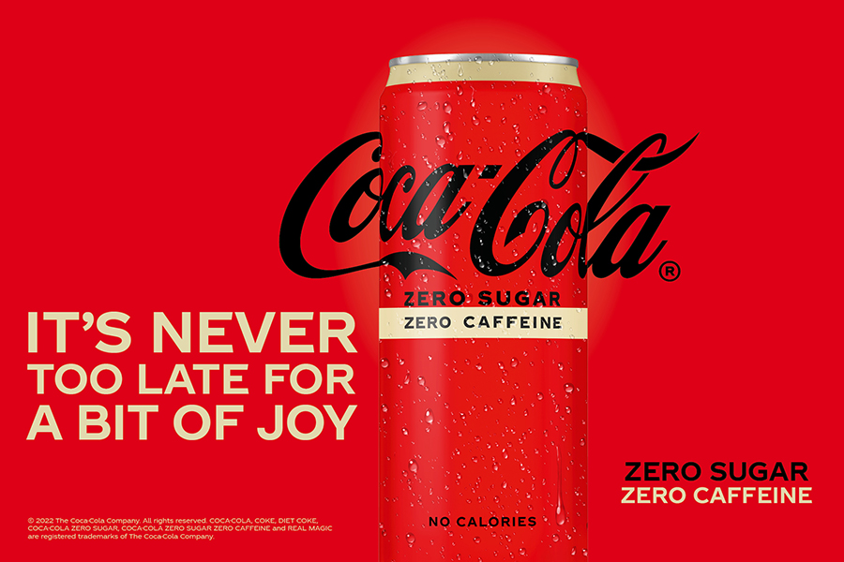
Coca Cola Company
COCA‑COLA ZERO SUGAR ZERO CAFFEINE
Coca-Cola has kicked off a new social-first campaign to promote the launch of its latest product, Coca-Cola Zero Sugar Zero Caffeine, positioning itself as an evening friendly alternative to other Coca-Cola beverages.
Promoted under the brand platform ‘It’s never too late for a bit of joy!’, the new campaign was launched with what the soft drink giant claims to be the ‘first Insta musical’, named ‘That moment when’.

Slide 43
Dropbox
Dropbox brings everything—traditional files, cloud content, and web shortcuts—together in one place. Back in 2007, making work better for people meant designing a simpler way to keep files in sync. Today, it means designing products that reduce busywork so you can focus on the work that matters.
Most “productivity tools” get in your way. They constantly ping, distract, and disrupt your team’s flow, so you spend your days switching between apps and tracking down feedback. It’s busywork, not the meaningful stuff. Dropbox wanted to change this.
Dropbox believe there’s a more enlightened way to work. Dropbox helps people be organized, stay focused, and get in sync with their teams.

Slide 44
References
• https://learnenglish.britishcouncil.org/business-english/business-magazine/five-essential-marketing-trends
• https://www.investopedia.com/terms/t/target-market.asp
• https://blog.hootsuite.com/target-market/
• https://www.techtarget.com/searchcio/definition/product-development-or-new-product-development-NPD
• https://ec.europa.eu/social/main.jsp?catId=1317&langId=en
• https://www.bigcommerce.com/articles/ecommerce/target-market-analysis/
• https://grin.co/blog/reach-your-target-audience-more-effectively/
• https://www.sprinklr.com/cxm/market-research/
• https://www.practicalbusinessskills.com/getting-started/creating-a-business-plan/understanding-the-market
• https://www.qualtrics.com/experience-management/brand/what-is-market-segmentation/

Slide 45
References
• https://www.shopify.com/blog/niche-markets
• https://blog.hubspot.com/sales/niche-market
• https://www.investopedia.com/terms/m/market.asp
• https://www.managementstudyguide.com/what-is-market.htm
• https://www.indeed.com/career-advice/career-development/market-structure
• https://www.semrush.com/blog/trends/
• https://www.indiainfoline.com/knowledge-center/online-share-trading/how-to-identify-trends
• https://www.investopedia.com/articles/technical/03/060303.asp
• https://www.investopedia.com/terms/t/trend.asp
• https://www.coca-cola.co.uk/marketing/launches-and-innovation/coca-cola-zero-sugar-zero-caffeine-that-moment-when
• https://www.dropbox.com/about
• https://techcrunch.com/gallery/a-brief-history-of-dropbox/

Slide 46
Thank you!
@Regio.Digi.Hub

