Slide 1
Promoting Regional Development by building the capacity of the VET system

Slide 2
Green mindset and Sustainability in Innovation, Leadership and Corporation

Slide 3
Disclaimer
The European Commission support for the production of this publication does not constitute an endorsement of the contents which reflects the views only of the authors, and the Commission cannot be held responsible for any use which may be made of the information contained therein.
Project Nº: 2021-1-RO01-KA220-VET-000028118

Slide 4
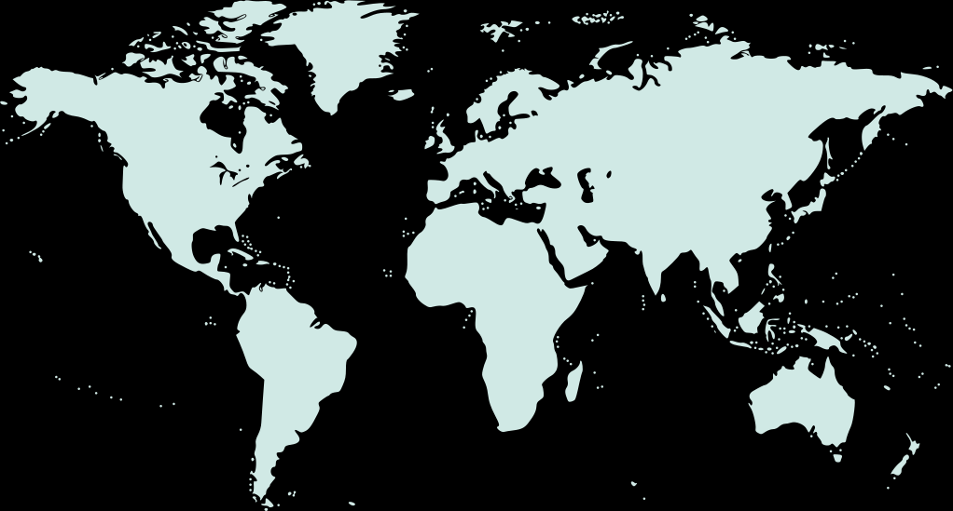
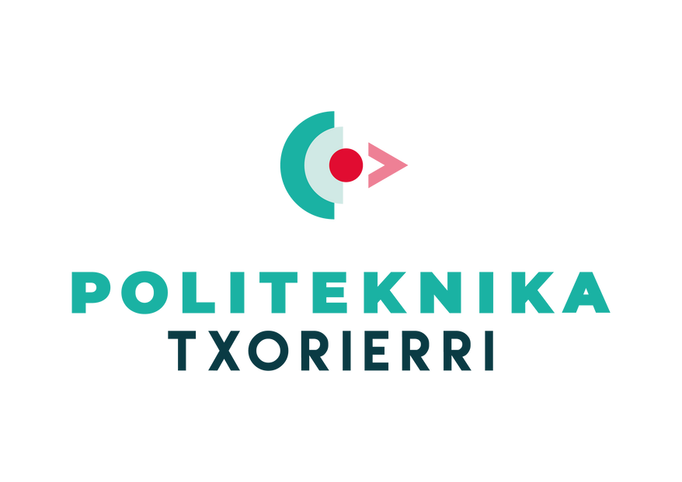
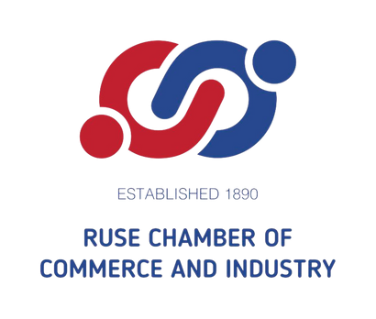
Consortium

Slide 5
01
Zero Waste Movement
02
Plastic and trash facts
03
Sustainability and business
Content
04
Examples of eco-friendly companies
05
References

Slide 6
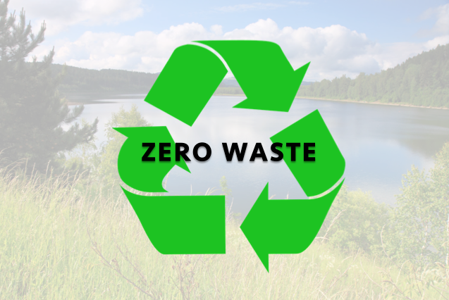
Zero waste
What it is and why is it popular
In the last few years the term "zero waste" has become popular in Bulgaria and beyond. It is not just a fashion, but a philosophical concept, a world movement that more and more people, small and large businesses, corporations are turning to.
In Bulgaria, for example, it all started in 2018, when provoked by the amount of waste in everyday life, few innovative activists with various backgrounds created the Zero Waste Bulgaria Association. This happened on the symbolic date of 22 April - International Earth Day.
Speaking of green mindset, zero waste is definitely a part of it, because it arises from the quest for nature conservation and more conscious consumption.

Slide 7
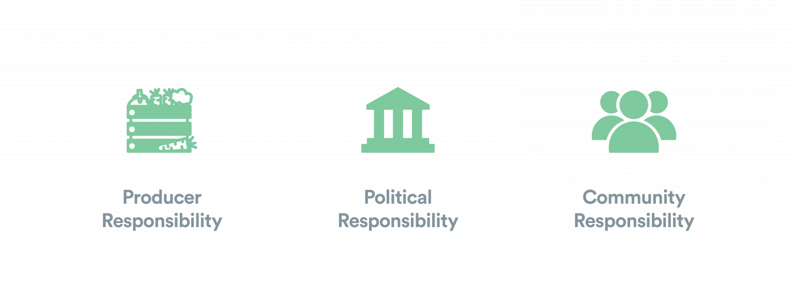
What is zero waste…really?
Definition and principles
The definition of zero waste according to the Zero Waste International Alliance (ZWIA) is as follows:
“Zero waste: The conservation of all resources by means of responsible production, consumption, reuse, and recovery of products, packaging, and materials without burning and with no discharges to land, water, or air that threaten the environment or human health.”
At its core, zero waste takes aim at our “take, make, and waste” approach to production and consumption, encouraging a more circular approach to the way we use resources. On its most basic level, this means that the goal of zero waste is to push economies towards the target of sending no waste to landfill, incinerators, and the ocean.
The zero waste principles include three underlying obligations that target different sections of society:

Slide 8
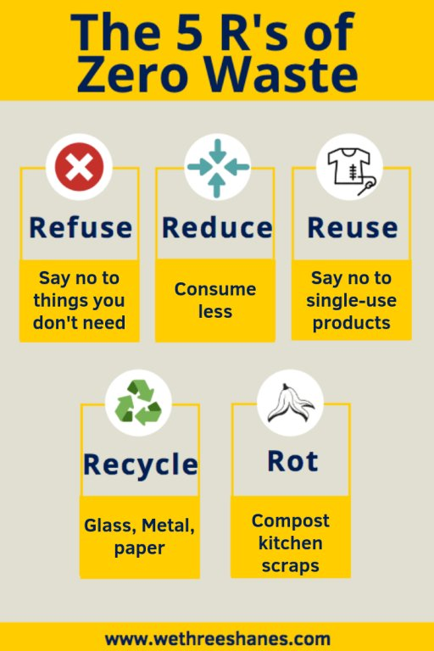
5 R’s of zero waste
We've all probably heard of the phrase “reduce, reuse, recycle.” But have you heard about the other two “Rs”? The Five Rs: Refuse, Reduce, Reuse, Recycle, Rot. The Five Rs are guiding principles for reducing the waste we output, and they follow a specific order.
Why is the 5 R's in waste management important?
As mentioned in the 5Rs of Zero Waste, by reusing and recycling things, we can lessen the burden placed upon poorer countries, suffering the consequences of our buy and throw away habits.
In addition, it creates a sustainable environment by saving scarce natural resources for future generations too.

Slide 9
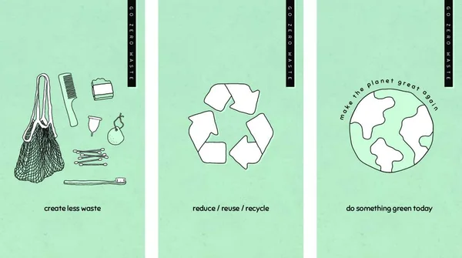
Zero waste history
The zero waste concept is not new. In fact, any ancient or pre-modern civilization, tribe, or village would immediately recognize the concept of zero waste, or rather, would wonder exactly when our wasteful practices became the norm.
The zero waste story really begins in the 1980s, gathering pace over the past 40 years to become what it is today. Take a look at our abridged timeline for zero waste sourced from the excellent The Zero Waste Solution: Untrashing the Planet One Community at a Time by Paul Connet.

Slide 10
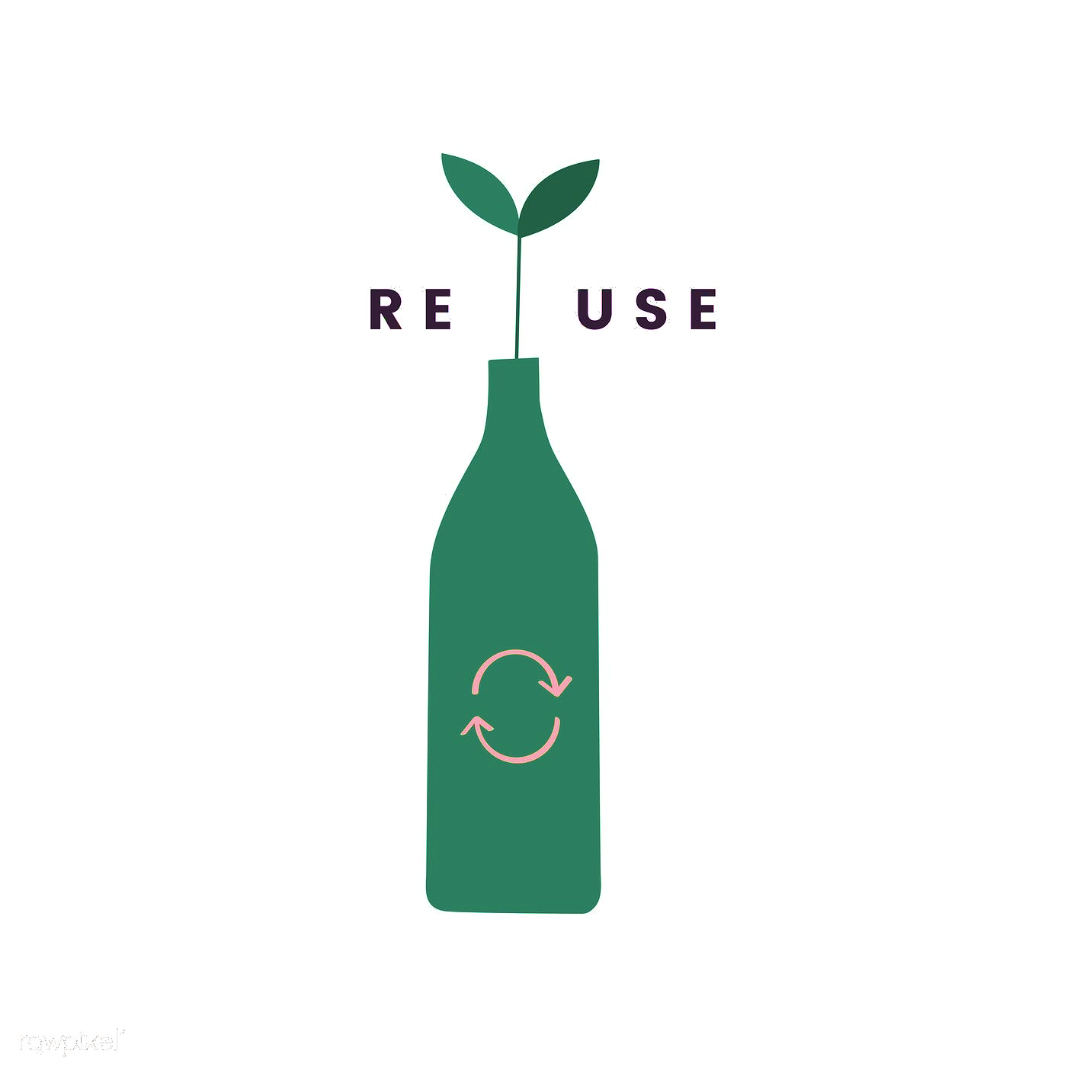
Zero waste history
Grandparents and parents likely remember a time when they returned milk bottles to the store, or used reusable bags, containers, and jars in the kitchen and at the grocery store.
Perhaps the first mention of the term “zero waste” comes from Daniel Knapp’s concept of Total Recycling. Knapp and his wife founded salvaging operation and market, Urban Ore, in Berkeley, California in the 1980s, and from this real-world experiment, they showed how all types of waste could be diverted from landfill and reused within the community. Its success is still evident today, and Urban Ore estimates that it diverts more than 8,000 tons of waste away from landfill each year.

Slide 11
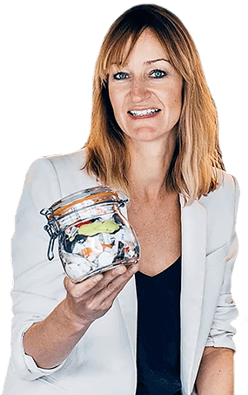
2010
The Zero Waste Lifestyle
In the second decade of the new millennium, the zero waste concept had moved out of the hands of experts, policymakers, and environmentalists and into the mainstream. Bea Johnson, a French-American woman living in California, is widely credited with beginning the zero-waste lifestyle movement, starting small with her family of four and sharing the journey on her blog Zero Waste Home.

Slide 12
Zero Waste for Business
Setting goals to meet zero waste for a business can be overwhelming and many times confusing. It’s important to begin with the basics. What is your business throwing away? Knowing what waste is currently being generated will guide decision making for materials being purchased, engagement programs for employees and staff members, and how waste should be separated in order to prioritize reuse and recycling.
For businesses, zero waste is when 90% waste is diverted from landfill and incineration [Sources: ZWIA and TRUE].
Here is a great article - “Tips for Making Your Office Zero Waste”.

Slide 13
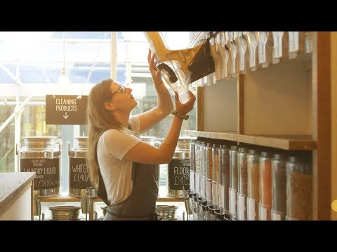
Video: Are Zero Waste shops the future?
Step inside Britain’s first no-packaging supermarket. Located in Totnes in Devon, Earth Food Love is a dry goods store run by ex-pro footballer Richard and his wife Nicola. A triumphant story about conscientious consumption, sustainability, innovation and behaviour change; they explain what it means to be waste-free and whether this could be the beginning of a new era for shopping habits.

Slide 14
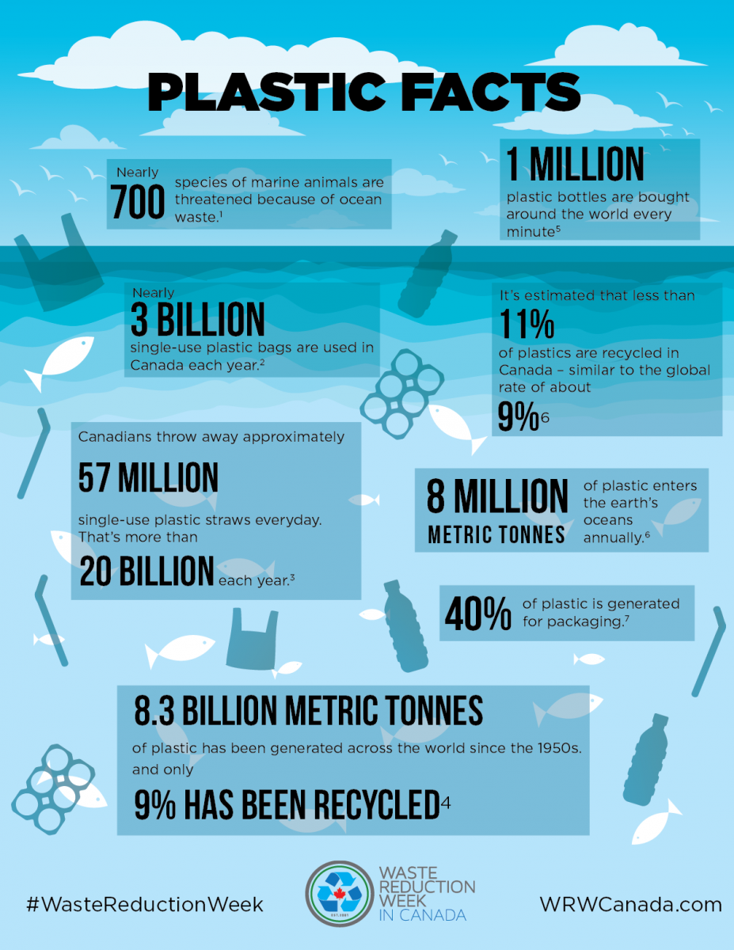
Why bother?
Plastic facts
In a study published in Science Advance, researchers estimate since the 1950s 8.3 billion tons of plastic has been generated around the world and only 9 per cent of those plastics have been recycled. It is estimated that an additional 12 billion tonnes of plastic will be lost to disposal by 2050.
So, looking at the infographic, one can draw the conclusions him/herself. Source and more resources.

Slide 15
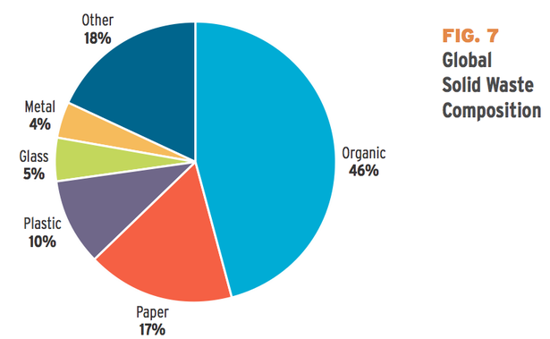
2.6 Trillion Pounds of Garbage
Where Does the World's Trash Go?
In 2012, the world will generate 2.6 trillion pounds of garbage -- the weight of about 7,000 Empire State Buildings. What kind of trash is it? Where does it all go?
The answer is that just under half of it comes from "organic" waste -- food, mostly -- and most of it goes into landfills, according to a new report this week from the World Bank. Here's that story in pie charts, provided by the report.

Slide 16
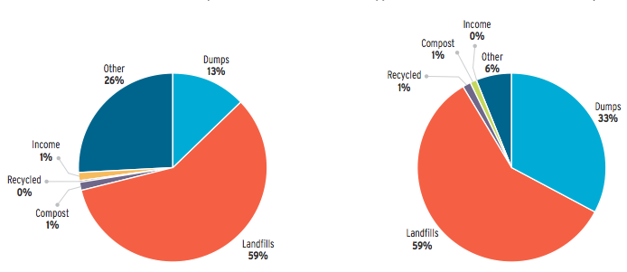
2.6 Trillion Pounds of Garbage
Where Does the World's Trash Go?
In both rich and poor countries, the vast majority of our waste goes into landfills where it's (often) covered up. A very small share of waste in the World Bank's data -- which, the authors admit, was difficult to collect for this category -- went to recycled or composted waste. "Africa's collected waste is almost exclusively dumped or sent to landfills," the report said.
[Lower income countries to the left; Higher income to the right]

Slide 17
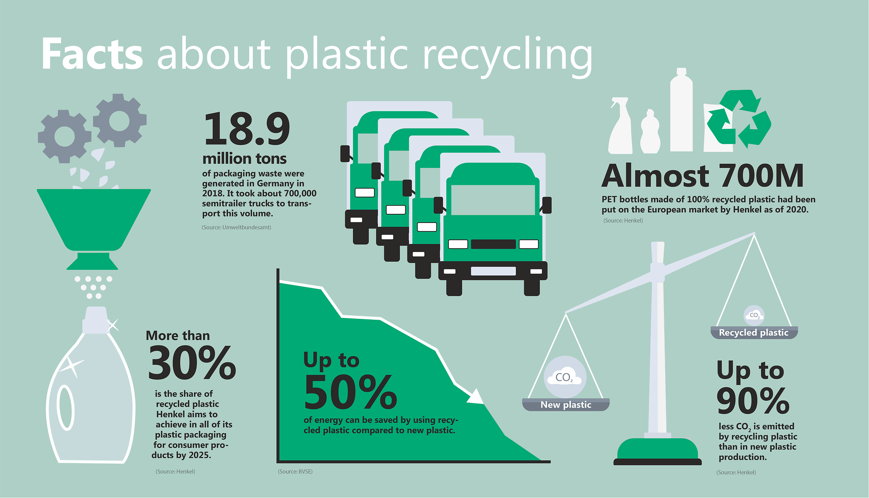
Infographic Source

Slide 18
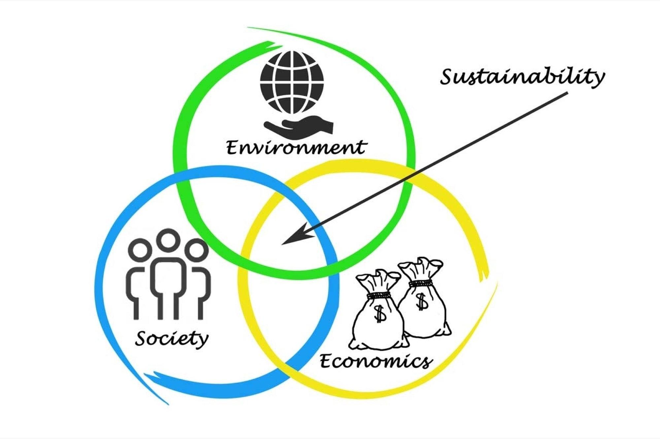
Why is sustainability important to business success?
A sustainable business has reduced costs
33% of businesses are integrating a sustainability strategy to improve operational efficiency and drive down costs. With this in mind, efficiency improvements can in turn boost operational profits by as much as 60% according to McKinsey.
“We are the first generation to feel the impact of climate change and the last generation that can do something about it.” – Barack Obama, Globalo

Slide 19
Our reality
1937: The world population is 2.3 billion. Carbon in our atmosphere is 280 parts per million (ppm). The remaining wilderness is 66%.
1960: The world population is 3.0 billion. Carbon in the atmosphere is 310 ppm. The remaining wilderness is 64%.
1997: The world population is 5.9 billion. Carbon in the atmosphere is 360 ppm. The remaining wilderness is 46%.
2020: The world population is 7.8 billion. Carbon in the atmosphere is 415 ppm. The remaining wilderness is 35%.

Slide 20
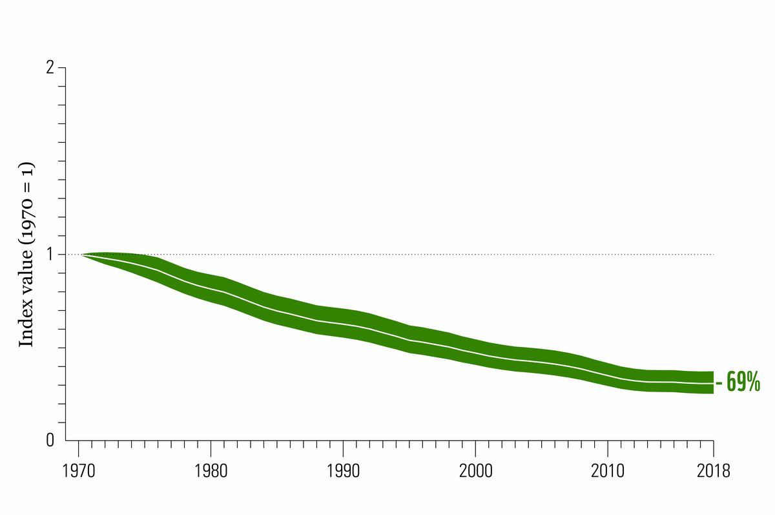
Our reality
Under the current trajectory of human economic activity, within the span of the next lifetime, human security and stability will be lost. Economic success is driven by the exchange of goods and services. Profitable exchanges do not come from fragile, poverty-stricken, and despondent communities.

Slide 21
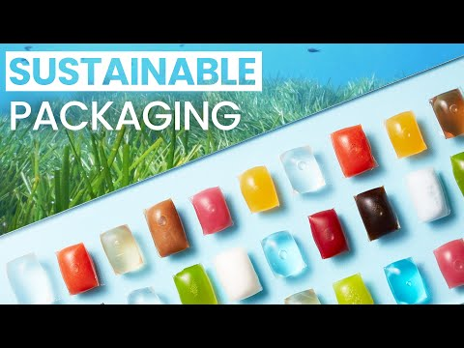
Video: Edible & Biodegradable Packaging
This is Notpla, a company that is challenging plastic pollution by creating edible and biodegradable packaging using seaweed.
Seaweed and other plants are 100% biodegradable and can break down in weeks, making them a great sustainable packaging alternative to plastic. In this video Pierre is interviewed, the co-founder of Notpla to learn more about the company's ambitions. Notpla is a company dedicated to innovation and improving the market of single use packaging through the use of their revolutionary plant-based material.

Slide 22
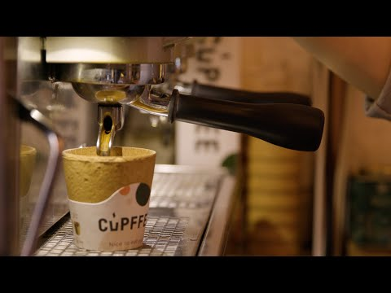
Video: Edible & Biodegradable Packaging
Another example of a green type business is Bulgarian start-up Cupffee has been producing edible cups since 2014. Cupffee developed a recipe for the cups that allows them to stay crispy for 40 minutes, which quickly grew in popularity with consumers. Since 2018, Cupffee has been producing their cups on a specially modified Bühler solution. This partnership is set to expand to address the growing demand for the Cupffee cups.

Slide 23
10 global companies that are environmentally friendly

Slide 24
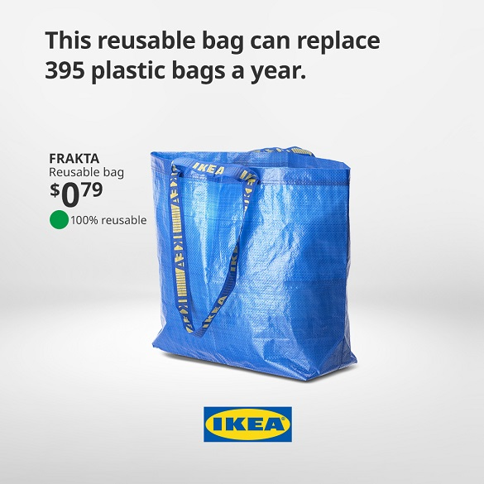
1. IKEA
IKEA’s invested in sustainability throughout its entire business operations, including things customers can readily see and things they can’t. It starts with their supply chain, where the Swedish furniture-maker has sourced close to 50 per cent of its wood from sustainable foresters and 100 per cent of its cotton from farms that meet the Better Cotton standards, which mandate reduced user of water, energy and chemical fertilisers and pesticides. You can also see their commitment to sustainability at the store. IKEA has more than 700,000 solar panels powering its stores, and plans to start selling them to customers in the UK. In 2012, IKEA announced its goal to be powered by 100 per cent renewables by 2020 – but just four years later, it upped the ante aiming to be a net energy exporter in the same time.

Slide 25
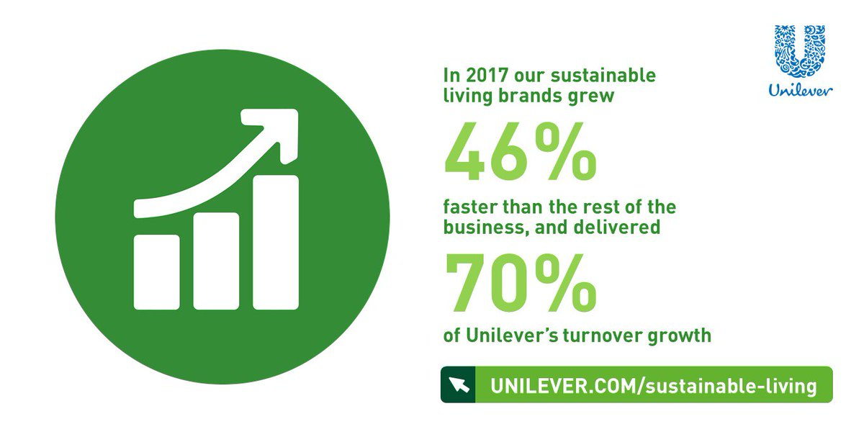
2. Unilever
Unilever has done more than make green investments, it’s made sustainability part of its corporate identity. The company’s Sustainable Living Plan sets targets for sourcing, supply chain and production on everything from energy and water use to treatment of suppliers and communities where they operate. When it was first adopted in 2010, CEO Paul Polman said he wanted to double the company’s business while halving its environmental impact in just 10 years. It’s made amazing strides: three quarters of Unilever’s nonhazardous waste does not go to landfills and the share of its agricultural suppliers that use sustainable practices has tripled. The United Nations awarded the company’s CEO its Champion of the Earth Award in 2015 for his efforts toward reaching this goal.

Slide 26
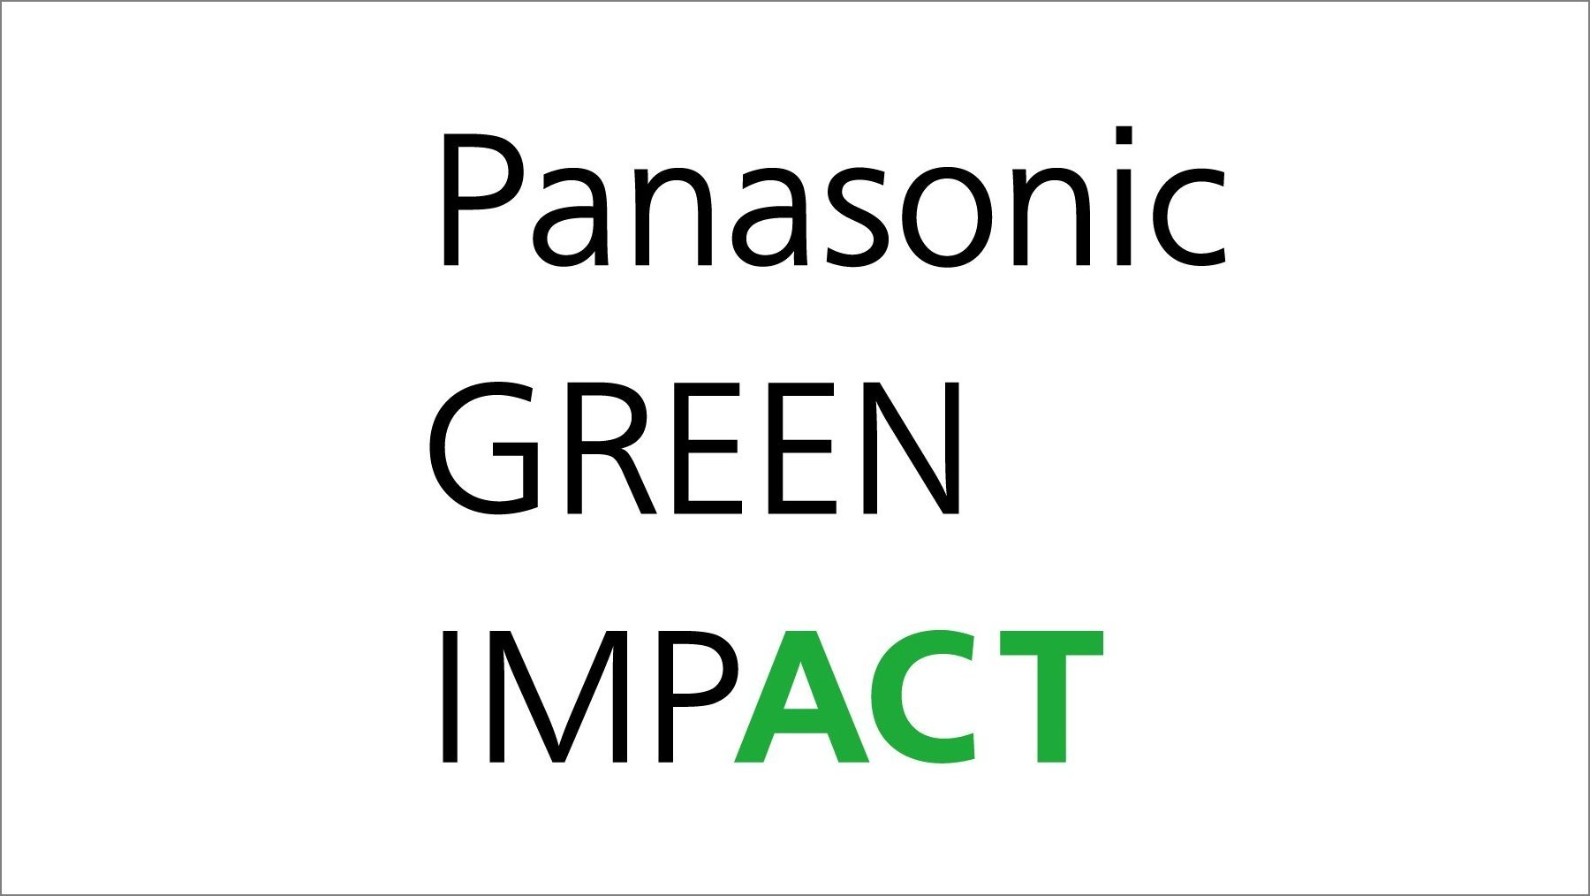
3. Panasonic
Panasonic doesn’t get as many public accolades as many companies (something that Interbrand, which ranks companies on sustainability, calls the 'gap'), but it consistently wins high marks from experts. Like many companies on this list, Panasonic has ambitious energy goals, both in terms of efficiency and renewables, and it also focuses on making environmentally friendly products. What sets them apart is the way they’ve incorporated sustainability into their day-to-day life. It moved its North American headquarters from suburban Seacaucus, New Jersey to a LEED-certified building in downtown Newark by Penn Station, an intentional move to eliminate the need for employees to drive to work and reducing their carbon footprint. They’re also partnering with several companies to make a demonstration Sustainable Smart Town in Japan centred around sustainability.

Slide 27
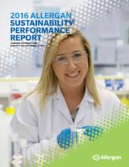
4. Allergan
The Venn diagram between environmentalism and Botox has a pretty small overlap, but smack in the middle of it is Allergan, the Botox producer that has been at or near the top of Newsweek’s green companies rankings for years.
The California-based pharmaceutical company began its commitment to sustainability more than two decades ago with a policy on water conservation grounded in reporting and benchmarking.
. Their strategy has grown from water to energy conservation, waste reduction and emissions reduction in both their direct operations and supply chain. In 2016, it won the Environmental Protection Agency’s EnergySTAR Award for the fifth time, recognizing its achievements in energy efficiency.

Slide 28
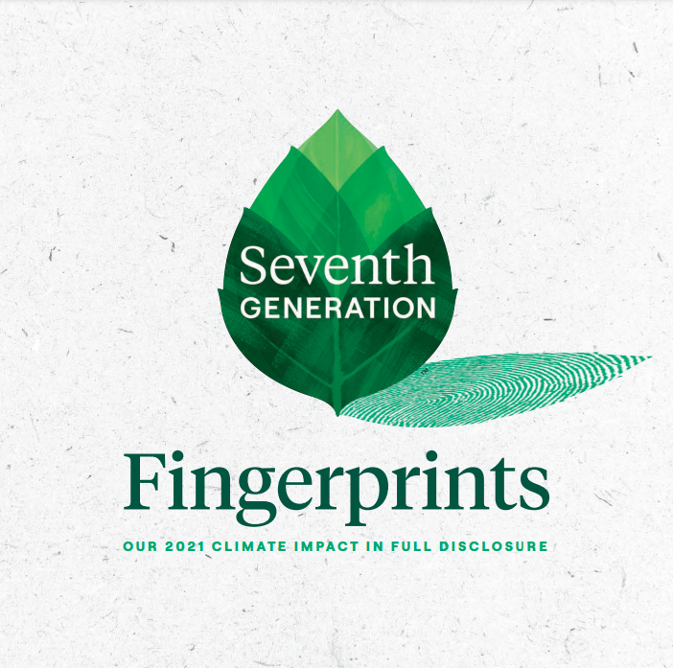
5. Seventh Generation
Seventh Generation not only uses sustainable practices, it’s also created space for green products in a particularly environmentally destructive industry – household cleaners.
Cleaning products are mostly washed down the drain, and despite the best efforts of wastewater treatment plants, some of the strong and toxic chemicals still pollute groundwater and waterways.
Often, the argument against more environmentally friendly ones is they don’t work as well – but that myth died with the success of Seventh Generation. Now, even brands like Clorox have created greener versions of their products to meet demand for environmentally friendly cleaning options.

Slide 29
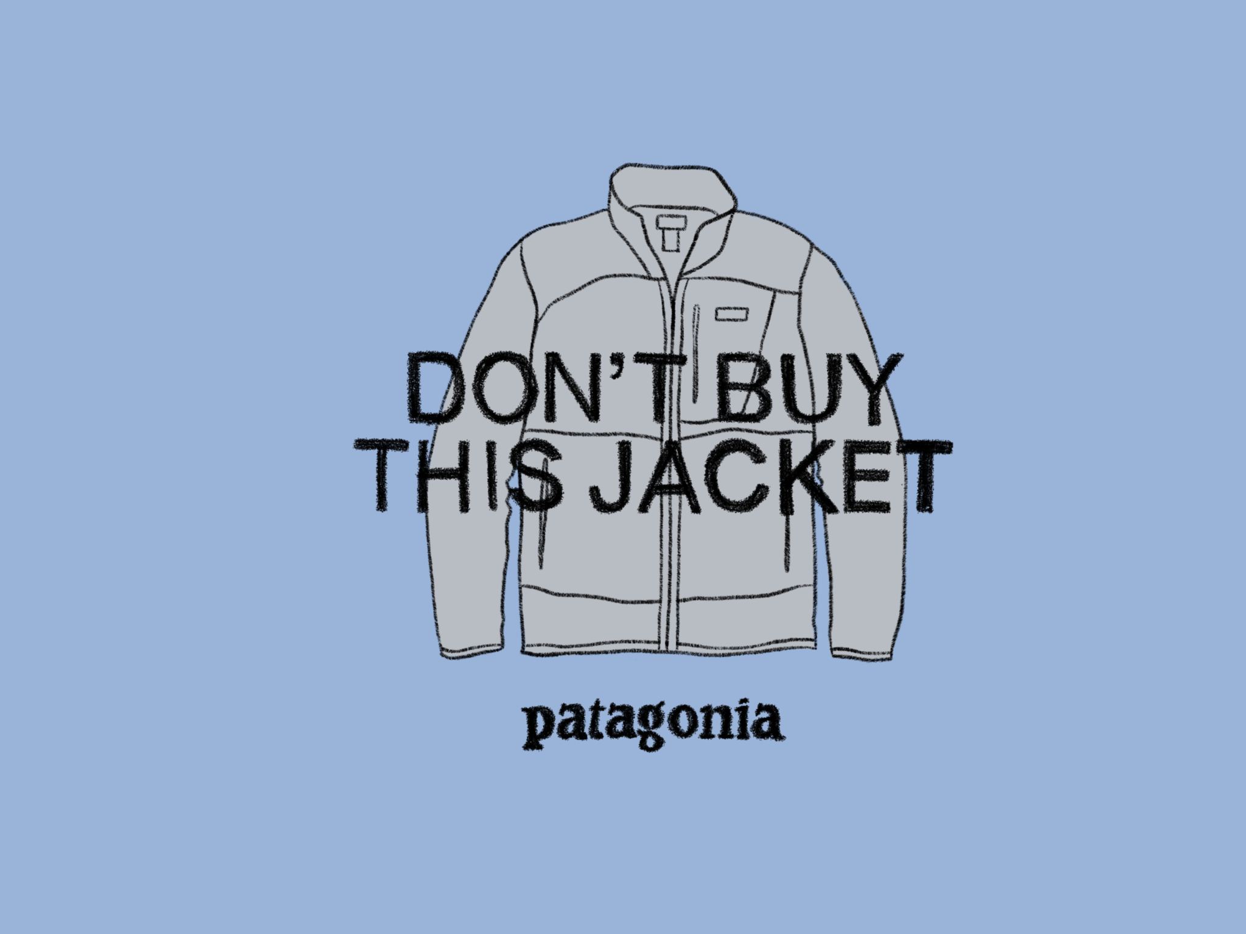
6. Patagonia
A 2015 New Yorker profile called Patagonia’s corporate strategy 'anti-growth', a tongue-in-cheek nod to the retailer’s crusade against conspicuous and superfluous consumption.
They’ve released ads encouraging people to not buy things they don’t need (even their own products) and implemented a program to repair rather than replace their products. Their commitment lies in their products – not just their messaging and marketing.
Wetsuits are made of natural rubber and plastic bottles are turned into parkas. Patagonia also recognises the importance of political action on the environment and has made voting for eco-friendly leaders a cornerstone of its sustainability message.

Slide 30
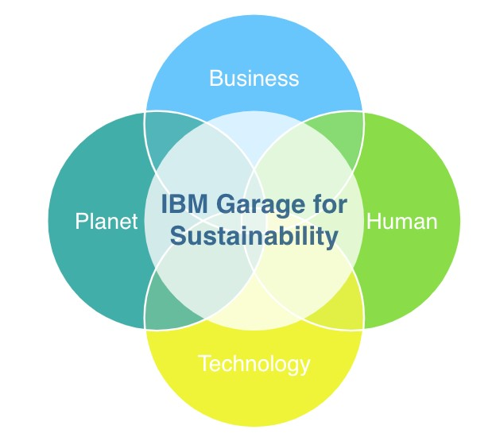
7. IBM
IBM was another early adopter of sustainability and eco-friendly business. Corporate social responsibility and environmental stewardship has been part of the company’s mission since the 1960s. Its first sustainability report was published in 1990 and its data centres have received awards from the European Commission for their long-time energy efficiency successes. Today, IBM’s efforts include smart buildings that reduce resource demand, green procurement, water resource management and more for a truly comprehensive approach.

Slide 31
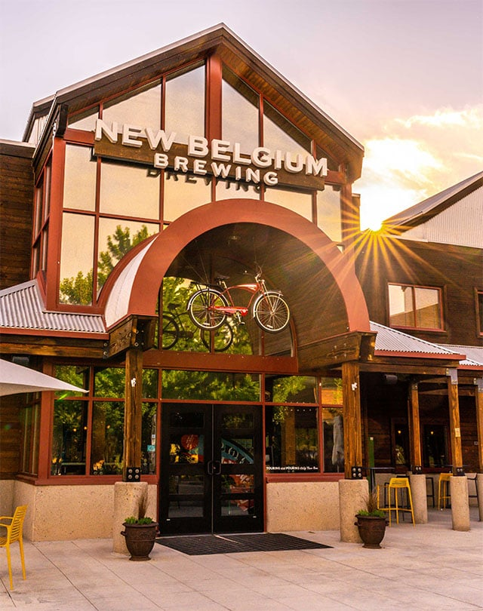
8. New Belgium Brewing
Colorado-based New Belgium Brewing is an industry leader when it comes to sustainability, an ethos that is shot through every part of the company from its production and marketing to encouraging employees and customers to bike rather than drive. The brewery diverts 99.8 per cent of its waste from landfills. In addition to making energy efficiency integral to their brewing process, they’re also an outspoken advocate for climate change action and signatories to both the BICEP pro-climate business coalition and the Brewery Climate Declaration.

Slide 32
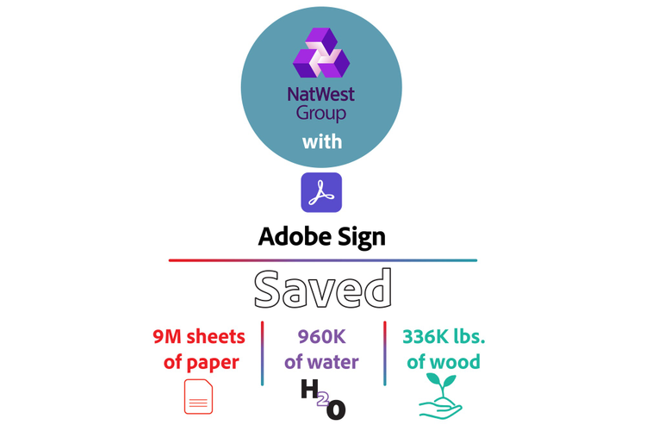
9. Adobe
Adobe systems was the greenest IT company in Newsweek’s 2014 rankings, a well-earned distinction. The company has already made some impressive achievements, including obtaining LEED certification for more than 70 per cent of its workspaces, including retrofitting a historic building in San Francisco.
t also has ambitious goals—including getting to net zero energy consumption and reducing its packaging, packaging being a resource drain and big contributor to plastic pollution.
Adobe was also a corporate leader in reducing its water use to respond to California’s historic drought, even after it had already reduced its water use by more than 60 per cent since 2000 through means like installing environmentally friendly fixtures and landscaping with native plants.

Slide 33
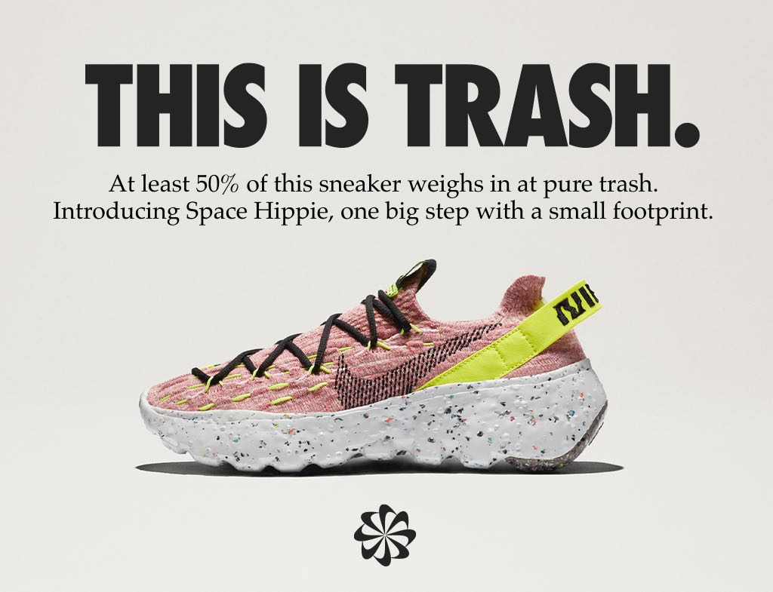
10. Nike
Nike hasn’t always had a stellar record when it comes to corporate sustainability, but they’ve made a lot of change that’s doing a lot of good. Nike topped Morgan Stanley’s list in 2015 of most sustainable clothing and footwear brands. Key to their success is the company’s robust disclosure about its supply chain and production practices. They’re also making it easier for designers to make green choices with an app that helps you compare the environmental footprint of different fabrics. Like, Patagonia, it also uses post-consumer recycled materials in some of its products, including its 2011 World Cup jerseys. It’s also redesigned its boxes to reduce packaging, committed to eliminating chemical discharges, invested in energy efficiency in its factories and more. Nike is also partnering with NASA and other government agencies to spark innovation in chemistry to green the processing of raw materials into goods.

Slide 34
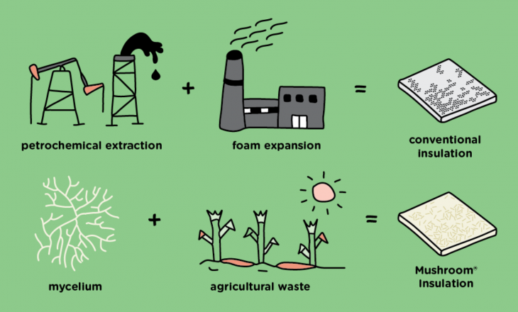
Biodegradable packaging
The way most of us know fungi best is by their mushrooms. For millennia, humans have cultivated a productive relationship with mushrooms: we’ve eaten them for food, benefitted from their medicinal properties, and enjoyed their enchanting forms.
Mycelium is often described as the ‘root structure’ or ‘vegetative state’ of mushrooms. The terms come from plants, but fungi are a wholly separate kingdom of life, distinct from animals, plants, or bacteria. Mycelium does sort of look like roots, with its webbed networks of branching, thread-like cells called hyphae.

Slide 35
Biodegradable packaging
More recently, people have learned to cultivate them at scale under controlled conditions. The company Ecovative is expanding the possibilities of working with mushrooms, with a focus on the networks of mycelia to create durable, sustainable biomaterials.
But mycelial networks are unique, extremely fine, and strong, with high tensile strength and the ability to resist water, decay, and immense internal or external pressures. They come from nature, and under the right conditions, return to the soil as nutrients. In other words, they’re one of nature’s most amazing supermaterials.

Slide 36
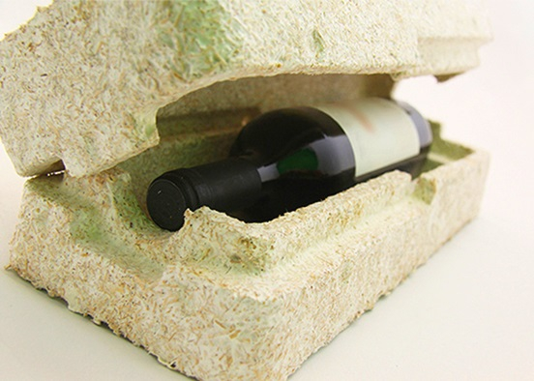
Global Perspective
One company can’t save the planet, which is why Ecovative is teaming up with anyone who sees the value in what they’re growing.
Ideas come from everywhere, so the company developed a partner program that allows anyone with an idea for how to use myco materials to realize their ideas, and put them to use in their own homes, businesses, and communities.
It is their goal to form a global mycelial web of partner producers, to steadily replace numerous unsustainable materials with those that come from nature, and return to nature when their use is through.

Slide 37
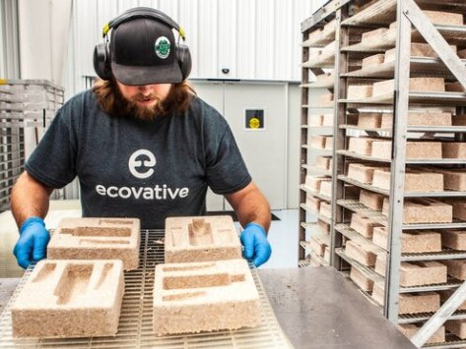
Technology
MycoComposite™
This technology binds mycelium together with shredded plants to form a solid, lightweight material that composts in 45 days after use.
AirMycelium™
AirMycelium is 100% pure mycelium, produced at commercial scale in environmentally controlled, vertically stacked Growth Chambers.
The Mycelium Foundry
Our Foundry services use high throughput screening to quickly develop new mycelium materials at small, pilot, and commercial scales.

Slide 38
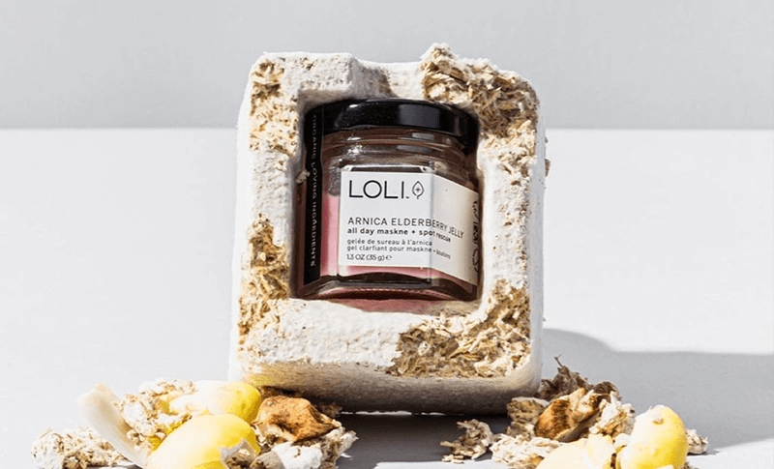
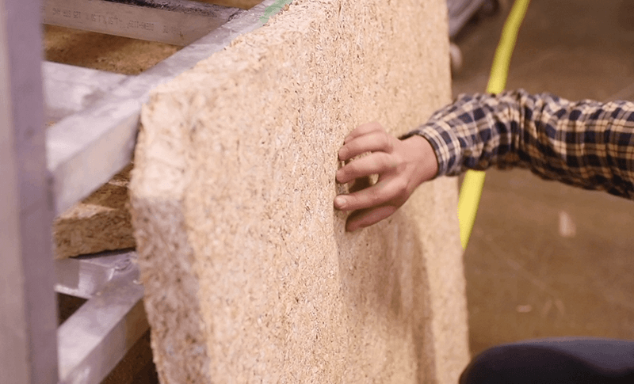
Biodegradable packaging
Building and Construction
Our MycoComposite™ hemp blend is naturally flame-retardant, providing insulation and noise-dampening benefits to any space.
.
Grow It Yourself™ Materials
Anyone can design and grow their own hemp–and–mycelium creations at home with one of our GIY materials.
Mushroom® Packaging
Mushroom® Packaging uses MycoComposite™ to grow fully compostable protective packaging in an endless variety of custom shapes.
Aerated Bed System
With our large format MycoComposite trays, forms can be grown ready to use in products like wetland rafts, door cores, and many others.

Slide 39
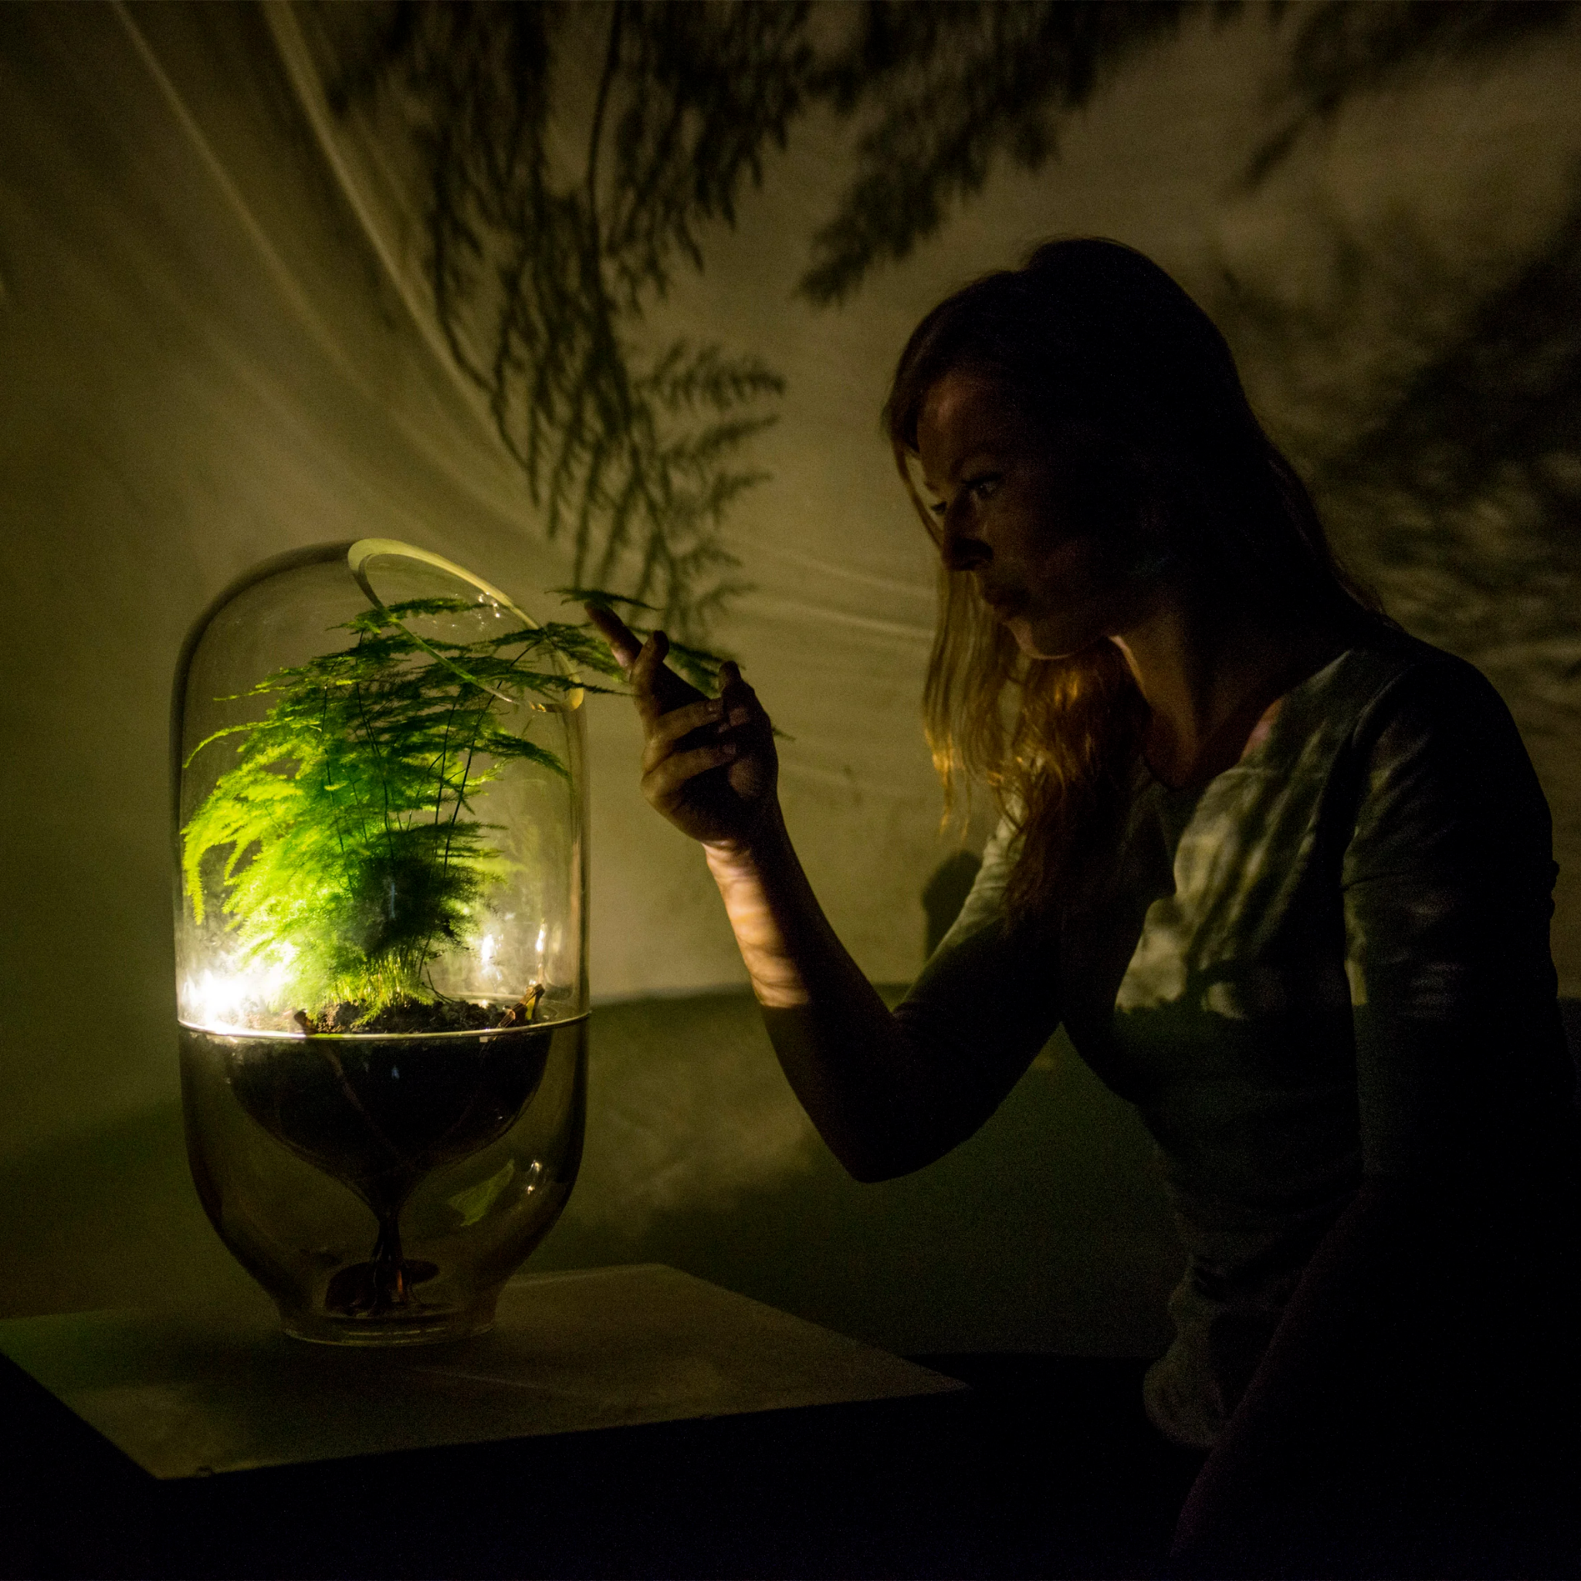
Living Light – Park
Can a city park’s lighting be powered by plants? Yes!
The startup Living Light can transform an everyday urban park into a magical, green, interactive experience.
The experience is based on the Living Light lamp, but suitable for larger scale.
Nova Innova together with Plant-e we developed an interactive system, where electricity-generating plants will react to peoples presence.
Little lights, powered by electricity-generating-plants, will lead one’s way as you walk along. The technology is based on natural processes and is safe for both the plant and the environment. The system is applicable to all sorts of plants that live in moist soil.

Slide 40
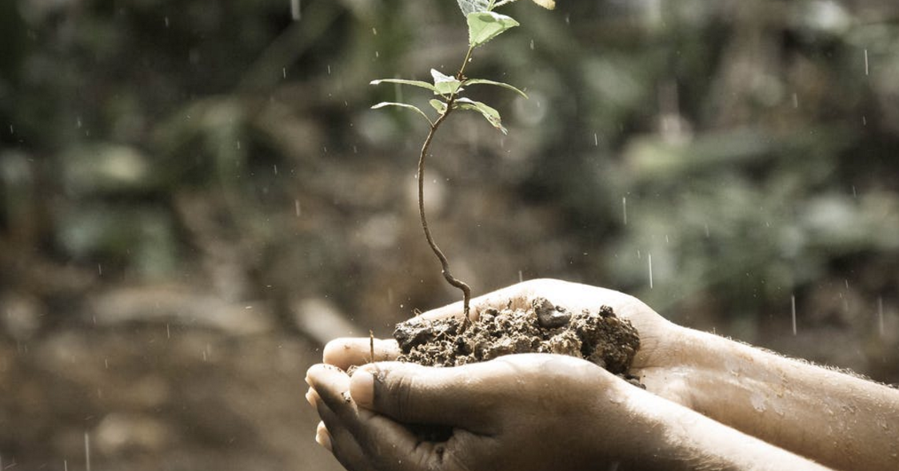
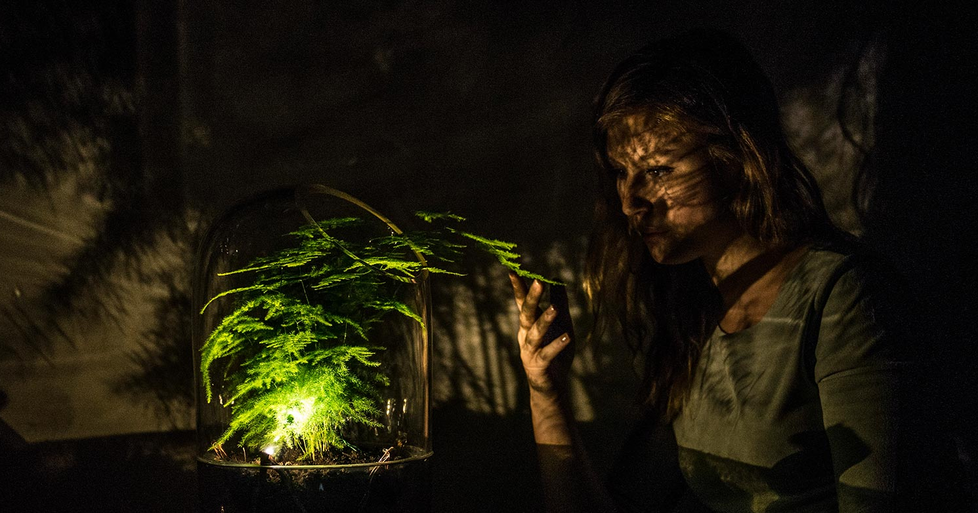
Living Light – how does it work?
Economical value
This system increase a city’s capability to store water, through its water basins and the removement of concrete for green areas. Biodiversity (in a city) is increased, as greenery get an extra economical value.
Reconnecting with nature
This application stimulates the use of more greenery in urban areas and create a stronger connection between people and their surroundings. Nature becomes an inspiring experience for passers-by.

Slide 41
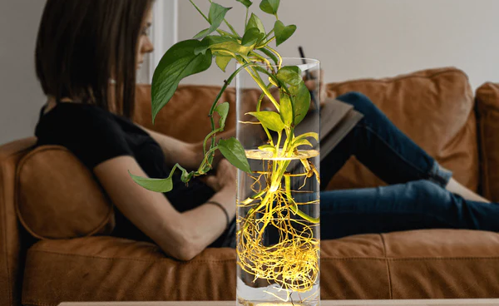
Living Light – how does it work?
CO2 negative energy source
Plant Microbial Fuel Cells are a CO2 negative way to produce sustainable energy, as the plants have the capability to filter the air from CO2.
Infinite
Energy that we can harvest without damaging the natural processes. The waste sources from the plants transform into something valuable. This technology can be used anywhere in the world, the only prerequisite is that the plants live in wet soil.

Slide 42
Summary
Sustainable development is development that meets the needs of the present without compromising the ability of future generations to meet their own needs.
Five simple ways to create a more sustainable future:
Buy from sustainable brands. Many of us are already making a conscious
effort to buy better in order to reduce our carbon footprint.
Support local sustainability charities and initiatives.
Use less energy in the home.
Recycle more.
Part ways with single-use plastic.
Some experts believe we must focus on curbing climate change, which will have positive effects on the other goals as well. Others think education should be the top priority because of its potential to break the cycle of poverty and generate systems change across other urgent areas of global need.

Slide 43
References
/ 10 global companies that are environmentally friendly
/ Biodegradable packages: Ecovative company
/ Living Light project
/ Plastic facts
/ Zero Waste Bulgaria
/ Zero Waste movement
/ The 5 R’s
/ Zero Waste home

Slide 44
Thank you!
@Regio.Digi.Hub

