Slide 1
Promoting Regional Development by building the capacity of the VET system

Slide 2
Adapting to digital communication and being familiar with digital literacy, IT education, Artificial Intelligence

Slide 3
Disclaimer
The European Commission support for the production of this publication does not constitute an endorsement of the contents which reflects the views only of the authors, and the Commission cannot be held responsible for any use which may be made of the information contained therein.
Project Nº: 2021-1-RO01-KA220-VET-000028118

Slide 4
Consortium

Slide 5
01
Digital literacy
02
6 elements of digital capability
03
4 Principles Of Digital Literacy
Content
04
Technology and education:
05
Artificial Intelligence - examples, benefits, types
06
References

Slide 6
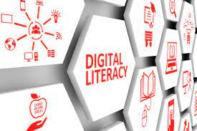
What is digital literacy?
Meaning and importance
Digital literacy means having the skills you need to live, learn, and work in a society where communication and access to information is increasingly through digital technologies like internet platforms, social media, and mobile devices.
Developing your critical thinking skills (PDF, 128 kB) is essential when you're confronted with so much information in different formats – searching, sifting, evaluating, applying and producing information all require you to think critically.

Slide 7
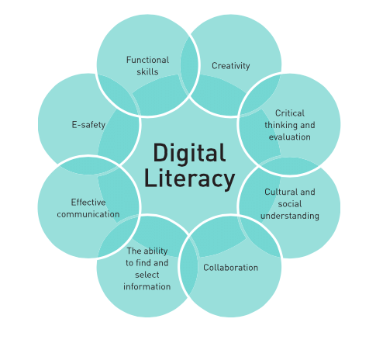
What is digital literacy?
Some aspects
Communication is also a key aspect of digital literacy. When communicating in virtual environments, the ability to clearly express your ideas, ask relevant questions, maintain respect, and build trust is just as important as when communicating in person.
You'll also need practical skills in using technology to access, manage, manipulate and create information in an ethical and sustainable way. It's a continual learning process because of constant new apps and updates, but your future self will thank you if you keep your digital life in order!

Slide 8
What is digital literacy?
Digital literacy is really important in 21-st century.
It'll also be really important in the future when you enter the professional world. In your workplace you'll be required to interact with people in digital environments, use information in appropriate ways, and create new ideas and products collaboratively. Above all, you'll need to maintain your digital identity and wellbeing as the digital landscape continues to change at a fast pace.

Slide 9
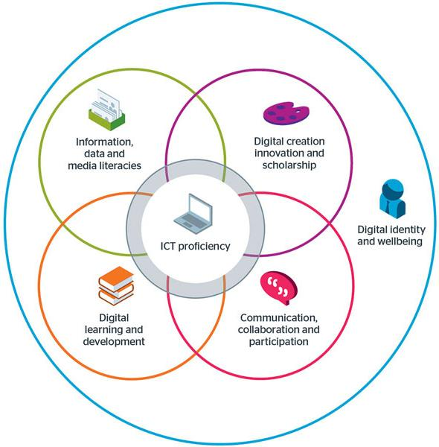
6 elements of digital capability
Here you can learn more about the six elements of digital capability as modelled by Jisc. The Jisc model below illustrates the idea that proficiency in ICT (Information and Communication Technology) is a core element, whilst other skills overlap and build on this capability, and overarching it all is our digital identity and wellbeing.
The framework has most often been used by digital leaders and staff with an overall responsibility for developing digital capability in their organisation. However, it can be used by staff in any role and by students in any educational setting.

Slide 10
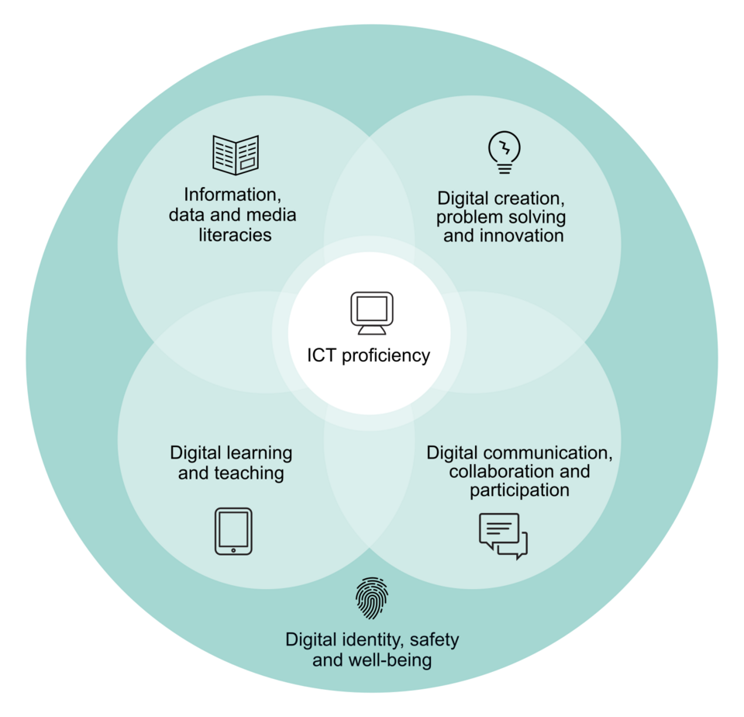
6 elements of digital capability - list
ICT proficiency (Functional skills)
The use of ICT-based devices, applications, software and services.
The use of ICT-based tools to carry out tasks effectively, productively, and with attention to quality
2. Information, data and media literacies (Critical use)
The capacity to find, evaluate, manage, curate, organise and share digital information.
The capacity to collate, manage, access and use digital data
The capacity to critically receive and respond to messages in a range of digital media

Slide 11
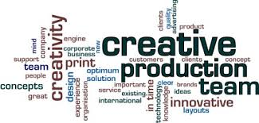
6 elements of digital capability - list
3. Digital creation, problem solving and innovation (Creative production)
The capacity to design and/or create new digital artefacts and materials.
The capacity to use digital evidence to solve problems and answer questions
The capacity to adopt and develop new practices with digital technology
4. Digital learning and development (Development)
The capacity to participate in and benefit from digital learning opportunities;
The capacity to support and develop others in digitally-rich settings

Slide 12
6 elements of digital capability - continued
5. Digital communication, collaboration and participation (Participation)
The capacity to communicate effectively in digital media and spaces;
The capacity to participate in digital teams and working groups;
The capacity to participate in, facilitate and build digital networks;
6. Digital identity and wellbeing (Self-actualising)
The capacity to develop and project a positive digital identity or identities and to manage digital reputation
The capacity to look after personal health, safety, relationships and work-life balance in digital settings

Slide 13
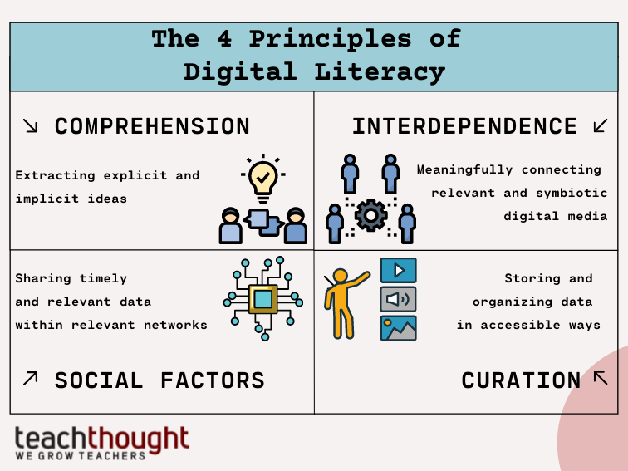
4 Principles Of Digital Literacy
1. Comprehension
The first principle of digital literacy is simply comprehension–the ability to extract implicit and explicit ideas from a media.
2. Interdependence
The second principle of digital literacy is interdependence–how one media form connects with another, whether potentially, metaphorically, ideally, or literally. Little media is created with the purpose of isolation, and publishing is easier than ever before. Due to the sheer abundance of media, it is necessary that media forms not simply co-exist, but supplement one another.

Slide 14
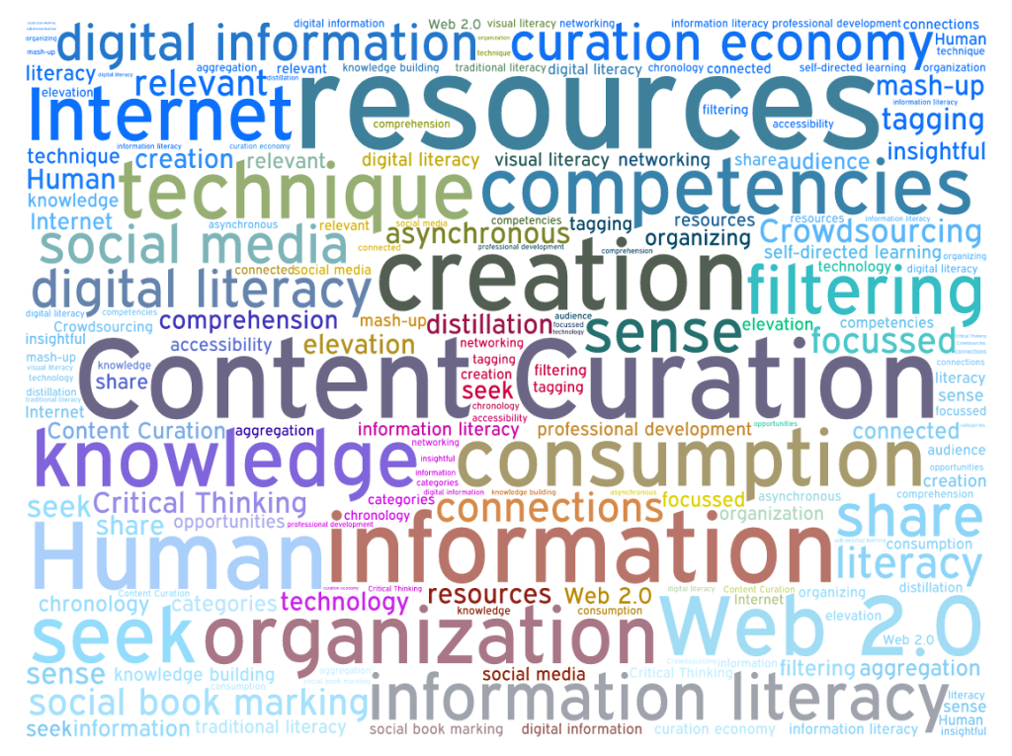
4 Principles Of Digital Literacy
3. Social Factors
Sharing is no longer just a method of personal identity or distribution, but rather can create messages of its own. Who shares what to whom through what channels can not only determine the long-term success of the media, but can create organic ecosystems of sourcing, sharing, storing, and ultimately repackaging media.
4. Curation
Curation involves organizing, storing, and preserving digital data. As not all digital content is created equally, it is important for society to think about what content should be preserved and why. The preservation efforts will entail sorting through to focus on meaningful digital content to curate

Slide 15
The Top 10 Benefits Of Digital Learning
Is Digital Learning The Future?
According to Solutionpath, experts in digital learning, “It is now widely recognized by institutions that digitalization in education is paramount to providing positive learning experiences and student choice, driving future innovation in practice and delivery and, of course, survival in the new digital world as access to education becomes a global service.”
There are several reasons why digital learning is both beneficial to students and educational institutions.
Here are the top 10 of them:
1. Full-Time Access To Materials. 2. Facilitates Collaboration. 3. More Resources. 4. Better Engagement.
5. Personalized Learning. 6. Facilitates New Digital Learning Strategies. 7. Preparation for Work. 8. Building Peer Communities.
9. Boosts Accountability. 10. Student Progress Tracking.

Slide 16
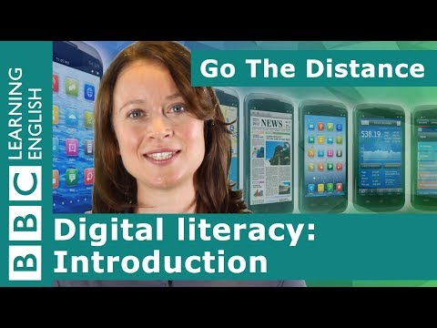
Video: What is digital literacy - summary
With the impact of social media, Digital Literacy skills also now includes a wide range of skills like uploading content on YouTube to sharing things on Facebook.
Especially in the connected, online world we live in today, there are some essential digital literacy skills that we need to achieve our goals and live our day-to-day lives.
Examples of Digital Literacy skills
Using your phone to check emails.
Using an online search engine to find the answer to a question.
Using online search to complete a research project
Creating an online profile on a social media platform

Slide 17
Technology and education: Google Classroom
Google classroom is a Learning Management System (LMS) offered by Google for teachers. This application provides a central location to communicate with students, ask questions, and make assignments.
What can you do with Classroom?
Start a video meeting.
Create and manage classes, assignments, and grades online without paper.
Add materials to your assignments, such as YouTube videos, a Google Forms survey, and other items from Google Drive.
Give direct, real-time feedback.

Slide 18
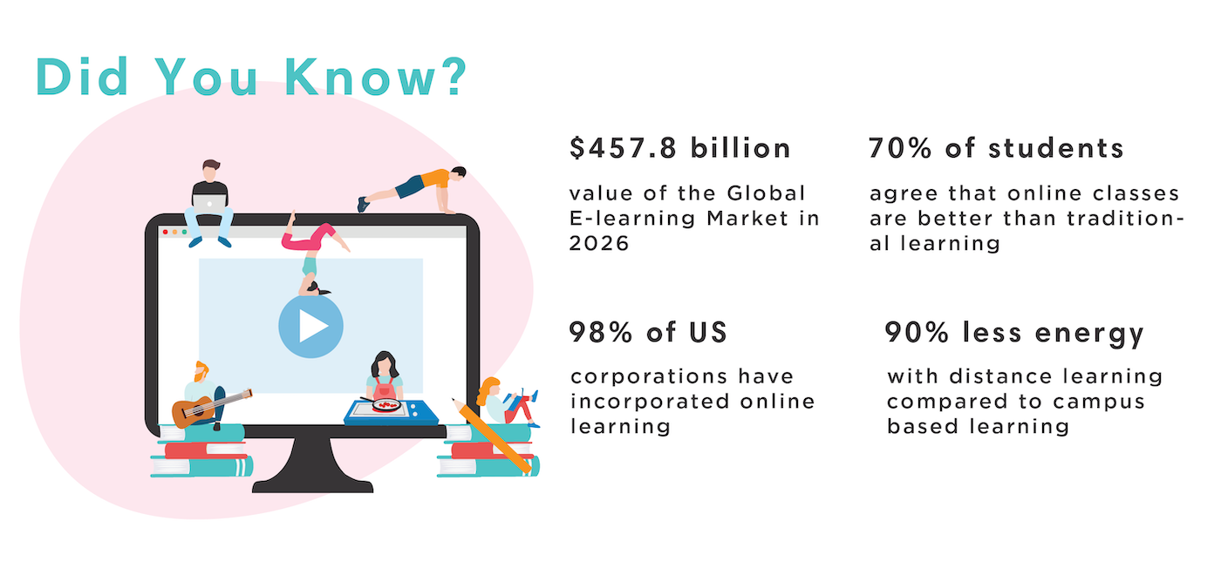
Online Learning Statistics
Top Facts and Stats in 2022
It’s no secret that online learning is becoming more and more popular, with the global elearning industry expected to reach $1 trillion in valuation by 2027. More and more students are transitioning to online learning platforms, whether its graduate students or adult learners looking to upskill and further their career. Enrollment in online learning platforms has risen consistently every year in the last decade, and saw a huge increase due to the Covid-19 pandemic.

Slide 19
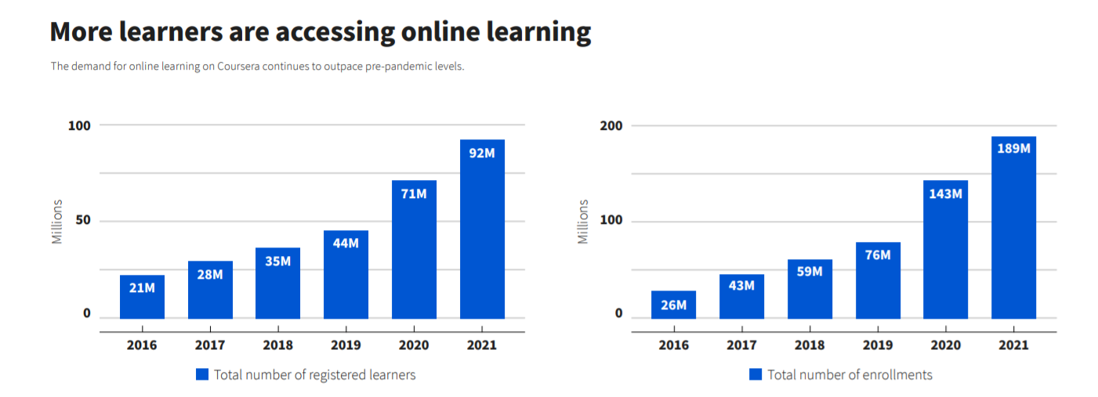
3 charts: global growth in online learning
Online learning platform Coursera has released its 2021 Impact Report, which shows more than 20 million new learners registered for courses in the year - equivalent to total growth in the three years pre-pandemic.
The increase continues an upward trend that predates the pandemic but has since gained momentum.

Slide 20
How digital innovation is improving the lives of deaf and hard of hearing people
Deaf professionals can now book these services remotely, instantly, over a conference or Skype call, and only pay for the time that they use. Suddenly there is a whole raft of new workplace communications that are intuitive and affordable, and can help deaf people to get a job and succeed at work. High tech services that were previously unreachable for most people are now cheap enough to be an ordinary fact of life. The internet has been a huge democratising force in this way, disrupting markets and opening up new opportunities. In workplaces across Britain, deaf people will tell you: there is a quiet revolution underway.

Slide 21
How digital innovation is improving the lives of deaf and hard of hearing people
Here's just one human story to illustrate. Matthew Johnston has been profoundly deaf since birth. He has always worn hearing aids. But when he discovered Ai-Live in his thirties, he decided to join a small private company as a technical director. His main role was meeting potential clients and managing a team of consultants. As most consultants were at the client sites, online captioning was very important for him to be able to keep in touch with them constantly. He is now working for IG, a financial market trading company, and uses both online and onsite captioning constantly. Matthew says, "They have allowed me to further enhance my career prospects and to work more confidently.”

Slide 22
The power of gamification
Case study: How Duolingo Utilises Gamification to Increase User Interest?
“We created Duolingo in 2011 with a mission to develop the best education in the world and make it universally available. I’ve always felt that economic inequality is one of the biggest problems facing humanity, and education is the best way to help most people around the world improve their lives. Our vision is to create a world where more money can’t buy you a better education.” -Luis von Ahn, CEO
Duolingo has grown at an enormous scale, with over 500 million total users and around 40 million monthly active users, representing every country in the world. They offer 98 language courses that teach 39 different languages.
Duolingo is notorious for its constant (and almost over the top) notification bombardment. It has even become such a big meme sensation that Duolingo has written about their notification process in a blog post discussing ‘the AI behind the meme.’
To some, these notifications might be a total hindrance, but to others, it’s that daily piece of encouragement / a friendly nudge to get back amongst their language learning.

Slide 23
Gamification: The Good & Bad
Duolingo have managed to pave quite a solid foundation for crafting a truly engaging, player-centered design. Utilising all eight pillars of the Octalysis Framework, Duolingo provides a sense of purpose, challenge, clear feedback along the way and creates a fun, voluntary way to learn for hose busy language learners out there.
In this video you will see successful and unsuccessful ways of using gamification, including the app Duoligo.

Slide 24
Another gamification example
TimeHeroes is the biggest volunteering platform in Bulgaria. It matches volunteers with causes that need support. One can Find all volunteering causes at one place. It is highly gamified, featuring badges, points, etc. , which encourages users to contribute to meaningful causes. The platform is a great example of using technology for a higher good.
How does it work?
Points and badges accumulate according to mysterious rules (the element of surprise). But it won't hurt to support many missions, upload photos and stories about how they went (after each mission one receives an mail), invite friends to share their talents on the site, and so on. Like be a real hero.

Slide 25
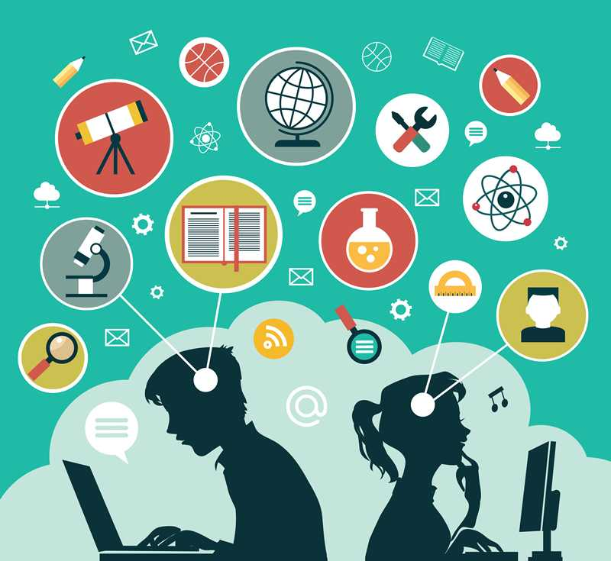
Summary
Digital Literacy is about being able to make sense of digital media. This occurs through meaningful and sustainable consumption and curation patterns that improve an individuals potential to contribute to an authentic community. This includes the ability to analyze, prioritize, and act upon the countless digital media 21st century citizens encounter on a daily basis.
Digital literacy is an ever more important factor in education from a young age.Digital literacy in education, students must develop specific digital literacy skills when reading and interacting with online content that may contain embedded resources such as hyperlinks, audio clips, graphs, or charts that require students to make choices. Students today are also being asked to go one step further to create, collaborate, and share digital content and to do so responsibly. For these reasons teachers need to understand the importance of digital literacy skills for students and teaching digital literacy in the classroom.

Slide 26
Artificial Intelligence

Slide 27
What is Artificial Intelligence?
Artificial intelligence leverages computers and machines to mimic the problem-solving and decision-making capabilities of the human mind.
What are the main artificial intelligence?
Artificial intelligence is the simulation of human intelligence processes by machines, especially computer systems. Specific applications of AI include expert systems, natural language processing, speech recognition and machine vision.

Slide 28
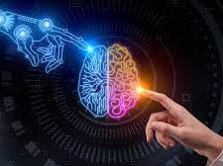
Types of Artificial Intelligence
1. Purely Reactive
These machines do not have any memory or data to work with, specializing in just one field of work. For example, in a chess game, the machine observes the moves and makes the best possible decision to win.
2. Limited Memory
These machines collect previous data and continue adding it to their memory. They have enough memory or experience to make proper decisions, but memory is minimal. For example, this machine can suggest a restaurant based on the location data that has been gathered.

Slide 29
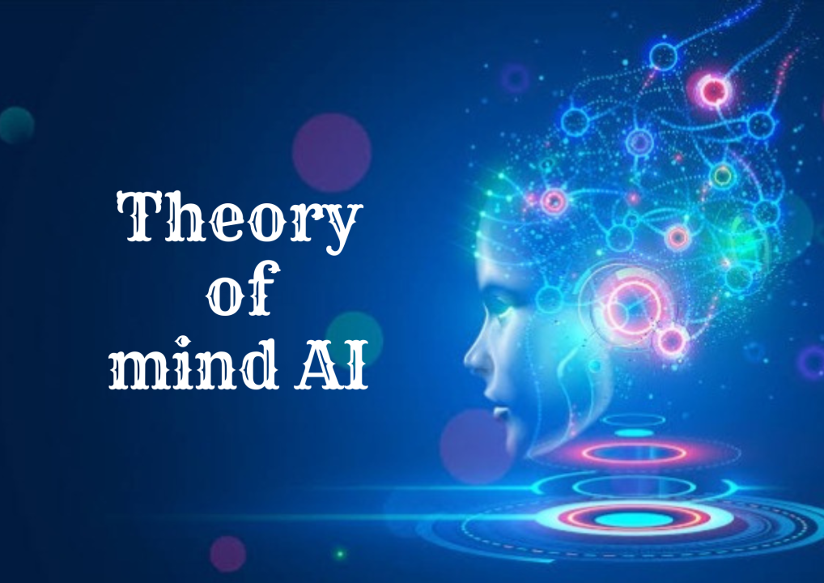
Types of Artificial Intelligence
3. Theory of Mind
This kind of AI can understand thoughts and emotions, as well as interact socially. However, a machine based on this type is yet to be built.
4. Self-Aware
Self-aware machines are the future generation of these new technologies. They will be intelligent, sentient, and conscious.

Slide 30
How Does Artificial Intelligence Work?
Put simply, AI systems work by merging large with intelligent, iterative processing algorithms. This combination allows AI to learn from patterns and features in the analyzed data. Each time an Artificial Intelligence system performs a round of data processing, it tests and measures its performance and uses the results to develop additional expertise.

Slide 31
How is AI used in the real world?
AI, or artificial intelligence, is used in the real world in many ways. Firstly, in professional life it has become an invaluable tool for marketers, analysts, bankers, engineers and more. In our personal lives, it powers the virtual assistant smart speakers people have at home, shapes the recommendations we get when shopping online or listening to music, and more.

Slide 32
What is machine learning?
Machine learning is the most well-known type of artificial intelligence. It is used in everything from self-driving cars to marketing software. At its core, it’s about teaching computers to program themselves to make decisions or perform actions based on its existing knowledge. Several examples of AI in everyday life use machine learning, such as smart thermostats like Nest and transportation apps such as Uber.

Slide 33
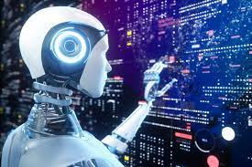
What does AI change?
Artificial intelligence (AI) is changing business as we know it, but what many people don’t realize — or at least don’t think about — is how AI is also impacting our lives outside of the office.
Experts regard artificial intelligence as a factor of production, which has the potential to introduce new sources of growth and change the way work is done across industries. For instance, this PWC article predicts that AI could potentially contribute $15.7 trillion to the global economy by 2035. China and the United States are primed to benefit the most from the coming AI boom, accounting for nearly 70% of the global impact.
Next we consider some examples of artificial intelligence in everyday life, so we can see how the technology is impacting our personal world each day.

Slide 34
5 Examples of AI In Our Everyday Lives

Slide 35
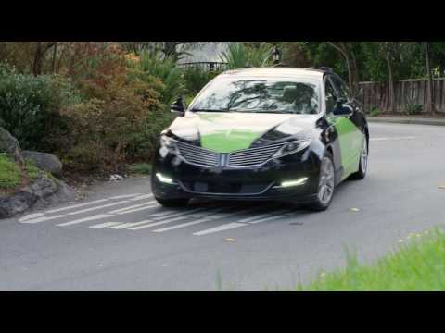
1. Self-Driving and Parking Vehicles
Self-driving and parking cars use deep learning, a subset of AI, to recognize the space around a vehicle. Technology company Nvidia uses AI to give cars “the power to see, think, and learn, so they can navigate a nearly infinite range of possible driving scenarios,” Nvidia explains on its website.
The company’s AI-powered technology is already in use in cars made by Toyota, Mercedes-Benz, Audi, Volvo, and Tesla, and is sure to revolutionize how people drive — and enable vehicles to drive themselves.

Slide 36
2. Digital Assistants
Apple’s Siri, Google Now, Amazon’s Alexa, and Microsoft’s Cortana are one of the main examples of AI in everyday life. These digital assistants help users perform various tasks, from checking their schedules and searching for something on the web, to sending commands to another app.
AI is an important part of how these apps work because they learn from every single user interaction. This allows them to better recognize speech patterns and serve users results that are tailored to their preferences. Microsoft says that Cortana “continually learns about its user” and that it will eventually anticipate user needs.

Slide 37
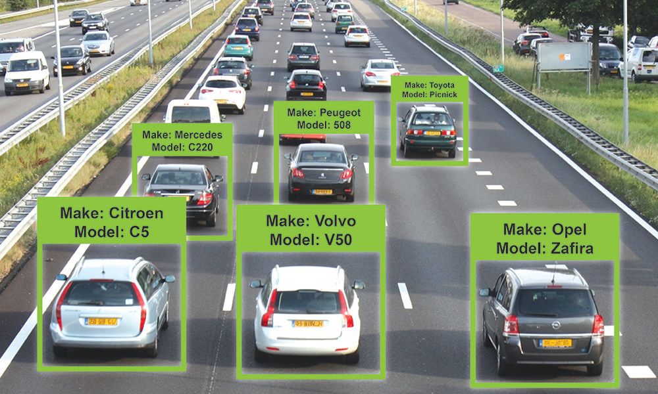
3. Vehicle Recognition Identification
Companies such as PlateSmart, IntelliVision, and Sighthound, among others, use computer vision — a form of AI that can see and understand images — along with deep learning to turn conventional surveillance into vehicle monitoring.
This is a very important part of integrated traffic systems and a big help to authorities as well, as surveillance videos are now searchable for specific plate numbers. That’ll make you think twice about blowing through that red light.

Slide 38
4. Robot vacuums
We all have to clean, right? So, robot vacuums are a great example of AI affecting everyday life. The Roomba 980 model vacuum (the one that cleans your floor on its own) uses AI to scan a living area’s size, look for objects that might be in the way, and remember the best route for cleaning the carpet.
The vacuum bot can also identify how much cleaning it needs to do based on the size of the room, repeating a cleaning cycle three times in smaller rooms or cleaning twice in a medium-sized room.

Slide 39
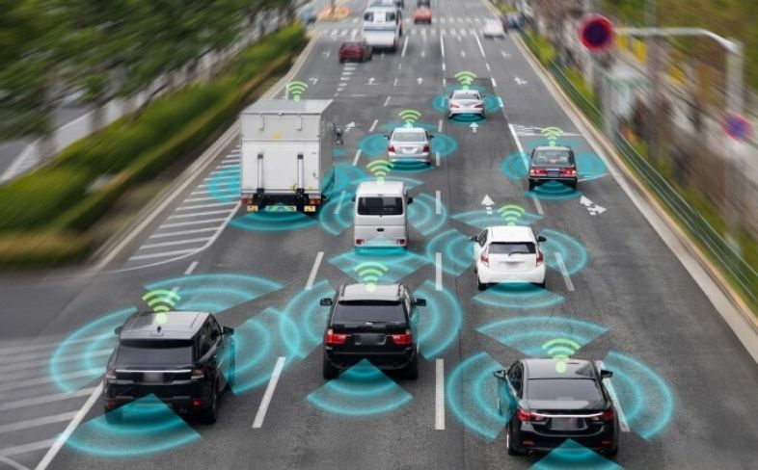
5. Transportation
Machine learning, another subset of AI, powers some of the magic that happens inside of apps like Uber.
“[AI and machine learning] are critical to supporting Uber’s mission of developing reliable transportation solutions for everyone, everywhere,” the company explains on its Uber Engineering site. “… We use ML to enable an efficient ride-sharing marketplace, identify suspicious or fraudulent accounts, suggest optimal pickup and drop-off points, and even facilitate more delicious UberEATS delivery by recommending restaurants and predicting wait times so your food can get to you when you need it.”

Slide 40
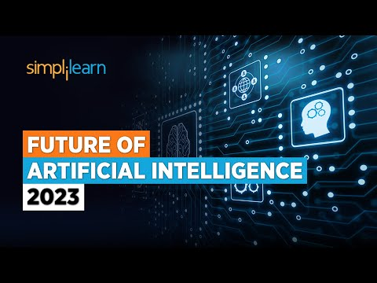
Future of AI | Future of Artificial Intelligence 2023
Conclusion
So, there we have it. Across these examples of artificial intelligence, we can see that AI is becoming a part of everyday life. We’ve looked at how it has pioneered the development of self-driving cars, which may be some way off today but feels like an inevitable part of the future.
We’ve explored the digital assistants that sit within powerful, compact speakers — and how the AI within them helps to keep us informed, not to mention organized. We’ve seen how it’s helping us to be smarter about our energy use with Nest thermostats and shaping our soundtracks with Spotify. It feels like when it comes to everyday life, artificial intelligence is here to stay.

Slide 41
References
/ What is digital literacy?
/ 6 elements of digital capability
/ 4 Principles Of Digital Literacy
/ Digital literacy in the classroom
/ Online Learning Statistics
/ 3 charts: global growth in online learning
/ The Top 10 Benefits Of Digital Learning
/ How digital innovation is improving the lives of deaf and hard of hearing people

Slide 42
References
/ Duolingo and gamification - a case study
/ TimeHeroes: volunteering made easy… and fun
/ 5 Examples of AI In Our Everyday Lives
/ What is Artificial Intelligence: Types, History, and Future

Slide 43
Thank you!
@Regio.Digi.Hub

