Slide 1
Promoting Regional Development by building the capacity of the VET system

Slide 2
Social-environmental – CSR,
Sustainable consumption, Ecological footprint, Social Enterprises

Slide 3
Disclaimer
The European Commission support for the production of this publication does not constitute an endorsement of the contents which reflects the views only of the authors, and the Commission cannot be held responsible for any use which may be made of the information contained therein.
Project Nº: 2021-1-RO01-KA220-VET-000028118

Slide 4
Consortium

Slide 5
01
Digital and Green Transformation - Definitions
02
Social-environmental – CSR
03
Sustainable consumption
Contetns
04
Ecological footprint
05
Social Enterprises
06
Articles, Bibliography

Slide 6
Introduction
Digital Transformation - Definition
Digital and green transformation involves the integration of digital technology in all areas of a business and will result in fundamental changes in the way businesses operate and in the way they deliver value to customers, while increasing the competitiveness of industrial sectors, impacting not only the private sector, but also the public sector, including agencies and organizations.

Slide 7
Introduction
Green Transformation - Definition
Green transformation is one of the essential processes in the further development of the world that involves the development of green technologies and the creation of legal regulations to impose, for example, energy saving or the reduction of greenhouse gas emissions, as well as any other activities aimed at changing attitudes society towards the acceptance of innovative technological solutions and legal norms for a friendly environment. Thus, the green transformation can be defined as combining economic growth with care for the environment to guarantee a high quality of life for present and future generations at a level that can be reached thanks to civilizational development, as well as the efficient and rational use of available resources.

Slide 8
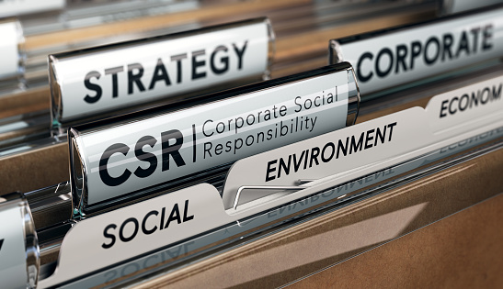
Social-environmental – CSR
What is CSR?
Corporate social responsibility is a way of sustainable development through which companies choose to treat environmental and social issues as integral parts of business operations.
In the relations between companies and the community, social responsibility is mutually beneficial. On the one hand, it generates profit for companies, and on the other hand, it provides support to disadvantaged groups or communities and participates in local development.

Slide 9
Video - What is Corporate Social Responsibility (CSR)?
C = Corporate (Bussiness)
S = Social (People + Enviorement)
R = Responsibility (Things you have to do)
CSR is not only Risk Management
CSR aims:
To identify and improve of impact on society and environment
to improve the image of the brand
to differentiate themselves from competitors
To increase the employee satisfaction
https://www.youtube.com/watch?v=T317juXMaBs
Succefull Ways for Enganging in CSR
Better living conditions
Education
Saving the environment
Health Services

Slide 10
Principles of corporate social responsibility
In 2007, the International Organization for Standardization (ISO) launched the initiative to standardize the widely used concept of social responsibility, developing a standard with international applicability - ISO 26000
This standard is useful to all private or public organisations, large or small, and details how they can support the communities in which they operate.
The standard defines seven principles of social responsibility, which aim at:
the responsibility that the organization has on society, on the economy, the impact on the environment, the transparency of the organization's decisions and activities;
ethical behavior;
respect for the interests of stakeholders,
respect for the rule of law,
respect for human rights.

Slide 11
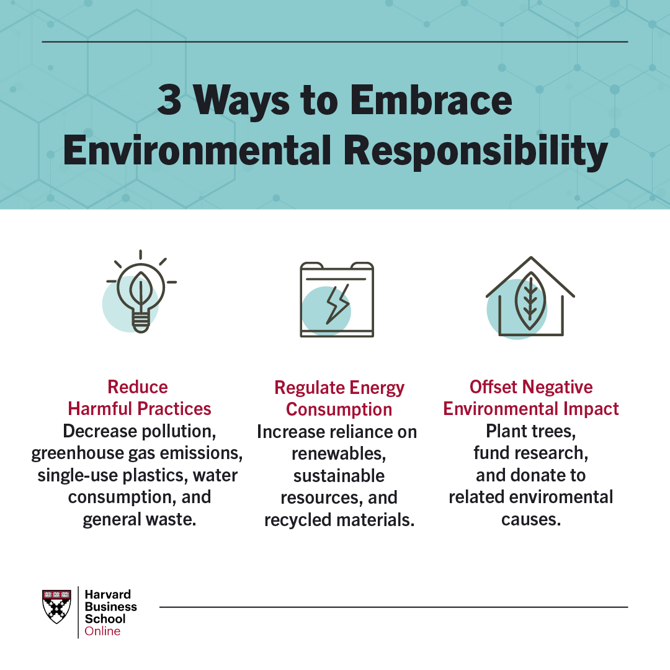
TYPES OF CORPORATE SOCIAL RESPONSIBILITY
Corporate social responsibility is traditionally broken into four categories: environmental, philanthropic, ethical, and economic responsibility.
1. Environmental Responsibility
Environmental responsibility refers to the belief that organizations should behave in as environmentally friendly a way as possible. It’s one of the most common forms of corporate social responsibility. Some companies use the term “environmental stewardship” to refer to such initiatives.
Companies that seek to embrace environmental responsibility can do so in several ways:
Reducing harmful practices, such as decreasing pollution, greenhouse gas emissions, the use of single-use plastics, water consumption, and general waste
Regulating energy consumption by increasing reliance on renewables, sustainable resources, and recycled or partially recycled materials
Offsetting negative environmental impact; for example, by planting trees, funding research, and donating to related causes

Slide 12
TYPES OF CORPORATE SOCIAL RESPONSIBILITY
2. Ethical Responsibility
Ethical responsibility is concerned with ensuring an organization is operating in a fair and ethical manner. Organizations that embrace ethical responsibility aim to practice ethical behavior through fair treatment of all stakeholders, including leadership, investors, employees, suppliers, and customers.
Firms can embrace ethical responsibility in different ways. For example, a business might set its own, higher minimum wage if the one mandated by the state or federal government doesn’t constitute a “livable wage.” Likewise, a business might require that products, ingredients, materials, or components be sourced according to free trade standards. In this regard, many firms have processes to ensure they’re not purchasing products resulting from slavery or child labor.
3. Philanthropic Responsibility
Philanthropic responsibility refers to a business’s aim to actively make the world and society a better place.
In addition to acting as ethically and environmentally friendly as possible, organizations driven by philanthropic responsibility often dedicate a portion of their earnings. While many firms donate to charities and nonprofits that align with their guiding missions, others donate to worthy causes that don’t directly relate to their business. Others go so far as to create their own charitable trust or organization to give back and have a positive impact on society.

Slide 13
TYPES OF CORPORATE SOCIAL RESPONSIBILITY
4. Economic Responsibility
Economic responsibility is the practice of a firm backing all of its financial decisions in its commitment to do good in the areas listed above. The end goal is not to simply maximize profits, but make sure the business operations positively impact the environment, people, and society.

Slide 14
WHAT ARE THE BENEFITS OF CORPORATE SOCIAL RESPONSIBILITY?
Most firms are driven to embrace corporate social responsibility due to moral convictions, and doing so can bring several benefits and important social change.
Corporate social responsibility initiatives can, for example, be a powerful marketing tool, helping a company position itself favorably in the eyes of consumers, investors, and regulators. CSR initiatives can also improve employee engagement and satisfaction—key measures that drive retention. Such initiatives can even attract potential employees who carry strong personal convictions that match those of the organization.
Finally, corporate social responsibility initiatives, by their nature, force business leaders to examine practices related to how they hire and manage employees, source products or components, and deliver value to customers.
This reflection can often lead to innovative and groundbreaking solutions that help a company act in a more socially responsible way and increase profits. Reconceptualizing the manufacturing process so that a company consumes less energy and produces less waste, for example, allows it to become more environmentally friendly while reducing its energy and materials costs—value that can be reclaimed and shared with both suppliers and customers.

Slide 15
CSR in Europa
The number of companies reporting on their CSR efforts in Europe is likely to continue to increase in 2022. The EU Non-Financial Reporting Directive and the EU Action Plan on Sustainable Finance both aim to encourage companies to report on their environmental, social and governance (ESG) performance.
According to a report by the Global Reporting Initiative (GRI), the number of companies in Europe that reported using the GRI Standards increased by 9% in 2020, with a total of 7,851 companies reporting using the GRI Standards, which is the most widely used framework for sustainability reporting. Additionally, a study by the Sustainability Accounting Standards Board (SASB) found that the number of companies in Europe disclosing information on their sustainability performance using SASB standards has also increased.
In conclusion, more and more companies in Europe are expected to report on their CSR performance in 2022 due to the EU regulations and frameworks that encourage sustainability reporting. The number of companies that report using GRI Standards and SASB standards are also expected to increase.

Slide 16
GRI Standards
The Global Reporting Initiative (GRI) Standards are a set of sustainability reporting guidelines that provide a framework for companies to report on their economic, environmental, and social performance. The GRI Standards are widely used around the world and are considered to be the most widely used sustainability reporting framework.
The GRI Standards are organized into three main categories: Economic, Environmental, and Social. Within each category, there are specific performance indicators that companies can use to report on their performance. The Standards also include guidelines for how to report on each indicator, as well as how to disclose any material aspects of sustainability performance.
The GRI Standards are designed to be flexible and can be used by companies of all sizes and industries. They are also designed to be compatible with other reporting frameworks, such as the Integrated Reporting Framework and the Sustainability Accounting Standards Board (SASB) Standards.
One of the advantages of using GRI Standards is that it gives companies a common language for discussing and reporting on their sustainability performance, which makes it easier for stakeholders to understand and compare performance across different companies and sectors. This increases transparency and accountability of companies in their performance and makes it easier for stakeholders to make informed decisions.

Slide 17
Video - Sustainability reporting with the GRI Standards
GRI Sustainability Reporting Standards, the first global standards for sustainability reporting.
The GRI Standards enable all organizations to report publicly on their economic, environmental and social impacts and demonstrate their contributions - positive or negative - to the goal of sustainable development.
Developed by the Global Sustainability Standards Board – an independent standard-setting body – the GRI Standards are based on years of expert input from diverse stakeholders.
The Standards are global best practice and create a common language for sustainability reporting.
https://www.youtube.com/watch?v=6LkrhalWIMc

Slide 18
Examples of European Companies with good Corporate Social Responsability
Ikea: The furniture giant has a strong commitment to sustainability and has set ambitious goals to reduce its environmental impact, such as sourcing 100% of its energy from renewable sources by 2020.
Unilever: The consumer goods company has a number of initiatives in place to promote sustainability and improve the lives of the communities in which it operates.
Nestle: The food and beverage company has a number of sustainability initiatives in place, including a commitment to sourcing 100% of its agricultural raw materials sustainably by 2020.
Danone: The food company has a strong commitment to sustainability and is actively involved in a number of initiatives to promote sustainable agriculture and improve the lives of communities in its supply chain.
Novo Nordisk: The healthcare company has a number of initiatives in place to promote sustainability and improve the lives of the communities in which it operates.
Triodos Bank: The bank is known for its commitment to ethical banking and has a number of initiatives in place to promote sustainability and support sustainable development.
Interface: The company is a global leader in sustainable flooring and has a number of initiatives in place to promote sustainability and reduce its environmental impact.

Slide 19
Sustainable Consumption
What is Sustainable Consumption?
A simplistic definition - Sustainable consumption is the concept of consuming resources and products in a sustainable, responsible way, so they can meet our needs now and in the future, without creating a negative environmental impact.
A definition from the perspective of the final consumer - Sustainable consumption means achieving sustainable consumer behavior. It's about thinking and acting with the environment in mind when we, as end consumers, consume, buy and throw away. It's about adopting sustainable values upstream to make consumption choices that reduce waste generation and environmental impact.

Slide 20
How we can contribute to sustainability and responsible consumption
The first thing you should do is question your own consumption. There are already a lot of things in our daily lives that we can make more sustainable and thus make a difference.
Fast fashion, cheap meat and plastic products are a burden on nature and, in the long run, on your wallet. Even if the low prices seem tempting at first, in the long run you don't get cheap, because you have to constantly buy more.
Those who opt for better quality, fair production conditions and support the local economy leave their ecological footprint and actively do something for sustainability, social equity and ultimately their own well-being.
Too much clutter can be a burden. So: shop responsibly, get informed and rethink your own diet and the way you deal with clothes and other things.
Instead of spending your money on every supposed deal and special offer, save for something meaningful. This could be, for example, a vacation with loved ones, a nice activity, or supplies for later.

Slide 21
Reaching sustainable consumption in Europe by 2050
Reaching sustainable consumption in Europe by 2050 is an ambitious goal, but it is achievable. The main challenge lies in changing the current unsustainable lifestyle of Europeans. To do this, there needs to be a shift in attitudes and policies towards sustainable consumption.
The first step is to reduce consumption of energy and resources. Governments need to implement more stringent energy efficiency standards and incentives for energy-saving devices and appliances, such as LED lighting, solar panels, and electric vehicles. Additionally, the implementation of renewable energy sources and energy storage systems should be prioritized.

Slide 22
Reaching sustainable consumption in Europe by 2050
Second, there needs to be a shift in consumer behavior. This can be achieved through public awareness campaigns, educational programs, and incentives for sustainable consumption. Consumers should be encouraged to buy locally produced food and products, reuse and recycle as much as possible, and reduce their consumption of single-use and disposable products.
Third, governments need to provide financial and regulatory support to businesses and organizations that are transitioning to more sustainable practices. This includes incentives for companies that invest in renewable energy and energy-efficient products, as well as the promotion of circular and sharing economies.
Finally, there should be a focus on sustainable development goals, such as reducing inequality and poverty, improving health and well-being.

Slide 23
Ecological Footprint
What is Ecological Footprint?
The Ecological Footprint simply indicates the amount of pressure people put on the natural resources available in their surroundings.
The Ecological Footprint is a method that determines how dependent people are on natural resources. It is a measure of how many environmental resources are needed to support a certain way of life or business.
The most common unit of measurement for the ecological footprint is expressed in global hectares (gha) and allows professionals to determine the land area needed by each person to sufficiently meet their needs.
Ecological footprint is commonly used to calculate the sustainability of an entity such as a region, person or business.
It can also be expressed as the amount of resources consumed. First introduced in 1992 by William Rees, the idea of calculating ecological footprints is designed to assess the environmental impact of human activities, allowing analysts to determine the rate at which humans consume resources and generate waste.

Slide 24
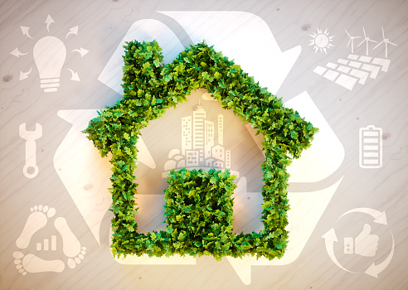
Ecological Footprint
Ecological Footprint or Carbon Footprint?
The carbon footprint takes into account all greenhouse gases and is used to assess the impact of human activities on the environment. The carbon footprint can be individual, for a country or global.
These indicators, ecological footprints and carbon footprints, are two different ways of educating people about their impact on the environment and encouraging them to change their habits, act against global warming and reduce their greenhouse gas emissions greenhouse.

Slide 25
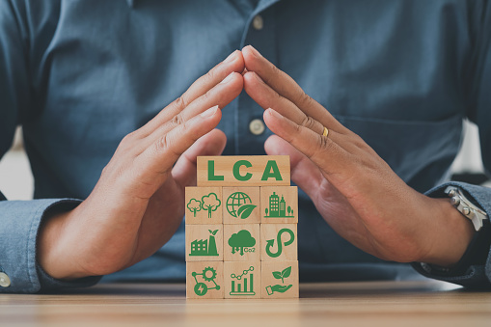
Ecological Footprint
How is the Global Ecological Footprint calculated and measured?
The ecological footprint calculation takes into account the following two factors:
Biocapacity of the Earth, that is the ability of the planet to produce resources;
Human activity and its ecological impact, that is the resources consumed by humans and their waste.
The resources consumed by each individual are subtracted from the resources generated by the planet during a year. The ecological footprint is measured in global hectares. On average, a European would need 4.5 hectares, while a North American would need 6.6 hectares and an African 2.7 hectares.
The results of this calculation on a global scale show that the planet's capacity to meet the needs of its inhabitants is insufficient.

Slide 26
Ecological Footprint
How to reduce your ecological footprint?
A significant part of the ecological footprint is due to greenhouse gas emissions from human activity. In fact, the ecological footprint of individuals predominantly depends on their lifestyle.
To limit greenhouse gas emissions and thereby reduce the ecological footprint, it is imperative to change people's lifestyles by adopting simple habits:
Reduce meat consumption;
Recycle and give new life to materials;
Optimize your energy consumption;
Opt for a green energy company;
Produce your own energy;
Move sustainably...

Slide 27
Ecological Footprint
The positive environmental stories from 2022
The EU has approved a €28 billion German renewable energy scheme
The policy is aimed at rapidly expanding use of wind and solar power. It is designed to deliver Germany's target to produce 80 per cent of its electricity from renewable sources by 2030. Replacing an existing renewables support scheme, it runs until 2026.
New EU plastic waste ban could mark the end of miniature hotel toiletries
The EU may ban miniature hotel toiletries and single-use food containers in its battle against wasteful packaging.
The proposal is part of the European Green Deal, an EU-wide plan to reach net zero by 2050, separate economic growth from resource use, and promote a circular economy.
In Europe, each person generates almost 180 kg of packaging waste on average every year. Packaging is one of the main culprits, accounting for 40 per cent of plastics and 50 per cent of paper used in the EU.

Slide 28
Ecological Footprint
The positive environmental stories from 2022
Solar power in Europe is set to grow by almost 50% in 2022, according to a new report from industry group SolarPower Europe.
It reveals that the EU installed a record 41.4 GW of solar this year - enough to power the equivalent of 12.4 million homes. This is a 47% increase from the 28.1 GW installed in 2021.
Replacement of plastic packaging
The founders of London-based start-up Notpla won the Earthshot Award in the 'Build a Waste-Free World' category, receiving £1m (€1.2m) for creating an alternative to plastic bags made from algae and plants.
The product is completely natural, completely biodegradable and can be used to make a wide range of packaging, from bubble wrap to retain liquid to liners for food containers.

Slide 29
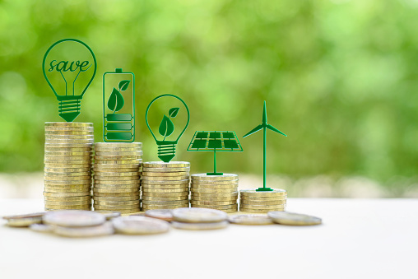
The social economy and social enterprises in Europe
In the European Union, the social economy already has a tradition, also being found under various other names such as the solidarity economy or the third sector, having wide recognition both in the member states and at the level of the European institutions.
The social economy has developed starting from a mainly cooperative historical tradition and enjoying recognition from the public authorities who have adopted special laws and have long institutionalized support and collaboration relations with this sector primarily in southern European countries: France, Spain and Portugal, but also in Belgium, and more recently in Greece and Romania.
This sector includes cooperatives, mutual societies, non-profit associations, foundations and social enterprises that carry out economic activities, offer a wide range of products and services in the European single market and generate millions of jobs. These constitute the main institutional components of the social economy, being sometimes also known as social economy organizations or enterprises.

Slide 30
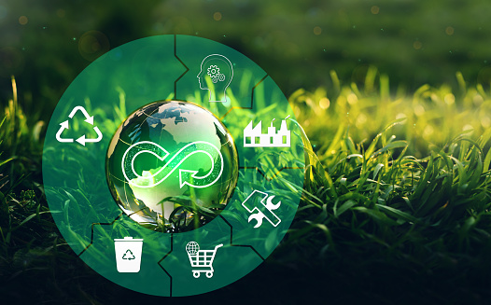
The social economy and social enterprises in Europe
The concept of social economy, which originally appeared in policies related to enterprises or the associative world, was more recently joined by the concept of social enterprise, after the success recorded since the 90s in Italy - the country that legislated the first form of social enterprise, respectively the social cooperative.
The concept of social enterprise emphasizes the entrepreneurial character of these entities and the main existence of an economic activity dedicated to a social mission.
Social cooperatives and part of the social enterprises, namely those of insertion through the economic activity of disadvantaged workers, in the states with tradition, are integrated into the devices of public welfare policies, as providers of social services and employment of disadvantaged workers .

Slide 31
The social economy and social enterprises in Europe
The social economy represents 10% of all European enterprises, respectively 2 million enterprises.
This social economy is part of the European social and welfare model that includes the necessary mechanisms for this sector to generate a high level of services, including social services of general interest, products and jobs.

Slide 32
What is a Social Enterprise? A Gold Medal Winning Business Model.
Because there is no legal definition of what a social enterprise is and where it fits in the pantheon of business organizations, in this video the Olympic rings are used for didactic purposes for the most suggestive explanations.
Video Reference here: https://www.youtube.com/watch?v=qXesPpXYHXo

Slide 33
Social Enterprise
What is a Social Enterprise?
A social enterprise is a business designed around a core altruistic mission, which in turn influences how it’s managed, from product development to branding, from supply chain management to financial planning.
Instead of a single bottom line focused on earnings, many social enterprises measure success based on a triple bottom line:
People. The human impact of your business, and your ability to affect social change, improve lives, and develop a community in a sustainable way.
Planet. Your environmental impact—how you contribute to a sustainable planet or reduce the carbon footprint (CO2 emissions) of your business and customers.
Profit. Like traditional businesses, social enterprises need to make money in order to sustain themselves, pay workers, and grow as an enterprise.

Slide 34
Social Enterprise
What is a Social Enterprise?
Unlike a traditional business where profit is reinvested into the business for the sake of its own growth, a social enterprise allocates a large portion of its profits to create positive change in the world.
Social enterprises are not necessarily the same as companies with corporate social responsibility (CSR) policies. “Doing good” isn’t a value-add for social enterprises. It’s the core value prop and the mission they organize themselves around.

Slide 35
Social Enterprise
The different types of social entrepreneurship
The different models you can adopt as a social entrepreneur include:
Nonprofit. A tax-exempt, non-business entity that invests excess funds back into the mission.
Co-operative. A business organized by and for its members. Credit unions and community grocery stores are some examples of co-ops.
Social purpose business. These businesses start on the foundation of addressing a social mission.
Social firm. Social firms employ those in the community who need jobs, such as at-risk youth.
Socially responsible business. These companies support social missions as a part of their day-to-day business operations.
For-profit. Perhaps the vaguest category, these businesses are profit-first but donate funds, raise awareness, or otherwise support causes.
Arguably the most common social enterprise model is donating a portion of profits to a charity, but that’s not all there is to building an effective social enterprise.

Slide 36
Social Enterprise
The benefits of building a social enterprise
A social enterprise’s mission is a competitive advantage that can help it stand out in a crowded market—if they can communicate their motivation and impact.
Building a social enterprise comes with its own unique benefits for the entrepreneur that are worth getting excited about if you plan to start your own:
Alignment between your business’s mission and your personal one, fuelling you to show up every day and push through any obstacles
Mission-based branding with a cause at its core that makes consumers feel good about every purchase they make.
Access to more partnership opportunities as an altruistic business, such as other nonprofit organizations, influencers, and for-profit companies to leverage existing audiences and established reputations to create a presence in their market.

Slide 37
Social Enterprise
The benefits of building a social enterprise
More press coverage—publications and journalists love to cover social innovation and change-makers and share the stories of their impact to help social enterprises evangelize their efforts.
“In kind” resources, sponsorships, and vendor discounts are often available to social enterprises, especially nonprofit charities, which may also be considered for tax-exempt status. NPOs can also access great rates and special features on the Shopify for nonprofits plan.
Certifications and support systems. Social enterprises can be eligible for grants, “impact investing” opportunities that focus on job creation and sustainability, and special certifications such as a B Corporation status that make it easier to establish credibility, commit to transparency, and attract customers, employees, volunteers, and investors.
Transparency and sustainable impact are essential for a successful social enterprise. And these things are easier to achieve if your cause is close to your heart with impact you can measure.

Slide 38
Some examples of European social businesses
In Italy, a medical centre provides high-level specialised assistance, including cultural mediation, particularly in areas poorly served by public services, with a particular emphasis on people in fragile socio-economic situations (such as immigrants).
In Romania, a company with 5 members of staff and 5 volunteers has been working since 1996 to provide cultural services in the Romanian language to blind people by adapting media (especially audio books and adapted films) for an estimated 90 000 people.
In France, a business launched an innovative concept of water-free car washing services in 2004 using biodegradable products and employing unqualified or marginalised staff in order to reintegrate them in the labour market.
In Hungary, a foundation set up a restaurant employing disabled staff (40 employees) and provided training and childcare to ensure the transition to stable employment.
In the Netherlands, a company teaches reading using innovative digital tools and a method based on play. This method is particularly suitable for hyperactive or autistic children but can also be used for illiterate people and immigrants.
In Poland, a social cooperative comprising two associations employs long-term unemployed and disabled staff and provides a variety of services: catering and food services, small construction and handicraft jobs and employability training for disadvantaged people.

Slide 39
Social Enterprise Case Study: Human
Human Ventures (Human) is a leading creative and social enterprise.
Video Reference here: https://www.youtube.com/watch?v=X31MRWhJv7w

Slide 40
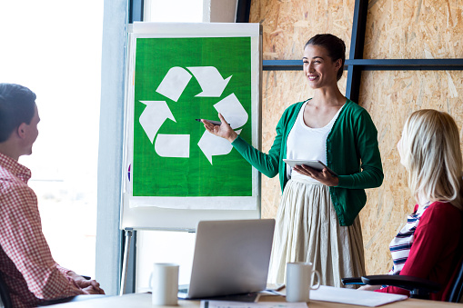
What is the future of social entrepreneurship in Europe?
The generation of social entrepreneurs in Europe is growing and there is a change in the sense that entrepreneurs are focused less on solving problems for beneficiaries and more on training those most affected by a problem to build solutions themselves.
Changes in social entrepreneurship
1. Creating new roles
One way innovators mobilize their communities is by giving them a new problem-solving role. They often do this by providing training and tools to successfully address the challenges they see and experience.
2. Building collaborative spaces
Innovators also operate as social architects, designing new spaces for changemakers to connect, learn from one another and co-create solutions.
3. Building a new narrative: community members are changemakers
Perhaps most importantly, innovators are working to support their communities to build new identities around changemaking. They reframe differences as strengths and catalyze a mindset shift around what community members are capable of.

Slide 41
What is the Social Economy?
What is the social economy about? This short video explains the main features of this alternative way of doing business.
The video was produced in the context of the Social Economy Action Plan, adopted by the European Commission on 9 December 2021..
Video Reference here: https://www.youtube.com/watch?v=GDSqf2Kjxi8

Slide 42
Social Business Initiative - Creating a favourable climate for social enterprises, key stakeholders in the social economy and innovation
The single market needs new, inclusive growth, focused on employment for all, underpinning the growing desire of Europeans for their work, consumption, savings and investments to be more closely attuned to and aligned with 'ethical' and 'social' principles.
In order to promote a 'highly competitive social market economy', the Commission has placed the social economy and social innovation at the heart of its concerns, in terms of both territorial cohesion and the search for new solutions to societal problems, in particular the fight against poverty a nd exclusion, under the Europe 2020 strategy, the flagship initiative 'The Innovation Union', the European Platform against Poverty and Social Exclusion and the 'Single Market Act' (SMA).

Slide 43
Social Economy Action Plan
A short explanation about what the Social Economy Action Plan is and how it benefits communities all over Europe.
Video Reference here: https://www.youtube.com/watch?v=NYtuAt_JyOc

Slide 44
References
https://www.beeco.green/sustainable-consumption/
https://online.hbs.edu/blog/post/types-of-corporate-social-responsibility
https://www.ecoonline.com/glossary/ecological-footprint
https://climate.selectra.com/en/environment/ecological-footprint
https://www.euronews.com/green/2023/01/03/here-are-all-the-positive-environmental-stories-from-2022-so-far
https://corporatefinanceinstitute.com/resources/esg/social-enterprise/
https://www.shopify.com/blog/social-entrepreneurship
https://alaturidevoi.ro/wp-content/uploads/2022/01/Modele-de-bune-practici-din-economia-sociala-si-ISI-AFF-2021.pdf
https://www.weforum.org/agenda/2022/11/what-is-the-future-of-social-entrepreneurship-in-europe/
https://www.fi-compass.eu/sites/default/files/publications/social-business-initiative-creating-a-favourable-climate-for-social-enterprises-key-stakeholders-in-the-social-economy-and-innovation.pdf

Slide 45
Resources
The social responsibility of business | Alex Edmans | TEDxLondonBusinessSchool - https://www.youtube.com/watch?v=Z5KZhm19EO0
European Commission, Executive Agency for Small and Medium-Sized Enterprises, Corporate Social Responsibility (CSR) by European Small and Medium-Sized Enterprises (SMEs) and Start-ups: Good Practice, Publications Office, 2021, https://data.europa.eu/doi/10.2826/093808
https://www.frontiersin.org/articles/10.3389/frsus.2021.647542/full Reflections on Sustainable Consumption in the Context of COVID-19

Slide 46
Thank you!
@Regio.Digi.Hub

