Slide 1
Promoting Regional Development by building the capacity of the VET system

Slide 2
Identifying the common elements between the smart specialization niches of each sector and major regional challenges

Slide 3
Disclaimer
The European Commission support for the production of this publication does not constitute an endorsement of the contents which reflects the views only of the authors, and the Commission cannot be held responsible for any use which may be made of the information contained therein.
Project Nº: 2021-1-RO01-KA220-VET-000028118

Slide 4
Consortium

Slide 5
01
Identifying the common elements between the smart specialization niches of each sector and major regional challenges
Contetns
02
Project management with OpenProject
03
Hands-on project management with OpenProject

Slide 6
Chapter 1: Identifying the common elements between the smart specialization niches of each sector and major regional challenges
Identifying common elements between smart specialization niches of each sector and major regional challenges requires a systematic analysis of the existing data and stakeholder engagement. Here are some steps you can take to identify these commonalities:

Slide 7
Chapter 1: Identifying the common elements between the smart specialization niches of each sector and major regional challenges
Review smart specialization strategies and regional development plans: Analyze the smart specialization strategies and regional development plans of the different sectors and regions to identify the priority areas of investment and focus.
Conduct a SWOT analysis: Conduct a SWOT (Strengths, Weaknesses, Opportunities, Threats) analysis of the different sectors and regions to identify the internal and external factors that are affecting their development. Look for commonalities and overlapping factors between the different sectors and regions.

Slide 8
Chapter 1: Identifying the common elements between the smart specialization niches of each sector and major regional challenges
Engage with stakeholders: Engage with stakeholders from the different sectors and regions, including industry associations, policymakers, researchers, and community leaders. Conduct interviews or focus groups to gather their perspectives on the major regional challenges and opportunities and the potential smart specialization niches that could address these challenges.
Identify common themes: Analyze the data from the previous steps to identify common themes and areas of overlap between the smart specialization niches of each sector and the major regional challenges. Look for opportunities to align the smart specialization niches with the major regional challenges to create synergies and maximize impact.

Slide 9
Chapter 1: Identifying the common elements between the smart specialization niches of each sector and major regional challenges
Prioritize areas of investment: Prioritize the areas of investment based on the potential impact and feasibility. Consider factors such as the availability of resources, the level of expertise, and the potential for collaboration between the different sectors and regions.
By following these steps, you can identify the common elements between the smart specialization niches of each sector and major regional challenges, which can help to guide regional development strategies and maximize impact.

Slide 10
Chapter 1: Identifying the common elements between the smart specialization niches of each sector and major regional challenges
The steps to conduct a SWOT analysis:
Define the objective: Begin by clearly defining the objective of the SWOT analysis. This could be anything from assessing the viability of a new product or service, evaluating the performance of a department or team, or identifying areas for improvement within an organization.
Gather information: Gather relevant information about the company, organization, or project you are analyzing. This could include financial data, customer feedback, market research, and industry trends. Consider both internal and external factors.
Identify strengths: Consider the strengths of the company or organization. These may include its unique selling proposition, competitive advantage, skilled workforce, established brand, or loyal customer base.

Slide 11
Chapter 1: Identifying the common elements between the smart specialization niches of each sector and major regional challenges
The steps to conduct a SWOT analysis:
Analyze the results: Once you have identified the strengths, weaknesses, opportunities, and threats, analyze the results to identify trends and patterns. Look for ways to capitalize on strengths and opportunities while addressing weaknesses and threats.
Develop an action plan: Based on the results of the analysis, develop an action plan that outlines specific steps to take to improve the company or organization. Set priorities, assign responsibilities, and establish timelines for each action item.
Review and update regularly: Review and update the SWOT analysis regularly to ensure that it remains relevant and effective. Use it as a tool for ongoing strategic planning and decision-making.

Slide 12
Chapter 1: Identifying the common elements between the smart specialization niches of each sector and major regional challenges
The steps to conduct a SWOT analysis:
Identify weaknesses: Consider the weaknesses of the company or organization. These may include lack of resources, poor reputation, outdated technology, ineffective processes, or inadequate marketing efforts.
Identify opportunities: Consider the opportunities available to the company or organization. These may include emerging markets, new product or service offerings, industry trends, or changes in customer behavior.
Identify threats: Consider the threats to the company or organization. These may include competitors, changing regulations, economic downturns, technological disruptions, or shifts in consumer preferences.
Analyze the results: Once you have identified the strengths, weaknesses, opportunities, and threats, analyze the results to identify trends and patterns. Look for ways to capitalize on strengths and opportunities while addressing weaknesses and threats.
Develop an action plan: Based on the results of the analysis, develop an action plan that outlines specific steps to take to improve the company or organization. Set priorities, assign responsibilities, and establish timelines for each action item.
Review and update regularly: Review and update the SWOT analysis regularly to ensure that it remains relevant and effective. Use it as a tool for ongoing strategic planning and decision-making.

Slide 13
Chapter 1: Identifying the common elements between the smart specialization niches of each sector and major regional challenges
Smart specialization strategies refer to an approach to economic development that focuses on identifying a region's unique strengths and capabilities and leveraging them to create a competitive advantage in specific industries or sectors.
This strategy aims to foster innovation, productivity, and job creation by focusing resources and efforts on areas where a region has the most potential to excel.

Slide 14
Chapter 1: Identifying the common elements between the smart specialization niches of each sector and major regional challenges
Examples of smart specialization strategies include (1/3) :
Advanced manufacturing: This strategy focuses on leveraging a region's existing expertise in manufacturing to transition to high-tech and innovative manufacturing processes. Examples include the development of 3D printing technology, robotics, and the Internet of Things.
Digital economy: This strategy focuses on developing the infrastructure and ecosystem necessary to support the growth of the digital economy. This includes the development of high-speed internet access, the creation of incubators and accelerators for startups, and the development of a skilled workforce in areas such as data science, software development, and cybersecurity.

Slide 15
Chapter 1: Identifying the common elements between the smart specialization niches of each sector and major regional challenges
Examples of smart specialization strategies include (2/3) :
Clean energy: This strategy focuses on leveraging a region's natural resources and expertise in renewable energy to develop a competitive advantage in the clean energy sector. Examples include the development of wind and solar energy, as well as the development of energy storage technologies.
Life sciences and healthcare: This strategy focuses on leveraging a region's existing expertise in life sciences and healthcare to develop a competitive advantage in areas such as biotechnology, medical devices, and digital health.

Slide 16
Chapter 1: Identifying the common elements between the smart specialization niches of each sector and major regional challenges
Examples of smart specialization strategies include (3/3):
Cultural and creative industries: This strategy focuses on leveraging a region's unique cultural assets and creative talent to develop a competitive advantage in areas such as design, architecture, music, and film.

Slide 17
Chapter 1: Identifying the common elements between the smart specialization niches of each sector and major regional challenges
Example cases of successful smart specialization strategies include:(1/2):
Catalonia, Spain: Catalonia has developed a smart specialization strategy focused on the digital economy, with a particular emphasis on the development of the mobile and video game industry. This strategy has led to the creation of over 15,000 jobs and the establishment of over 400 startups.
Saxony-Anhalt, Germany: Saxony-Anhalt has developed a smart specialization strategy focused on the development of a hydrogen economy, leveraging the region's existing expertise in chemical engineering and renewable energy. This strategy has led to the establishment of several new companies and the creation of over 5,000 jobs.

Slide 18
Chapter 1: Identifying the common elements between the smart specialization niches of each sector and major regional challenges
Example cases of successful smart specialization strategies include:(2/2):
North Brabant, Netherlands: North Brabant has developed a smart specialization strategy focused on the development of high-tech systems and materials, leveraging the region's existing expertise in engineering and innovation. This strategy has led to the establishment of several new companies and the creation of over 10,000 jobs.

Slide 19
Chapter 6: PM with OpenProject
What is OpenProject?
OpenProject is:
free and open source software for classical as well as agile project management to support teams along the entire project life-cycle;
available in more than 30 languages;
licensed under GNU GPL V3. The source code is freely published on GitHub;
offer as paid subscriptions or Enterprise-on-premise Edition or Community Edition (see this link)
developed since 2011 (a fork of the deprecated ChiliProject which was a fork of Redmine)
.
https://www.openproject.org/docs/getting-started/openproject-introduction/

Slide 20
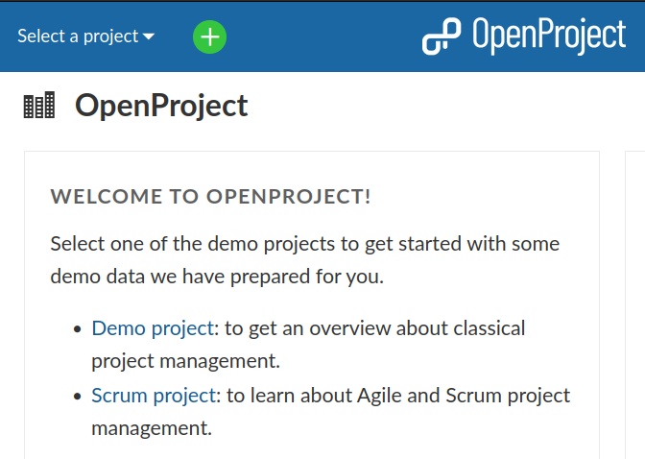
Chapter 2: PM with OpenProject
First steps to get started
To get started with OpenProject, there are a few easy steps to follow:
Get an account and sign in
Create a new project
Invite team members to collaborate
Create work packages
Set up a project plan
Source: https://www.openproject.org/docs/getting-started/openproject-introduction/

Slide 21
Chapter 2: PM with OpenProject
The entire Project Management Life-Cycle
Project phase | Documentation for
Project concept and initiation | Collect ideas and specify project scope and deliverables: set up a project, document initial ideas, project description, invite members.
Project definition and planning | Create a project overview with detailed information, set up a project plan, create your roadmap.
Source: https://www.openproject.org/docs/getting-started/openproject-introduction/

Slide 22
Chapter 2: PM with OpenProject
The entire Project Management Life-Cycle
Project phase | Documentation for
Project launch or execution | Manage all project activities, such as tasks, deliverables, risks, features, bugs, change requests. Use agile boards with your teams, document meetings, share news.
Project performance and control | Create and manage project budgets, track and evaluate time and costs. Have custom reports for accurate, current insight into project performance and allocated resources.
Source: https://www.openproject.org/docs/getting-started/openproject-introduction/

Slide 23
Chapter 2: PM with OpenProject
The entire Project Management Life-Cycle
Project phase | Documentation for
Project close | Document project achievements, lessons learned, best practices and easily summarize the main results of a project. Archive projects for later reference and lessons learned.
Source: https://www.openproject.org/docs/getting-started/openproject-introduction/

Slide 24
Chapter 2: PM with OpenProject
Project concept and initiation
OpenProject supports the initial set-up and configuration of a project structure.
Features | Documentation for
Create a new project | Create and set up a new project in OpenProject
Set up a project structure | Create a project hierarchy to structure your work in OpenProject
Source: https://www.openproject.org/docs/getting-started/openproject-introduction/

Slide 25
Chapter 2: PM with OpenProject
Project concept and initiation
OpenProject supports the initial set-up and configuration of a project structure.
Features | Documentation for
Project settings | Create first ideas, tasks, rough milestones.
Add members | Invite your team to collaborate in OpenProject.
Source: https://www.openproject.org/docs/getting-started/openproject-introduction/

Slide 26
Chapter 2: PM with OpenProject
Project definition and planning
Create a project overview with more detailed information, set up your project plan, structure your work, create a roadmap..
Features | Documentation for
Global projects overview | Create a project overview with important project information.
Structure your work | Create work packages and structure your work
Roadmap planning | Create a roadmap for your project.
Source: https://www.openproject.org/docs/getting-started/openproject-introduction/

Slide 27
Chapter 2: PM with OpenProject
Project launch or execution
Manage all project activities, such as tasks, deliverables, risks, features, bugs, change requests in the work packages. Use agile boards with your teams. Document meetings, share news.etc..
Features | Documentation for
Work packages | Create and manage all project deliverables, tasks, features, risks, and more.
Boards | Manage your work with an Agile approach in the flexible boards view.
Source: https://www.openproject.org/docs/getting-started/openproject-introduction/

Slide 28
Chapter 2: PM with OpenProject
Project launch or execution
Manage all project activities, such as tasks, deliverables, risks, features, bugs, change requests in the work packages. Use agile boards with your teams. Document meetings, share news.etc..
Features | Documentation for
Meetings | Plan and document your project meetings and share minutes with all your team.
News | Share project news with your team.
Source: https://www.openproject.org/docs/getting-started/openproject-introduction/

Slide 29
Chapter 2: PM with OpenProject
Project launch or execution
Manage all project activities, such as tasks, deliverables, risks, features, bugs, change requests in the work packages. Use agile boards with your teams. Document meetings, share news.etc..
Features | Documentation for
Wiki | Document all important project information and keep it up to date with your team.
Source: https://www.openproject.org/docs/getting-started/openproject-introduction/

Slide 30
Chapter 2: PM with OpenProject
Project performance and control
Create and manage project budgets, track and evaluate time and costs. Have custom reports for accurate, current insight into project performance and allocated resources
Features | Documentation for
Dashboard | Visualize your progress within a project or project overarching.
Budgets | Create and manage budgets in your project.
Source: https://www.openproject.org/docs/getting-started/openproject-introduction/

Slide 31
Chapter 2: PM with OpenProject
Project performance and control
Create and manage project budgets, track and evaluate time and costs. Have custom reports for accurate, current insight into project performance and allocated resources
Features | Documentation for
Time tracking | Track time for any work within your project.
Track unit costs | Track unit costs for your project.
Time and cost reporting | Have accurate detailed reports of current spent time and costs within your project.
Source: https://www.openproject.org/docs/getting-started/openproject-introduction/

Slide 32
Chapter 2: PM with OpenProject
Project close
Document project achievements, lessons learned, best practices and easily summarize the main results of a project. Archive projects for later reference and lessons learned.
Features | Documentation for
Wiki | Document all relevant project information, lessons learned, best practices, results, and more.
Project archive | Archive your project for further reference and documentation.
Source: https://www.openproject.org/docs/getting-started/openproject-introduction/

Slide 33
Chapter 2: PM with OpenProject
OpenProject can be used in three different editions, either on-premises or as software-as-a-service.
Source: https://www.openproject.org/docs/getting-started/openproject-introduction/

Slide 34
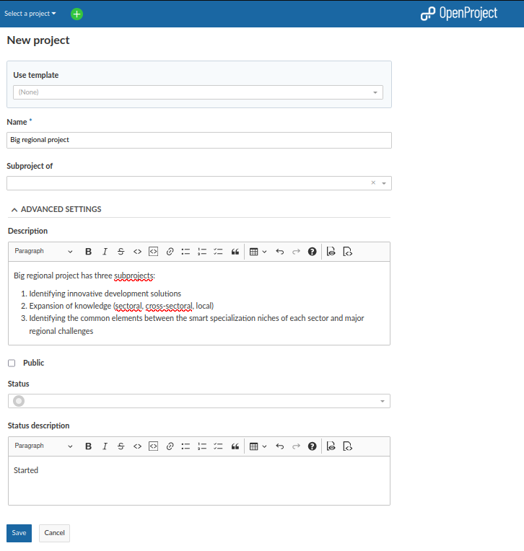
Chapter 3: Hands-on project management with OpenProject
Create new project:
Big regional project will have three subprojects.

Slide 35
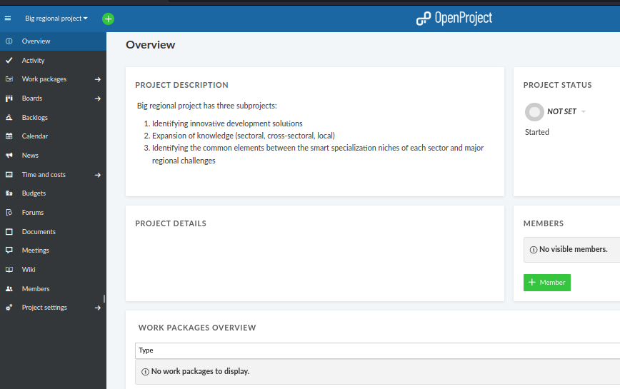
Chapter 3: Hands-on project management with OpenProject
New project is created:

Slide 36
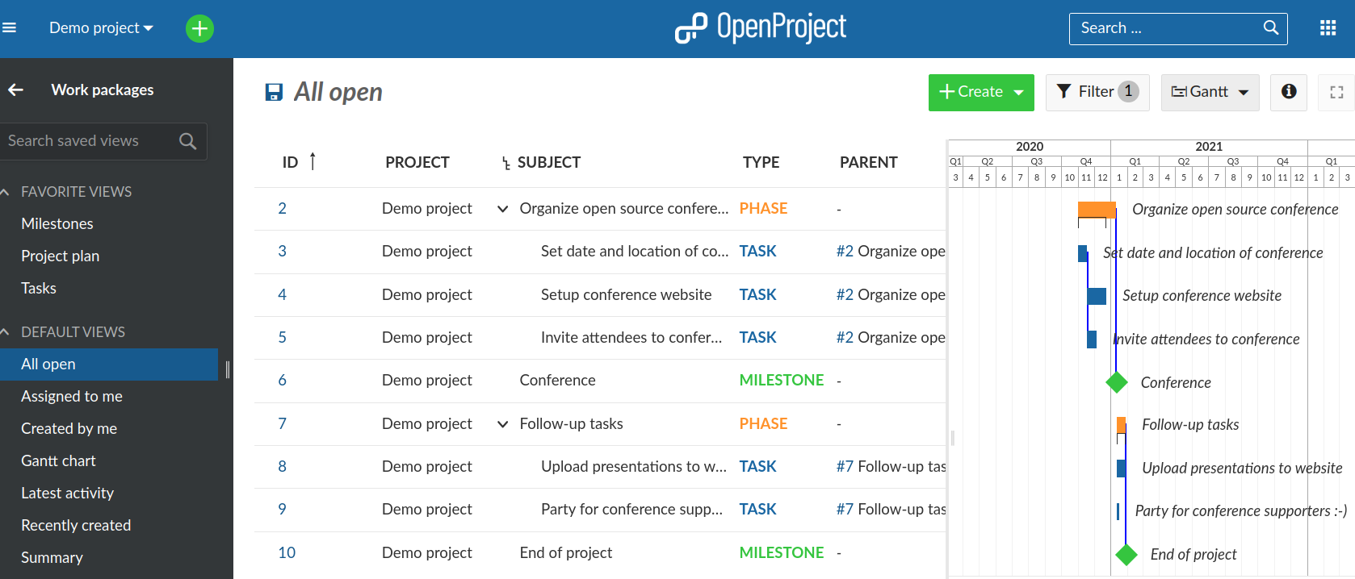
Chapter 3: Hands-on project management with OpenProject
Sample WBS

Slide 37
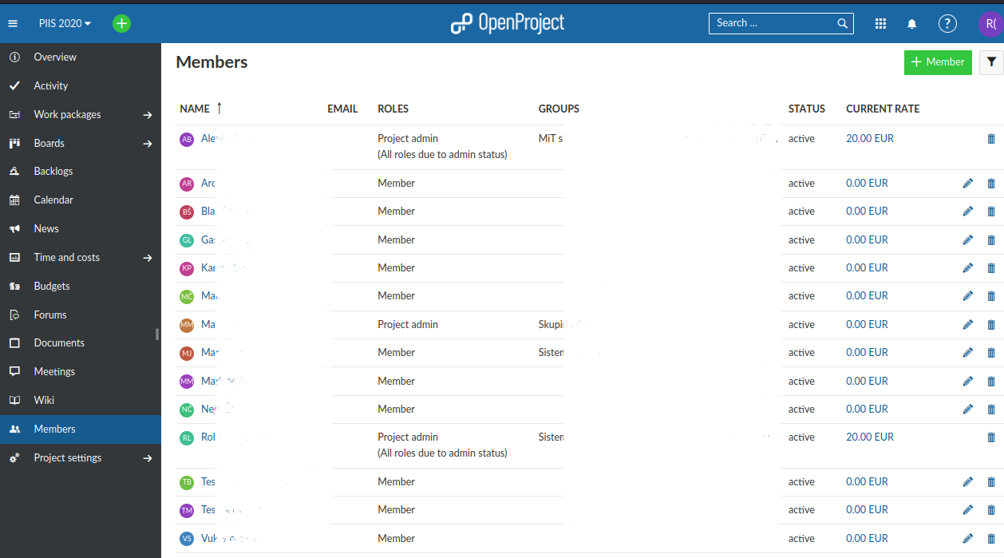
Chapter 3: Hands-on project management with OpenProject
Sample project members

Slide 38
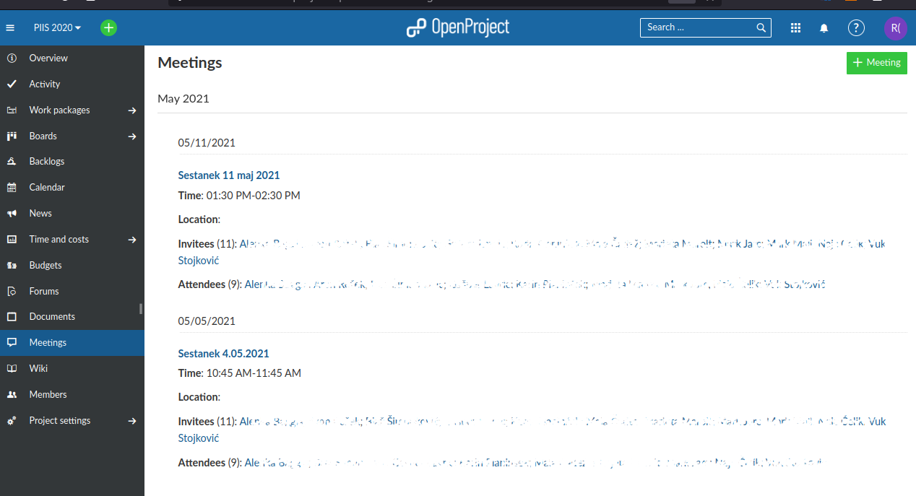
Chapter 3: Hands-on project management with OpenProject
Sample meetings and meeting minutes members

Slide 39
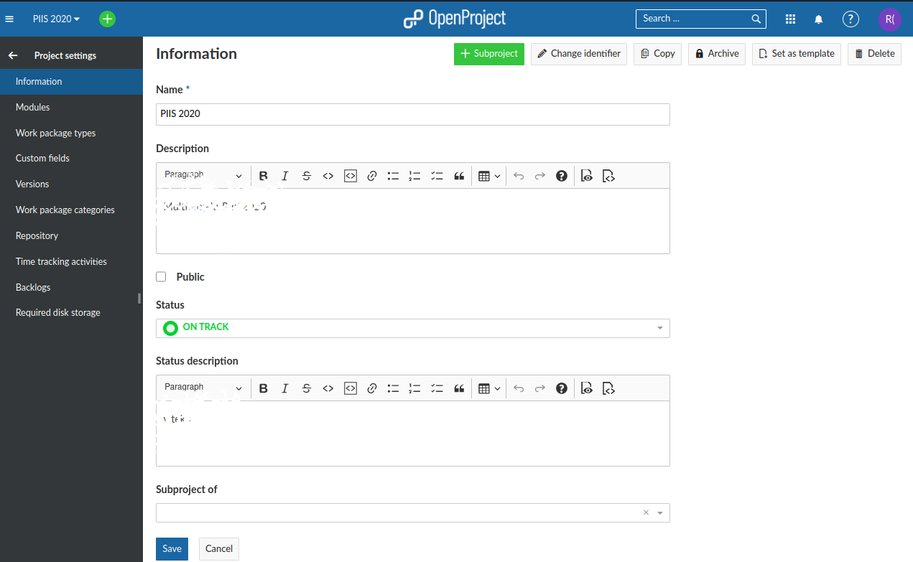
Chapter 3: Hands-on project management with OpenProject
Sample project settings

Slide 40
References
OpenProject, https://www.openproject.org

Slide 41
Thank you!
@Regio.Digi.Hub

