Slide 1
Promoting Regional Development by building the capacity of the VET system

Slide 2
Adaptability and transferable skills to enable workers to learn and apply the new (low carbon) technologies and process required to make their jobs greener

Slide 3
Disclaimer
The European Commission support for the production of this publication does not constitute an endorsement of the contents which reflects the views only of the authors, and the Commission cannot be held responsible for any use which may be made of the information contained therein.
Project Nº: 2021-1-RO01-KA220-VET-000028118

Slide 4
Consortium

Slide 5
01
Introduction
02
European Green Deal
03
European Skills Agenda
Contetns
04
Green Jobs and Green Skills
05
Examples of good practices
06
References

Slide 6
Introduction
The Environment
The environment can be viewed as a five-component system consisting of: atmosphere, hydrosphere, lithosphere, soil and organisms
The relationship between living beings and the environment that surrounds them is mutual, so that environment acts on living beings through physical, biological, chemical and other factors, significantly influencing them.
If there is an imbalance in the ecosystem, all living organisms that live in it suffer.

Slide 7
European Green Deal

Slide 8
The European Green Deal
Climate change and environmental degradation are an existential threat to Europe and the world. To overcome these challenges, the European Green Deal will transform the EU into a modern, resource-efficient and competitive economy, ensuring:
no net emissions of greenhouse gases by 2050
economic growth decoupled from resource use
no person and no place left behind

Slide 9
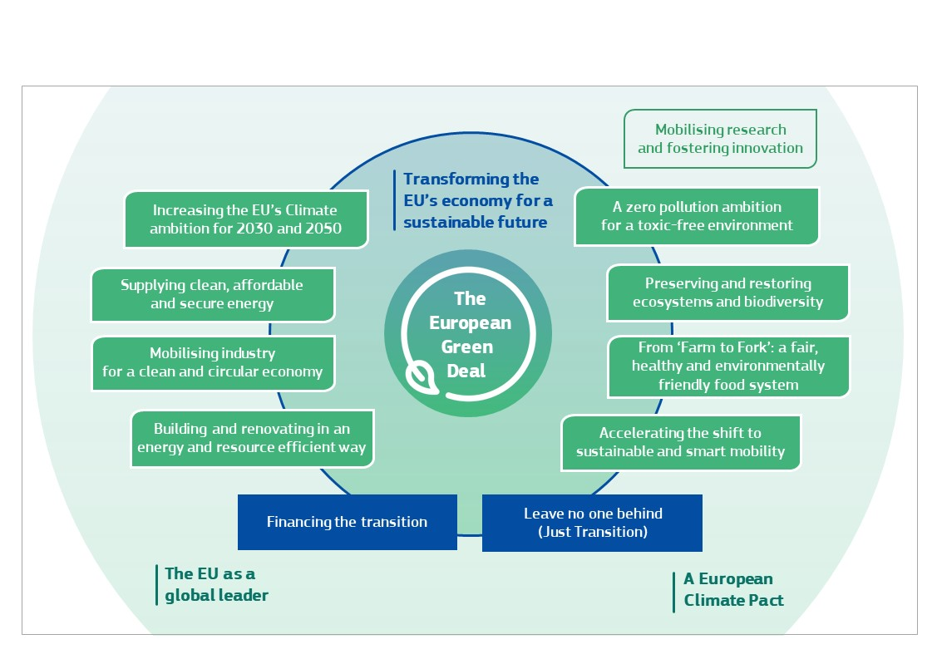
The European Green Deal

Slide 10
The European Green Deal
The European Green Deal is one of the priorities of the European Commission for 2019-2024. All 27 EU Member States committed to turning the EU into the first climate neutral continent by 2050. This will create new opportunities for innovation and investment and jobs, as well as: reduce emissions, create jobs and growth, address energy poverty, reduce external energy dependency and improve our health and wellbeing.
Successfully identifying and anticipating the skills required for greening the economy and green jobs often means that stakeholders must adapt their existing approach to skills strategies. Sustainable development drives new skills needs discontinuous with the past across a wide range of sectors and occupations.
Transition to the green economy and sustainable development bring about economic restructuring and shifts in employment. New jobs and new job tasks require different skills.

Slide 11
The European Green Deal
Since the release of the European Green Deal in 2019, the EU has presented a set of policies and measures to drive investments and efforts towards a just and inclusive transition. Such policies are aimed at deeply transforming the economy across production and consumption. This includes: the decarbonization of the energy system, the mobilization of industry for a climate neutral and circular economy, the engagement in resource-efficient investments in construction, the preservation of ecosystems and biodiversity, and the creation of a toxic-free environment. As the transition is bringing fundamental transformations in the European economic model, new jobs are created, while some jobs are replaced, and others are redefined.

Slide 12
European Skills Agenda

Slide 13
European Skills Agenda
European Skills Agenda sets ambitious, quantitative objectives for upskilling (improving existing skills) and reskilling (training in new skills) to be achieved within the next 5 years. Its 12 actions focus on skills for jobs by partnering up with Member States, companies and social partners to work together for change, by empowering people to embark on lifelong learning, and by using the EU budget as a catalyst to unlock public and private investment in people’s skills.
The green and digital transitions as accompanied by demographic trends are transforming how we live, work and interact. We want to ensure people have the skills they need to thrive. The coronavirus pandemic has accelerated these transitions and brought new career challenges for many people in Europe. In the aftermath of the crisis, many Europeans will need to retrain in a new skill or improve their existing skills to adapt to the changed labor market. The Skills Agenda aims to improve the relevance of skills in the EU to strengthen sustainable competitiveness, ensure social fairness and build our resilience. It does this through 12 “actions”.

Slide 14
The European Skills Agenda has a dozen actions:
Pact for Skills - Mobilizing all partners for more and better opportunities for people to train, and to unlock public and private investments across industrial and skills ecosystems.
Strengthening skills intelligence - To skill for a job, we need online ‘real-time’ information on skills demand, including at regional and sectoral level, using big data analysis of job vacancies and making it widely available.
EU support for strategic national upskilling action - We will work with Member States on modern and comprehensive national skills strategies and join forces with national public employment agencies to realize them. This can be coupled with a more strategic approach to legal migration, oriented towards better attracting and keeping talent.
Future-proof vocational education and training (VET) - Taking a fresh approach to make vocational education and training more modern, attractive for all learners, flexible and fit for the digital age and green transition.
Rolling out the European Universities initiative and upskilling scientists - Building long-term transnational alliances between higher education institutions throughout Europe and developing a core set of skills for researchers.

Slide 15
6. Skills to support the green and digital transitions - Developing a set of core green skills, statistical monitoring of the greening of our workplaces, boosting digital skills through a Digital Education Action Plan and ICT jump-start training courses.

Slide 16
7. Increasing STEM graduates, fostering entrepreneurial and transversal skills - We encourage young people, especially women, into Science, Technology, Engineering and Maths. We also want to strengthen support for entrepreneurs and the acquisition of transversal skills like cooperation and critical thinking.
8. Skills for life - Beyond the labour market, we will support adult learning for everyone — young people and adults — on issues such as media literacy, civic competences, and financial, environmental and health literacy.
9. Initiative on individual learning accounts - We will explore if and how portable and quality-checked training entitlements could help stimulate lifelong learning for all.
10. A European approach to micro-credentials - Training courses are becoming shorter and more targeted and are often online. We will create European standards that should help recognise the results of such training.
11. New Europass platform - We have completely revamped the Europass platform. As of today, it offers online tools and guidance on CV-writing, suggests tailored jobs and learning opportunities, provides information for job seekers, and is available in 29 languages.
12. Improving the enabling framework to unlock investment - A key element of the Skills Agenda is the much-boosted EU budget to catalyse Member States and private actors to invest in skills. We will work on improving transparency around skills investment and explore novel financing mechanisms.

Slide 17
Green Jobs and Green Skills

Slide 18
Green and Digital Transformation
The United Nations defines green jobs as sectors and jobs in which waste creation and pollution is minimized (UNEP et al., 2008). The International Labor Organization (ILO) includes in its definition of green jobs any sector that has a lower-than-average environmental footprint (ILO, 2012). Statistical agencies across the world usually focus their definition of green jobs on the definition of the environmental goods and services sector. The distinction between jobs and skills is important because the labor market dynamics of “greening” in the economy are, and will be, complex into the future. Skills analysis offers a disaggregated level to examine and unpick these dynamics.

Slide 19
Green and Digital Transformation
The successful transition to a low carbon economy will only be possible by ensuring that workers are able to adapt and transfer from areas of decreasing employment to other industries and that human capital exists and is maximized to develop new industries.

Slide 20
The identification, assessment and creation of green skills is essential in transitioning to a low-carbon economy and being able to capitalise on all the social, environmental and economic benefits that this brings.
Supporting green skills is integral to the transition to a low-carbon

Slide 21
The ESCO approach to support the green transition
The transition to a green, low carbon and resource-efficient economy is a challenge and an opportunity for the European labour market to be tackled at the level of skills.
To successfully support the re-skilling path, an advanced set-up to anticipate and provide training on both technical and transferable skills is needed. The ESCO classification is already playing a central role as the European taxonomy of skills and occupations.
Not only it offers a common language on occupations and skills, but it also provides relationships between them, specifying which skills are essential or optional for a specific occupation.

Slide 22
The ESCO approach to support the green transition
As workers need a skill set that can respond to the need of reducing emissions in working practices, the Skills/Competences pillar has been enriched with the additional information at skill level to distinguish green skills and knowledge concepts. This means that within the whole dataset of ESCO skills, some can now be filtered as green. ESCO also provides information such as their reusability type and are linked with occupations. All the concepts are translated in 27 languages and are available free of charge in different formats.

Slide 23
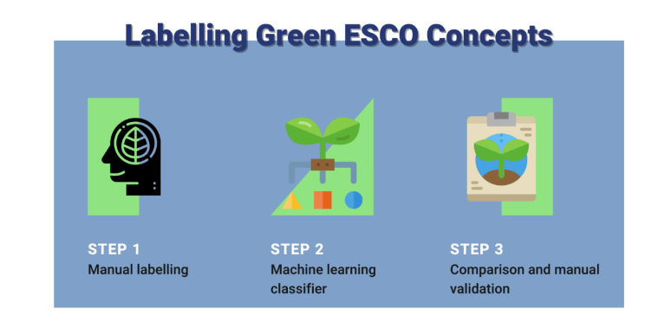
Labelling of skills
The labelling consists in verifying whether an ESCO skill concept should or should not be considered as green.
To build the classifier, the Commission created a training dataset composed of text of green and nongreen activities, mainly sentences and short definitions, collected from European and International sources.
Given the preferred term and description of a skill or knowledge, the classifier assigns the brown, white, or green label for the concept.
Skills and knowledge concepts are manually labelled based on the definition of green skills suggested by the European Centre for the Development of Vocational Training (Cedefop): the knowledge, abilities, values and attitudes needed to live in, develop and support a society which reduces the impact of human activity on the environment (Cedefop, 2012).
When running the manual labelling activity, each concept is analysed based on its preferred term, non-preferred terms, and description.

Slide 24
Labelling of skills
Definitions collected from European and International sources must be categorised in three groups:
brown skills, which are defined as knowledge and skills that increase the impact of human activity on the environment,
white skills, which do not increase nor reduce the impact of human activity on the environment,
green skills, which reduce the impact of human activity on the environment.

Slide 25
Labelling of skills
Finally, the list of concepts manually labelled as green (first step), and the concepts classified as green by the ML algorithm (second step) are compared.
The final round of validation follows the following rules:
If a concept is labelled as green by the two methods, it is automatically accepted as green
If a concept is labelled as non-green by the two methods, it is automatically accepted as non-green
If a concept is labelled as green by only one of the two methods, it is revised and then labelled either as green or non-green.

Slide 26
Green Skills
Skills for the green economy consist of:
transversal skills, linked to sustainable thinking and acting, relevant to all economic sectors and occupations;
specific skills, required to adapt or implement standards, processes and services to protect ecosystems and biodiversity, and to reduce energy, materials and water consumption;
highly specialised skills, required to develop and implement green technologies such as renewable energies, sewage treatment or recycling;
skills for the green economy are also referred to as skills for green jobs, skills for the green transition or green skills.
Smart Specialization

Slide 27
Green Skills
Dr Margarita Pavlova (2014) has classified generic green skills into the following three categories:
Cognitive competencies (for example, environmental awareness and a willingness to learn about sustainable development, systems and risk analysis, skills to assess, interpret and understand both the need for change and the measures required, innovation skills to identify opportunities and create new strategies to respond to green challenges;)
Interpersonal competencies (for example, coordination, management and business skills to facilitate holistic and interdisciplinary approaches that encompass economic, social and ecological objectives, communication and negotiation skills for discussion of conflicting interests in complex contexts, marketing skills to promote greener products and services)
Intrapersonal competencies (adaptability and transferable skills that help workers learn and apply new technologies and processes required to green their jobs, entrepreneurial skills to capture opportunities presented by low-carbon technologies)

Slide 28
Example of Intrapersonal Skill –
Adaptability
Adaptability refers to the ability and motivation to deal with unpredictable, new, and fast-changing environments, such as responding successfully to crisis situations and acquiring new roles, technology, and processes. Handling job stress, adapting to distinct personalities, behavioral patterns, and cultures, and physical endurance to lots of different work conditions are all examples of adaptability and is an intrapersonal skills example.
Asking questions is a terrific method to learn more and challenge established ways of doing things, and it's one of the most important aspects of adaptability. Ask questions that are well-researched and delivered in a proper manner to guarantee that you get the most useful answers from the people you think are adaptable to different situations.
Smart Specialization

Slide 29
Green vocational competences
Green vocational competences are technical skills, knowledge, values, and attitudes needed in the workforce to develop and support sustainable social, economic, and environmental outcomes in business, industry, and the community.
Green vocational competences comprise:
cross-occupational basic green competences
in-depth occupation-specific competences for occupational handling of "green" materials, technologies and processes.
Smart Specialization

Slide 30
Taxonomy
The European Commission has published a taxonomy (classification system) of skills for the green transition in European Skills, Competences, Qualifications and Occupations (ESCO).
The taxonomy contributes to a common understanding of which skills are needed for a successful and fair green transition in the labor market. ESCO provides information on which skills and knowledge concepts are essential or optional for specific occupations. In this way, it helps identify green elements that should be part of vocational education and training (VET) programs preparing for these occupations.

Slide 31
Taxonomy
The taxonomy includes:
185 knowledge concepts
5 transversal skills
381 skills
Examples of ‘green skills’ include how to conduct energy audits, measure the sustainability of tourism activities, as well as training staff on recycling programs.

Slide 32
Examples of good practices

Slide 33
Green skills award
The Green Skills Award is an annual competition which recognizes projects from around the world exemplifying innovation and creativity in green skills and education. The ten finalists shortlisted covered a range of environmental and sustainable issues and all were focused on developing training programs which supported the shift to sustainable, carbon-neutral and circular economies and societies. Award entitled “Green Transition: education, training and skills”, helped to showcase the projects which provide ideas and inspiration for education and training policy-makers and practitioners in the EU neighborhood and beyond.

Slide 34
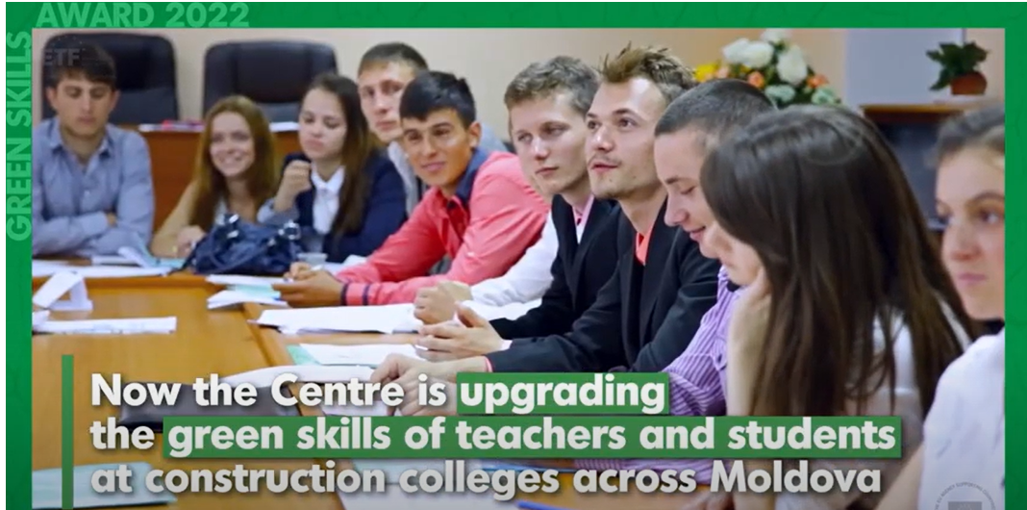
Example from Moldova – Training the Green Trainers
An integrated project in Moldova responding to the need to develop sustainability curricula for TVET and construction teachers, in order to improve the supply of green skills and support the green transition of the construction sector.
The programme has four modules and eight curricula dedicated to TVET teachers who will share their updated knowledge and skills with students in the following areas: environmental education, green building materials, energy efficiency and waste management. The new curricula have been developed to address the challenges facing the construction sector as part of the green transition and will enable more sustainable construction projects in the future. More than 6,000 students are expected to benefit from this project and to date, 45 teachers have successfully completed the program so far. The program includes study visits, access to research materials, and attendance at conferences and seminars.
https://www.youtube.com/watch?v=qLv9KEJID-U&list=PLYK8JpvJRLjiYTxvbc0AlH-nl_JUHul0K&index=4

Slide 35
Example from Ireland -Fifty shades Greener
A dynamic environmental education and training company in Ireland providing online programmes for schools, universities and businesses to help students and organisations meet their environmental objectives. Working internationally, its accredited training programmes enhance knowledge and encourage students to collaborate and take real action, and support businesses to make high impact changes.
Tasked with the objective to make her hotel "the greenest in Ireland", Raquel Noboa has used her experience to promote environmental awareness and green skills within the Irish hospitality sector. She is the Founder and CEO of Fifty Shades Greener, an international education and training company helping businesses on their journey to go green. Her mission is "to make environmental education mainstream for all age groups and industries" and as such, she has developed programmes for companies, as well as primary, secondary and tertiary level education. The training programmes are accredited as a Level 4 Certificate for Environmental Sustainability Management in Hospitality and a Level 7 course is currently being developed.
https://www.youtube.com/watch?v=GJEXFGtWAZc&list=PLYK8JpvJRLjiYTxvbc0AlH-nl_JUHul0K&index=4

Slide 36
Example from Jordan - Creating Green Land
A collaborative project from Jordan which aims to transform dry land into green land. The involvement of farmers, cooperatives, students and associations will facilitate the sharing of key knowledge and skills in a peer learning, inclusive context.
As a result of water recycling, a garden has been created in Al Hashimiyah (Zarqa), which functions as a community centre where community stakeholders, cooperatives and students can exchange sustainable practices (such as rainwater collection) and organise training and workshops. The aim is to extend this project in order to green even more land and to include building well gardens for houses and using grey water for irrigation.
https://www.youtube.com/watch?v=fC5unmvFbX0&list=PLYK8JpvJRLjiYTxvbc0AlH-nl_JUHul0K&index=8

Slide 37
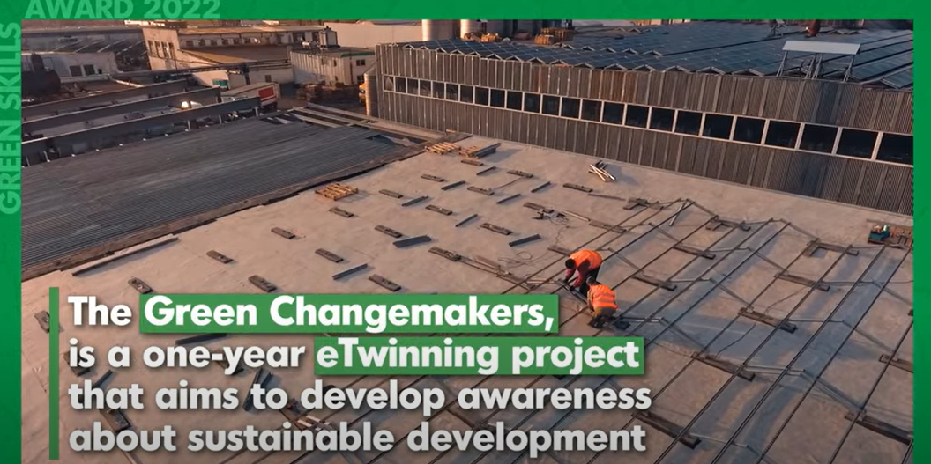
Example from Croatia – The Green Changemakers
A year-long program of international collaboration between schools in Croatia, Turkey and Armenia which aims to increase awareness and understanding of sustainable development and green technologies. The theoretical and practical activities have been developed to improve students' knowledge and skills, and to help them adopt a green lifestyle which will have a positive impact at both a local and global level.
"The Green Changemaker" project involves 79 students and 15 teachers from five primary and secondary schools in Croatia, Turkey and Armenia. Devised in the context of the 17 Sustainable Development Goals, the project activities will promote learning, cooperation, equality and inclusion, and will strengthen the partnership between schools and their local communities. This project will also include environmental engineering workshops which will support students' learning about green technologies.
https://www.youtube.com/watch?v=qtmvpduVPEI&list=PLYK8JpvJRLjiYTxvbc0AlH-nl_JUHul0K&index=10

Slide 38
Example from Netherlands - The Blue Hotspot Dordrecht
An integrated hub in The Netherlands which aims to create an environment where experts in the field of water, greenery and climate can collaborate with community stakeholders in order to find innovative solutions for major societal challenges such as climate change and biodiversity loss. Acting as a facilitator, the involvement of schools, businesses and governments will promote the sharing of knowledge and skills necessary to support a transition to a green economy.
The Blue Hotspot Dordrecht is a community for students, teachers, professionals and governments, focusing on blue-green themes, including water quality, water safety, subsidence and climate-proof cities. The aim is to create a meeting place (both online and in a physical location) to develop green skills and enable people to address the social challenges of tomorrow, such as climate adaptation and biodiversity. The collaborative environment will also help young people to enter the eco job market by ensuring they have the right green skills, and connecting them to employers and partners.
https://www.youtube.com/watch?v=42QeXSnTsYc&list=PLYK8JpvJRLjiYTxvbc0AlH-nl_JUHul0K&index=7

Slide 39
References
https://commission.europa.eu/strategy-and-policy/priorities-2019-2024/european-green-deal_en
https://ec.europa.eu/migrant-integration/sites/default/files/2020-07/SkillsAgenda.pdf
https://www.cedefop.europa.eu/en/publications/3057
https://ec.europa.eu/newsroom/empl/items/741088/en
https://www.etf.europa.eu/en/news-and-events/press/green-skills-awards-2022-winners-announced
https://www.ilo.org/wcmsp5/groups/public/---ed_emp/---ifp_skills/documents/publication/wcms_564692.pdfm

Slide 40
Thank you!
@Regio.Digi.Hub

