Slide 1
Promoting Regional Development by building the capacity of the VET system

Slide 2
Development of Smart Skills: T-shaped skills, smart solutions thinking, smart planning

Slide 3
Disclaimer
The European Commission support for the production of this publication does not constitute an endorsement of the contents which reflects the views only of the authors, and the Commission cannot be held responsible for any use which may be made of the information contained therein.
Project Nº: 2021-1-RO01-KA220-VET-000028118

Slide 4
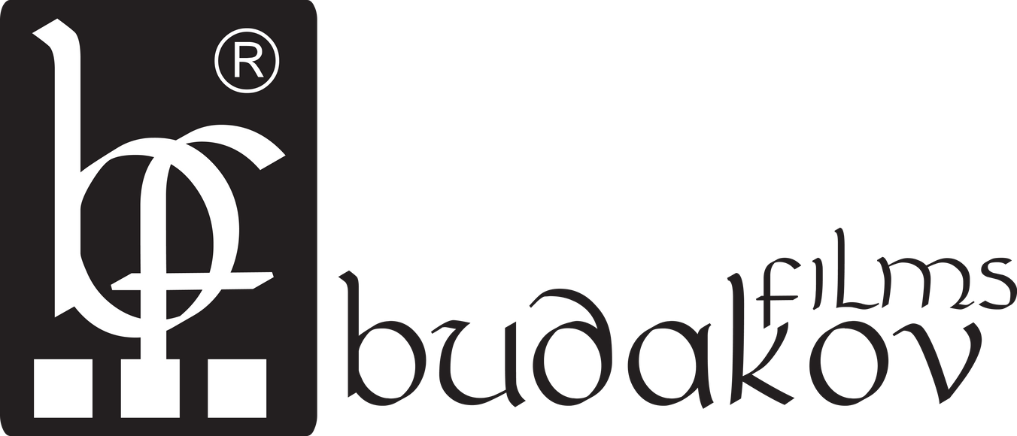
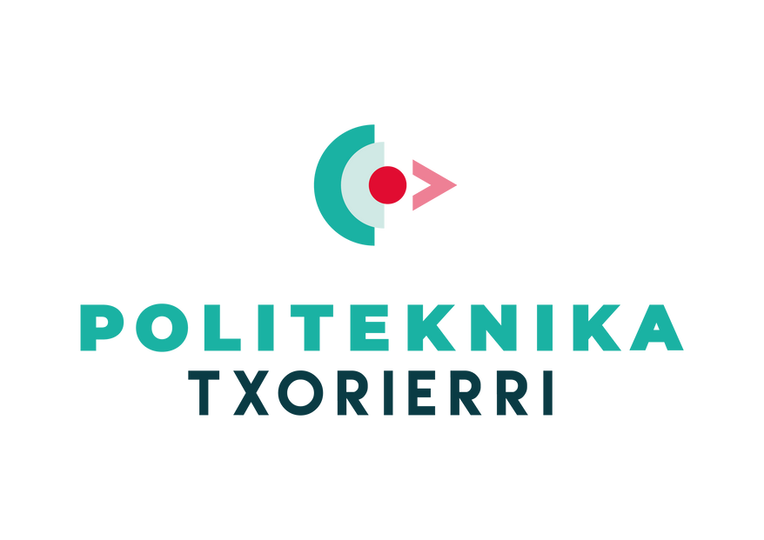
Consortium

Slide 5
01
INTRODUCTION
02
T-Shaped Skills
03
Become a T-Shaped Individual
04
Smart solutions thinking
Contents
05
CHAPTER4: Identifying the common elements between the smart specialization niches of each sector and major regional challenges
06
CHAPTER 5: Development of Smart Skills: T-shaped skills, smart solutions thinking, smart planning
07
THE END

Slide 6
Introduction
The Smart Specialisation approach has been part of EU regional innovation policy since 2010 and yet the role of skills and vocational education and training in implementing Smart Specialisation Strategies has only recently attracted attention. Despite being raised in earlier policy documents, it was the 2017 Communication on Strengthening Innovation in Europe's Regions, drawing on experience of implementing Smart Specialisation in practice, which illustrated its significance for regional innovation policy.

Slide 7
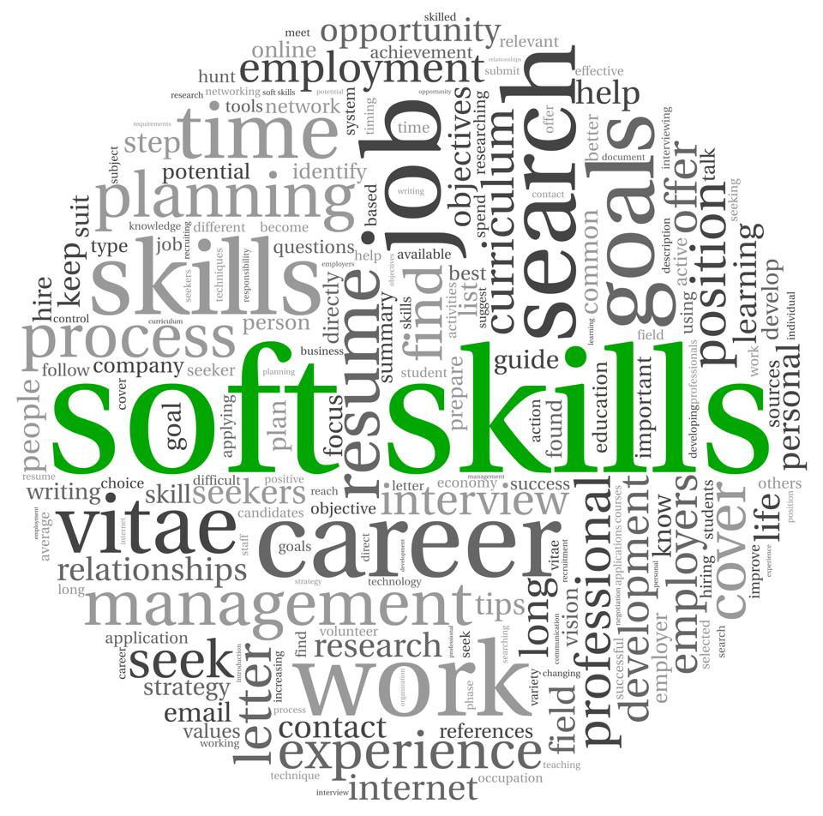
Development of Smart Skills
The COVID-19 pandemic has accelerated the need for reskilling and upskilling of the workforce, especially in regions that have been heavily impacted by the crisis. The VET sector has an important role in equipping individuals with the necessary skills to thrive in the rapidly changing job market.
In this context, the development of smart skills, including T-shaped skills, smart solutions thinking, and smart planning, is essential.

Slide 8
Development of Smart Skills
General steps for developing smart skills:
Assess your current skills: Start by identifying your current skills and determining which ones you need to improve.
Set specific goals: Determine the specific smart skills you want to develop and set clear and achievable goals for each one.
Develop a plan: Develop a plan to acquire the skills you need, such as taking courses, attending workshops, or seeking mentorship.

Slide 9
Development of Smart Skills
4. Gain hands-on experience: Practice the skills you have learned through real-life situations and projects.
5. Reflect on your progress: Regularly reflect on your progress and adjust your plan accordingly.
6. Seek feedback: Ask for feedback from others to see how you are progressing and to identify areas for improvement.
7. Continuously learn and grow: The job market and technology are constantly changing, so it is essential to continuously learn and grow your skills to stay relevant.

Slide 10
Forecasts of changing Occupational Structure of Employment in EU28+3 associate countries, numbers in employment; 2016 and 2030 compared

Slide 11
T-shaped skills
https://www.youtube.com/watch?v=J_yuGFMM6r0

Slide 12
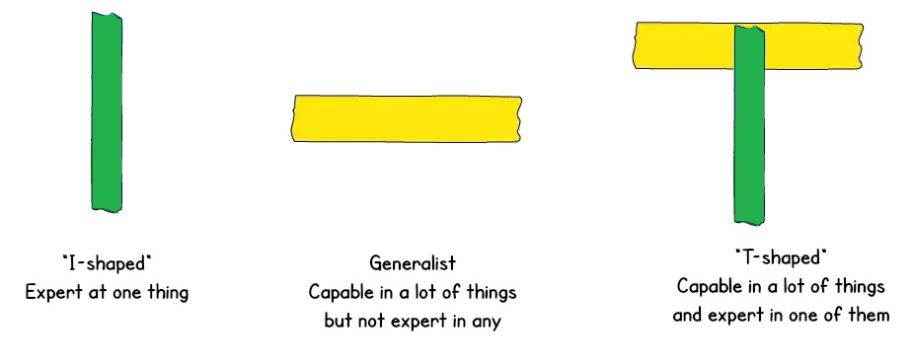
T-shaped skills
T-shaped skills are a set of skills that bring together a blend of deep expertise in one or more specific areas and broad knowledge across several different fields. The "T" shape visualizes the interplay between these two types of skills, with the vertical bar of the T representing deep expertise in a specific area, and the horizontal bar representing broad knowledge across multiple fields.
They are especially valuable because they allow individuals to bring together their technical expertise with a broad understanding of the context in which they are working. For example, a VET professional with T-shaped skills might have deep expertise in one area, such as digital skills, but also have a broad understanding of the social, economic, and political factors that impact the adoption of new technologies.
T-shaped skills can help decision-makers to see the bigger picture and to make informed decisions that take into account the wider context.

Slide 13
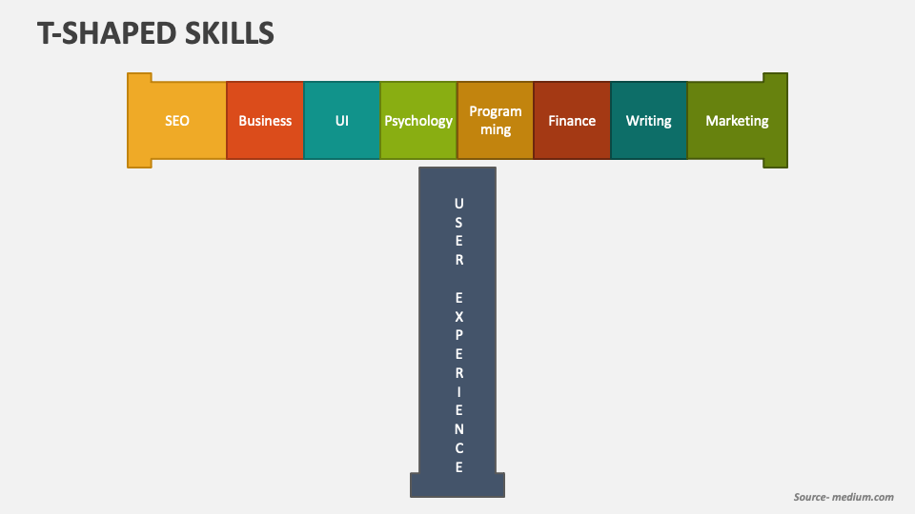
What actually are T-shaped skills?
T-shaped employees are highly valuable to any company. Examples of skills evident in many T-shaped people include:
A broad knowledge about a particular topic.
A broader context for your specialised skill set.
A basic knowledge of how humans and society work.
Understanding of the industry you work in.
Basic knowledge of how the business world works.
Soft skills – sometimes referred to as ‘interpersonal’ or ‘people’ skills. These are subjective and harder to measure – for example:
Teamwork.
Communication is essential in any team. To find out more, check out our course here.
Time management. To find out more you can take our Time Management Training course.
Basic IT skills.
Tolerance and open-mindedness.

Slide 14
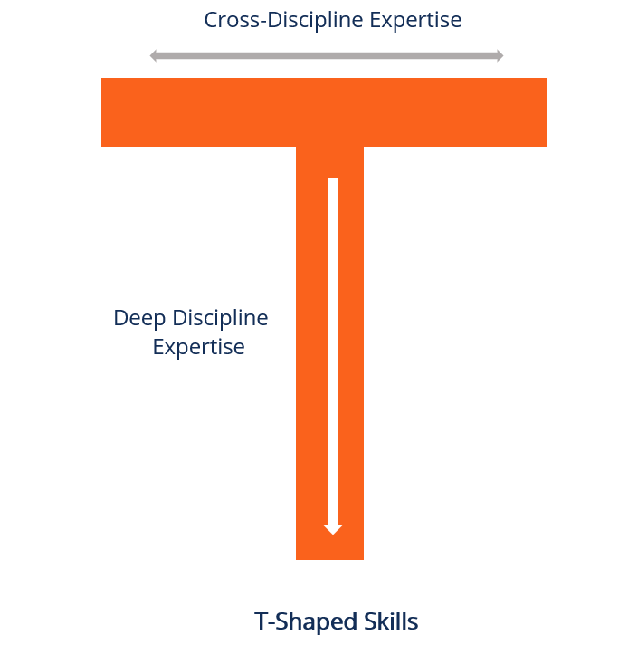
T-shaped skills can be split into two categories: depth skills and breadth skills.
Depth skills refer to the individual's expertise in a specific field. These are the technical skills and knowledge that an individual has in a particular area. For example, an engineer who has in-depth knowledge of computer science, electrical engineering, and software programming.
Breadth skills refer to the individual's ability to collaborate and communicate with people from different disciplines and backgrounds. This includes soft skills such as communication, collaboration, creativity, leadership, and emotional intelligence. For example, an individual who has breadth skills in project management may have a background in engineering, but also possess strong communication and collaboration skills that allow them to work effectively with cross-functional teams.

Slide 15
Advantages of becoming T-shaped Individual
Having T-shaped individuals is widely understood as being very beneficial not only on an individual level – perhaps as a manager – but also company wide. Core skills and the ability to learn quickly are just a few reasons why T-shaped employees excel in their main responsibilities, but they also perform other tasks throughout the business effectively. Thus, they contribute to the growth of the team.

Slide 16
T-shaped individuals offer these advantages:
Core skills. T-shaped employees excel in their main responsibilities within their job role. This also means they are great resources. The deep expertise that a T-shaped employee will display to push discution forward and encourage movement is undoubtedly a huge benefit to the organisation as a whole.
Better communication. Largely due to their interpersonal skills, they are able to empathise with people and understand their needs – across the team as a whole.
Better collaboration skills. This goes hand in hand with an ability to communicate well across the company, as they can discuss matters and work well over the entire organisation.

Slide 17
T-shaped individuals offer these advantages:
Flexibility. They are flexible enough to take on new tasks alongside their workload without compromising on the quality of work – achieving their immediate goals whilst helping out around the company.
They see the whole picture. Those who possess a very specific skill set (I-shaped employees) are of great value. However, they can often fall into a habit of tunnel vision – drilling down on their own subject area and neglecting other areas of importance. T-shaped employees, on the other hand, are able to apply their specialised knowledge and desire to learn to other areas and projects they may be working on

Slide 18
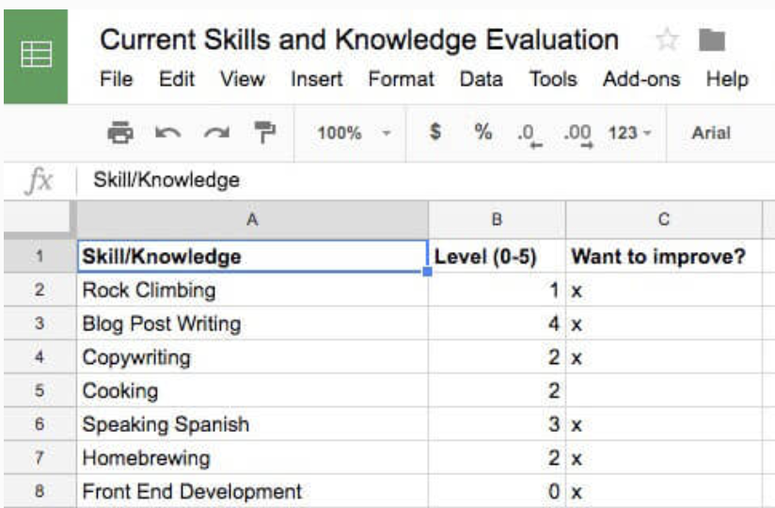
How to become T-shaped?
The first question to address when starting on your T-shaped journey is What skills should I build? What should I learn?
There isn’t a concrete answer. It all depends on the goals and values you’ve defined. But you can build a general framework, however.

Slide 19
Levels to become T-shaped
First, you need to assess what skills and knowledge you already have and you need to rate your ability in each area. You can do this in a spreadsheet where you write down all the skills and knowledge you can think of, and then rate each on a scale of 0-5. Here’s how you can think of each level:
0 – You know (almost) nothing besides the name of the area. You want to learn it but haven’t practiced or studied it.
1 – You’re a novice. You’ve started learning, but you don’t know how to do anything yet. If you want to put it in college terms, you’re in the first few weeks of a 101 course.
2 – You’re an advanced beginner. You can do a few things on your own, but you still need lots of guidance and formulas

Slide 20
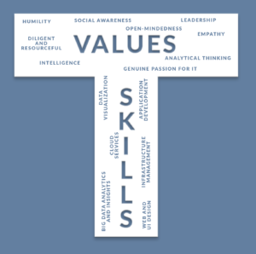
Levels to become T-shaped
3 – You’re now competent. You’ve gotten past the introductory material, and you’re figuring out where to apply the different rules you’ve learned.
4 – You’re proficient. You can do things that most people can’t even think of doing. You’re not perfect, and you still have to think about what to do in certain situations. But you’re really good.
5 – You’re an expert. You operate using intuition above all else, and to an outside observer, your performance looks like magic.

Slide 21
Activity
Assess your current skills:
Start by identifying your current skills and rate your skill on a scale (0-5)
Skills summary
The need for the development of smart skills is growing in the current job market due to the rapidly changing technology and market demands. Employers are looking for individuals who have a unique combination of technical skills and transferable skills, such as problem-solving, critical thinking, and communication.
Overall, the T-shaped model encourages individuals to develop a broad range of skills and knowledge while also going deep in specific areas. This can make you a more versatile and adaptable professional, better equipped to handle the challenges of the modern workplace.

Slide 22
The new (t-shaped) you
Once you’ve done this self-assessment, you need to determine :
Where you want to improve your knowledge/ability.
Identify areas where you want to improve your skills or knowledge. This can be in your current field of expertise or in new areas you want to explore. Focus on developing a broad understanding of these areas, rather than just shallow knowledge.
2. Where you comfortable maintaining.
Consider the skills and knowledge you already have and feel comfortable with. These can be your areas of expertise that you want to maintain and deepen. You should continue to develop these skills while also exploring new areas.

Slide 23
The new (t-shaped) you
3. What you want to add.
Identify new skills or knowledge areas you want to add to your T-shaped profile. These can be complementary skills that enhance your existing expertise or new areas you want to explore. This can help you broaden your perspective and become more versatile.
4. Where you want to go deep.
Consider which areas you want to specialize in and deepen your knowledge. This can be a particular aspect of your current field or a new area you want to become an expert in. Going deep in a specific area can help you stand out and become a valuable resource for others.

Slide 24
Descriptions
3. Addition
These are things you currently know nothing about but want to learn. Maybe you need to learn them to make yourself a better job candidate, or maybe they just interest you. Whatever the reason, you want to start learning. For example, I want to learn coding AI so that I can build cool projects to help my work.
1. Improvement
When you rated yourself for each of your existing areas, you probably noticed some that you wish were stronger. For example, I’d like to improve my programming and rock climbing skills. Make note of these areas in the spreadsheet so that you can start working on them.
4. Depth
Finally, you need to identify the area where you want to specialize. You may already know what this area is... It could be an existing area; or it could be something new you know nothing about but really feel will be useful/interesting. Regardless, you need to identify this area so that you can focus on it.
2. Maintenance
In some areas, you’re perfectly content with your level and have no interest in going further. This is fine. Don’t waste your time improving areas that don’t matter to you.
For example, I’m fine with my very basic cooking abilities. I know enough to healthy cook with sufficient variety, and I’m not interested in becoming the next chef. As long as I cook regularly, I’ll maintain my skills, no problem.

Slide 25
What does becoming a T-shaped person look like on a daily basis? The following are key to success:
1. Make it a habit.
Habits are such a huge portion of our lives (40% of your daily actions, according to Duke University researchers). So when you take control of your habits, you gain immense power.
We need to make developing T-shaped self a habit. We can do this by taking each area that we want to improve/maintain and add it to our daily to-do list.
T-shaped skills
2. Work on projects.
Create something in your spare time. For example, if you want to learn WordPress, you can create a personal website and maintain it.

Slide 26
What does becoming a T-shaped person look like on a daily basis? The following are key to success:
3. Evaluate your progress.
Making your practice a habit is the first step, but if you want to improve you need to evaluate your progress regularly. Here are a few self-evaluation ideas:
If you want to test a particular knowledge area, read a recent paper from the field and rate your understanding of it from 1-5.
Use the Feynman Technique: Take a piece of paper and write everything you know about the topic. You’ll quickly find the gaps in your knowledge.
Teach your skill to someone else. Similar to the Feynman technique (but with more immediate feedback), this will expose areas that you don’t really understand.
T-shaped skills
4. Give your specialty extra attention.
For the area in which you want to become an expert, you need to pay special attention to your progress.
Also, seek out a mentor who can help you once you’ve progressed past introductory learning materials.

Slide 27
What does becoming a T-shaped person look like on a daily basis? The following are key to success:
5. Deconstruct skills.
Something like “learn rock climbing” is a huge, vague goal. So huge that it can feel impossible; so vague that it will be impossible if you don’t make it more concrete. To overcome that, break the skill down. For example, you might decide to focus on just foot positioning or on strengthening your fingers.
T-shaped skills
6. Be patient
Building T-shaped skills takes time and effort. Be patient and consistent in your efforts and eventually, you will see the results.

Slide 28
Smart Solutions Thinking
"Smart solutions thinking" is a mindset and approach towards problem solving that is characterized by a focus on innovation, creativity, and finding effective and efficient solutions to complex challenges. In the context of regional development, it is a key skill for professionals working in the field of regional development, including those in the vocational education and training (VET) sector, and those working with development agencies and decision-making bodies in the European Union.
For example, a professional with smart solutions thinking skills would be able to take a comprehensive, multi-disciplinary approach to analyzing a complex development challenge, such as a skills shortage in a specific region. They would be able to identify the root cause of the issue, consider various alternative solutions, and develop a tailored approach to addressing the challenge that leverages existing resources and partners.

Slide 29
Smart Solutions Thinking
Smart solutions thinking is an important skill for professionals who are working to promote regional development and support skills development across Europe. By adopting this mindset, professionals are able to create innovative, effective, and sustainable solutions to challenges in the regions they work in, ultimately contributing to the overall development of the European Union.
The key to smart solutions thinking is a willingness to embrace change and innovation, and to continuously learn and adapt in the face of new challenges. By staying curious, flexible, and open-minded, we can create smarter and more sustainable solutions that benefit both ourselves and our communities.

Slide 30
Smart Solutions Thinking
Smart solutions thinking is a process of identifying and implementing innovative and effective solutions to complex problems.
It is often used in fields such as engineering, technology, business, and sustainability, where finding efficient and effective solutions is critical.
It involves taking a systematic and strategic approach to problem-solving, using critical thinking, creativity, and analytical skills.
Smart solutions thinking also emphasizes collaboration and teamwork, as individuals with different backgrounds and skill sets can bring unique perspectives to a problem.
Smart solutions thinking requires an open-minded approach, where individuals are willing to challenge assumptions and explore different perspectives.
With the increasing complexity of modern-day challenges, smart solutions thinking is becoming increasingly important, as it allows us to tackle problems in a more efficient and effective way, and ultimately create a better world for all.

Slide 31
Smart Solutions Thinking
Involves a systematic and creative approach in finding solutions to problems or challenges. It requires taking a step back from the problem at hand and looking at it from different angles, considering multiple options and making data-driven decisions. Tips for applying smart solutions thinking:
Define the problem: Clearly identify and define the problem you are trying to solve.
Gather information: Research and gather data related to the problem and relevant industry trends.
Brainstorm: Brainstorm and generate multiple ideas and potential solutions. Encourage diverse perspectives and out-of-the-box thinking.
Evaluate options: Evaluate the potential solutions and determine their feasibility, impact, and risks.
Make a decision: Based on the evaluation, make a decision on the best solution and plan for implementation.
Monitor progress: Regularly monitor progress and assess whether the solution is working as planned. If not, be prepared to make adjustments or consider alternative solutions.
Continuous improvement: Continuously evaluate and improve the solution over time, adapting to changing circumstances and learning from past experiences.

Slide 32
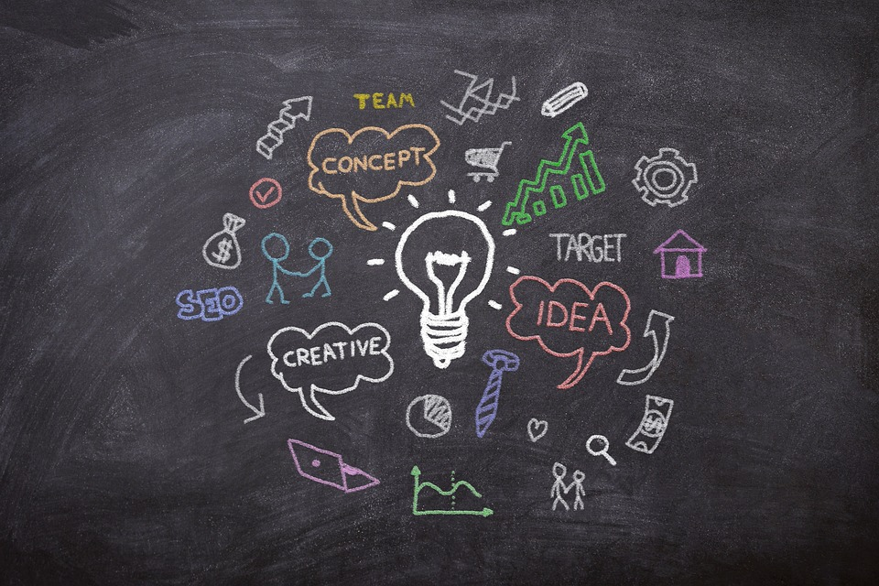
Smart Solutions Thinking
Smart solutions thinking can be applied in a variety of fields and industries, including regional development, VET (Vocational Education and Training), and within development agencies and decision-making circles. It can be a valuable skill to have in an ever-changing and dynamic environment, such as in the context of the European Union and the Erasmus program.

Slide 33
Examples of "smart solutions thinking"
Healthcare: In the context of healthcare, "smart solutions thinking" might involve looking at data, trends, and patient needs in order to create new and innovative ways to deliver healthcare services. For example, a hospital might use telemedicine to connect with patients remotely, or use machine learning algorithms to help diagnose patients more accurately and quickly.
smart solutions thinking
Energy: In the energy sector, it could mean developing new technologies and systems that are more efficient, sustainable, and environmentally friendly. For example, a company might develop new wind turbine technologies that generate more energy while using less land, or work on creating more energy-efficient building designs.

Slide 34
Examples of "smart solutions thinking"
Education: You might involve technology and data to create new ways of delivering education and training programs. For example, a university might use online learning platforms to reach students in remote locations, or use virtual reality simulations to provide hands-on training experiences.
smart solutions thinking
Transportation: In the transportation sector, "smart solutions thinking" could involve developing new technologies and systems that make transportation safer, more efficient, and more environmentally friendly. For example, a company might work on creating autonomous vehicles that can drive themselves, or use data and analytics to optimize transportation routes and reduce congestion.
In each of these examples, smart solutions thinking was applied by analyzing the root causes of a problem and implementing targeted solutions to address those causes. This approach can be applied to a wide range of challenges in various industries, and can lead to more effective and efficient solutions.

Slide 35
Activity
How to reduce waste in a company's office?
Smart solutions thinking
Form teams of 3-4 people
Each team has 5 minutes to come up with as many creative and feasible solutions as they can
Each team presents their solutions to the rest of the group
The teams will ask questions and provide feedback on each other's solutions
Each team will choose top 3 solutions and rank them in order of priority
Discuss as a group what made the solutions smart and what could be improved

Slide 36
Smart planning
"Smart planning" represents the process of using a strategic and well-informed approach in planning and decision-making. The goal of smart planning is to make better use of available resources, enhance the effectiveness and efficiency of plans, and improve the overall outcome of projects or initiatives. This type of planning incorporates the use of data, analysis, and creativity to develop realistic and achievable goals, while also considering potential obstacles and challenges that may arise. By using a smart planning approach, organizations and individuals can make informed decisions and implement effective strategies that lead to successful outcomes.

Slide 37
Smart planning
In the context of regional development, this implies the use of data-driven, strategic, and innovative approaches to address the specific needs and challenges of a region in terms of its economic, social, and environmental development. This approach recognizes the interdependence of these factors and seeks to balance them in the planning process.
Smart planning involves the use of technology and other tools to collect, analyze, and communicate data, as well as the engagement of stakeholders and decision-makers in a transparent and inclusive process to define and implement development goals. This approach also involves a continuous cycle of monitoring and evaluation, with regular adjustments made to ensure that plans remain relevant and effective in achieving regional development objectives.

Slide 38
What does smart mean?
Specific
o Explain the goal in detail – who, what, where, why o Could someone else understand your goal?
Time-bound
o Create a timeline/deadline for yourself o How long are you allowing yourself to achieve the goal?
S
Measurable
o Make sure you quantify the goal o Are you able to track your progress towards goal? o How will you know if you achieve the goal?
T
M
Relevant/Realistic
o Make sure your goal is applicable to the present concern o Does this goal align with your long-term goals?
Attainable/Achievable
o Make sure the goal is achievable – not too easy, but not out of reach o Can you realistically obtain goal? o Do you have the necessary resources?
R
A

Slide 39
Examples of "smart planning"
Urban Planning: The development of sustainable urban areas that promote a high quality of life and protect the environment is an example of smart planning. This involves considering factors such as accessibility, public transportation, green spaces, and the needs of different population groups.
smart planning
Healthcare Planning: Smart planning in the healthcare sector involves the efficient use of resources and the effective management of patient care, in order to improve the health outcomes of the population. This includes the use of electronic medical records, telemedicine, and the development of care pathways.

Slide 40
Examples of "smart planning"
Environmental Planning: Smart planning for the environment involves considering the long-term impacts of development and taking a proactive approach to environmental protection. This includes the use of renewable energy sources, reducing waste and greenhouse gas emissions, and promoting sustainable land use practices.
smart planning
Transportation Planning: The development of a smart transportation network that integrates different modes of transportation, such as walking, cycling, public transit, and private vehicles, is an example of smart planning. This helps to reduce traffic congestion, improve mobility, and reduce environmental impacts.

Slide 41
Examples of "smart planning"
Smart City Planning: This involves the integration of technology and data analytics to improve the management and delivery of urban services, such as transportation, energy, and waste management.
smart planning
Regional Economic Development Planning: This involves the development of a comprehensive strategy to drive economic growth and job creation in a specific region. This often involves collaboration between local governments, businesses, and communities.
Transportation Planning: The development of a smart transportation network that integrates different modes of transportation, such as walking, cycling, public transit, and private vehicles, is an example of smart planning. This helps to reduce traffic congestion, improve mobility, and reduce environmental impacts.

Slide 42
Examples of "smart planning"
Disaster Risk Reduction Planning: This involves the development of a comprehensive plan to reduce the impact of natural disasters on a region and its communities. This includes the identification of potential hazards, the development of evacuation plans, and the identification of critical infrastructure and services.
smart planning
Tourism Development Planning: This involves the development of a strategy to attract tourists to a region, while also ensuring the preservation of its natural and cultural resources. It usually involves collaboration between local governments, businesses, and communities.

Slide 43
Examples of "smart planning” in Romania
Best Practices in Romania:
The city of Timisoara's "Smart City" initiative, which uses technology and data to improve city services and livability for residents.
The "Smart Region" program in the county of Cluj, which focuses on innovation and digitalization in the local economy.
smart planning

Slide 44
Let’s watch smart planning in agriculture for example

Slide 45
Time to play
Form teams with 3-4 members
If you are a city manager, give 3 examples of Smart Planning for the city.
You have 10 minutes to think and after that each team will present their plan.
In the end will be choosen the best 3 Smart Planning solutions from all the teams

Slide 46
References
/ Overcoming the challenges of smart solution development: Co-alignment of processes, routines, and practices to manage product, service, and software integration https://www.sciencedirect.com/science/article/pii/S0166497221001632
/ Career challenges in smart cities: A sociotechnical systems view on sustainable careers https://journals.sagepub.com/doi/10.1177/0018726720949925
/ Building a Workforce for Smart City Governance: Challenges and Opportunities for the Planning and Administrative Professions https://www.mdpi.com/2227-9709/6/4/47
/ Smart cities: shaping the society of 2030 https://unesdoc.unesco.org/ark:/48223/pf0000367762
/ Vocational education and training: Skills for today and for the future
https://ec.europa.eu/social/main.jsp?catId=738&langId=en&pubId=8450&furtherPubs=yes
/ The T-Shaped Person: Building Deep Expertise AND a Wide Knowledge Base
https://collegeinfogeek.com/become-t-shaped-person/

Slide 47
Thank you!
@Regio.Digi.Hub

