Slide 1
Promoting Regional Development by building the capacity of the VET system

Slide 2
Smart Specialization – Sectors applied

Slide 3
Disclaimer
The European Commission support for the production of this publication does not constitute an endorsement of the contents which reflects the views only of the authors, and the Commission cannot be held responsible for any use which may be made of the information contained therein.
Project Nº: 2021-1-RO01-KA220-VET-000028118

Slide 4
Consortium

Slide 5
01
SMART SPECIALIZATION
02
S3 KEY ELEMENTS
03
DESIGNING STRUCTURE OF RIS3
Contents
04
SMART SPECIALIZATION PLATFORM
05
CASE STUDY OF ANDALUSIA
06
CASE STUDY OF CRETE

Slide 6
Smart Specialization Strategy (S3)
Definition
According to the Regulation (EU) N 1303/2013 of the European Parliament and of the Council, “Smart Specialisation Strategy (S3) means the national or regional innovation strategies which set priorities in order to build competitive advantage by developing and matching research and innovation own strengths to business needs in order to address emerging opportunities and market developments in a coherent manner, while avoiding duplication and fragmentation of efforts; a smart specialisation strategy may take the form of, or be included in, a national or regional research and innovation (R&I) strategic policy Framework”

Slide 7
What is Smart Specialization
Smart Specialization is an innovation policy concept that scopes to enhance regional innovation, supporting to growth and prosperity by assisting and enabling areas to emphasis on their strong points.
Smart specialization brings together local government, academia, business sectors, and the civil society through its partnership and bottom-up methodology to work for the implementation of long-term growth goals funded by EU funds.
Source: European Commission

Slide 8
S3 Key elements (a)
The following guiding concepts should be considered while developing a smart specialization strategy:
Place based-approach: It builds on the resources and assets available to regions and Member States as well as the distinct socioeconomic issues they face in order to identify special chances for growth and development;
Having strategy: Making investing decisions is the definition of having a strategy. Only a small number of clearly defined priorities for knowledge-based investments and/or clusters should receive support from Member States and regions. Focusing on competitive advantages and achievable development potentials that are underpinned by a critical mass of activity and entrepreneurial resources is what it means to specialize.

Slide 9
S3 Key elements (b)
The following guiding concepts should be considered while developing a smart specialization strategy:
Setting priorities should not be a top-down, picking-the-winner process: The process should involve all interested parties equally and be centered on "entrepreneurial discovery," which is an interactive process in which the private sector and market forces learn about new activities and produce information about them, and the government evaluates the results and gives the most power to those actors who can realize this potential.
Broad view of Innovation: The innovation plan should encourage technological, practice-based, social, and other types of innovation. This would enable each region and Member State to customize policy decisions in light of their particular socioeconomic circumstances;

Slide 10
Why the Concept of Smart Specialization is“smart”?
It establishes unique connections between research and innovation and economic development, such as the entrepreneurial process of discovery and the establishment of priorities by policymakers in close collaboration with local actors.
As a result of this process being conducted with an eye on the outside world, regions are forced to be ambitious but realistic about what can be accomplished while connecting local resources and capabilities to foreign knowledge sources and value chains.
Although each regional or national strategy will have some common elements, the place-based approach demonstrates how important it is to understand the local context for effective design.

Slide 11
Why the Concept of Smart Specialization is“smart”?
Source: https://youtu.be/hbTIVOBv8lU

Slide 12
The four Cs of smart specialization
Choices and critical mass: a small set of priorities based on personal strengths and global specialization
Competitive advantage: mobilize talent through an entrepreneurial discovery process that matches RTD + I capabilities with business needs.
Connectivity and Clusters: Create world-class clusters, establish arenas for cross-sector connections, and cultivate related variety to advance specialized technical diversification. Match what you have to what the rest of the world has.
Collaborative leadership: efficient innovation systems as a group effort based on a quadruple helix model of public-private collaboration - an experimental platform to give voice to unlikely suspects

Slide 13
Steps for designing structure of RIS3
1. Analysis of the regional context and potential for innovation
2. Creation of a transparent and inclusive governance framework
3. Creation of a common vision for the region’s future
4. Selection of a limited number of priorities for regional development
5. Establishment of appropriate policy mixes
6. Integration of monitoring and assessment mechanisms

Slide 14
Horizontal issues and policy delivery instruments for RIS³ (a)
Clusters
Clusters for regional growth: enterprise ecosystems that foster innovation
Innovation-friendly business environments for SMEs
Excellent jobs opportunities in competitive companies
Research infrastructures/centers of competence
support to ESFRI and EU wide diffusion of leading edge R&D results
Universities-enterprise cooperation
Lifelong learning in research and innovation
Digital agenda
Excellent jobs opportunities in competitive companies
Key enabling technologies
Possibility for fundamental change in a system

Slide 15
Horizontal issues and policy delivery instruments for RIS³ (b)
Internationalization…..
Internasionalization determines if the smart specialization approach can withstand global competition or seize opportunities
Cultural and creativity industries
Innovation beyond technology and outside manufacturing
Financial Engineering instruments
Stronger emphasis on financial engineering, not only grants
Innovative Public Procurement
Advantages as improved infrastructures and public services, cost savings, promotion of R&D investments
Green Growth
Smart simply refers to sustainability, eco-innovation and energy efficiency
Social Innovation
New organizational structures to address societal issues

Slide 16
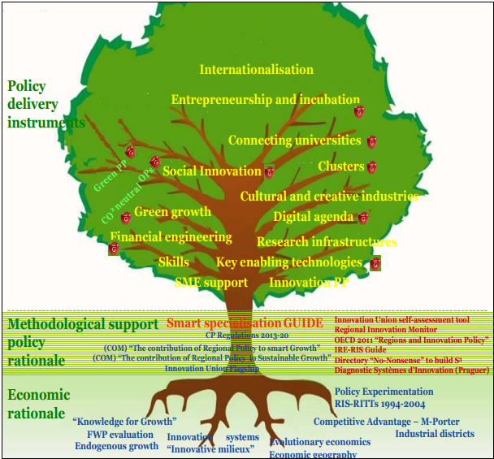
Branches of the Smart Specialization Tree

Slide 17
Smart Specialization Platform
In order to promote Smart Specialization, the European Commission announced the creation of the S3 Platform in 2010 in a relevant text “Regional Policy contributing to smart growth in Europe 2020”.
The platform was founded in 2010 and its role is to provide methodologies, information, expertise and guidance to national and regional policy makers, as well as encourage cross-border collaboration and mutual learning and to put the concept of Smart Specialization being discussed in academia.

Slide 18
Smart Specialization Platform
The Platform is hosted by JRC's Growth and Innovation Directorate (Dir. B) in Seville.
The three main platform’s components are the following:
1. A project management and R&D team at the JRC
2. A steering team made up of members from various commission services.
3. A mirror Group of eminent academics and specialists in innovation and regional development as well as representatives from organizations including the OECD, EURADA, ERRIN, EBN, and the European Cluster Observatory and Alliance).

Slide 19
Smart Specialization Platform activities (a)
Guidance
The S3Platform has created its own customized procedures for analyzing RIS3 based on current practice and holds regular seminars for registered regions and nations. The Platform can also offer assistance on procedures, serve as moderators and reporters, and suggest experts to add additional perspective to evaluations being conducted in specific Member States.
Academic research and analysis
The European Commission's scientific and technical branch, the Joint Research Centre (JRC), conducts multidisciplinary research to help with pressing policy issues. Smart specialization is an illustration of how theory and practice may exchange knowledge and how the EU can benefit from the broad spectrum of scholarly skills present in the many JRC institutions.
Peer review
This document provides methodological recommendations on how to develop, draft, and carry out a regional smart specialization strategy for policymakers and implementing authorities. Following conversations between regions and contributing policy experts, updates will be made on a regular basis.
Notes:
https://wbc-rti.info/object/document/10971/attach/IISP_Report__A1_1_EU_Institutions_and_Initiatives-1.pdf

Slide 20
Smart Specialization Platform activities (b)
Organize events
The website is useful for everyone interested in smart specialization and was created primarily for regions and nations that have registered on the Platform. It offers details about relevant initiatives and sources. Additionally, interactive tools that have been expressly created are currently being developed as online resources for registered regions and nations.
Management of the S3p website
Two kinds of events are organized into the platform: Outreach seminars in several European areas explain and promote the idea of Smart Specialization to all interested sectors and institutions; Workshops for registered regions focus on particular issues of interest to local decision-makers.
Additionally, the Platform will help Member States organize national Smart Specialization events.

Slide 21
Smart specialization platform services
Smart specialization platform offers:
Training to policy makers
Access to essential information
Attending in high quality research projects informing about policy making process and strategy formation
Facilitating peer-reviews
Instances of good practices and advices
Organizing policymakers' information sessions and attending conferences
All EU member States and Regions are eligible to register on the Platform

Slide 22
S3 Platform (Video)
Source: https://youtu.be/uqntML2ycGY

Slide 23
The role of Universities in Smart specialization
Universities can be a foundation for local economies in a wide range branches. Their contribution in this direction can be achieved through:
business innovation which is closely linked to the research function of the University,
The development of human capital linked to teaching
Of expanding the community associated with the University
The contribution of its executives and members to the local community
If the above prerequisites are met, then the University is capable to take an active role in the regional development process.

Slide 24
Universities and Regional innovation
The promotion of the active involvement of the Universities in the regions has acquired a new importance for the development of the concept of regional smart specialization.
According to McCann and Ortega-Argiles study Smart Specialization foresees that the definition of areas for expansion and development is related to the roe of specific stakeholders such as researchers, suppliers, manufacturers and service providers, entrepreneurs, end uses in research and industry etc.
These stakeholders seek to acquire knowledge and capital, explore potential buying opportunities, identifying technology to exploit. Thus, Universities can play an important role in defining a regional smart specialization strategy, contributing to a more rigorous assessment of knowledge area, area, competences and skills etc.

Slide 25
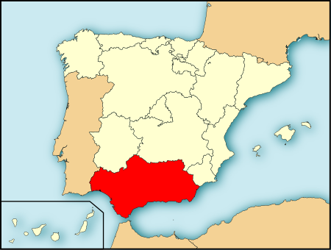
Case study of Andalusia (a)
Spain has given priority to its aerospace cluster, building on its Advanced Centre for Aerospace Technologies, aeronautical scientific and technological parks, advanced system for simulating forest-fire fighting, aerial test bench, and solid knowledge base in aeronautics
Andalusia is famous for aeronautic activities and is a pioneer in this field, having a long history that begins in 1926.
The Nucleus cluster is made up of the four manufacturing facilities that the former Spanish aircraft manufacturer CASA (now Airbus) developed.
Its considerable expansion can be dated to the late 1980s, when the cluster Auxiliaries, a well-maintained network of subcontractors, was formed.
About 11 000 people are employed by the cluster, which is made up of 80 SMEs and 40 non-SMEs. The cluster´s turnover is approximately EUR 2 billion, which accounts for 35% of the industrial GDP of the provinces of Seville and Cádiz, the home of the cluster.
This Photo by Unknown Author is licensed under CC BY-SA

Slide 26
Case study of Andalusia (b)
The regional administration has built an innovative infrastructure to enhance aeronautics capabilities:
CATEC (Advanced Centre for Aerospace Technologies
SEILAF: an advanced system for stimulating forest-fine fighting
ATLAS: A dedicated aerial space for conducting flight tests serves as a testing ground for designers and manufacturers of unmanned aerial vehicles
AEROPOLIS and TECNOBAHÍA: two Scientific Technological Parks dedicated to the aeronautics sector include incubators, Engineering centre, a Suppliers village among other services.
This Photo by Unknown Author is licensed under CC BY-SA

Slide 27
Case study of Andalusia (c)
Innovation Infrastructure
The "Innovation Infrastructure," a network of "Knowledge Agents“, including public and commercial Technological Centers, Scientific and Technological Parks, and Research and Technological Institutes, is the foundation of the innovation system in Andalusia. Through these Knowledge Agents, who must be approved by the Central Government, knowledge generated is made available to companies. In this manner, the national R&D priorities and programs are connected to the regional innovation infrastructure.
The Andalusian Plan for Industrial Development, which identifies the industries to be taken into consideration as strategic, provides a horizontal definition of industrial regional policy.
The Aerospace Plan 2010-2013 has been prepared and agreed by the regional administration and the social agents with a technical advice and assessment of the Helice Foundation.
In order to link the regional plan with the national objectives, CDTI prepared the National Aerospace Strategic Plan before the Andalusian Plan, and its priorities and channels of support were taken into consideration.

Slide 28
Case study of Andalusia (d)
The Strategic Plan aims to “turn the Andalusian Aerospace into a competitive sector of Knowledge & Innovation based economy and I one of the engines of development” . Thus, the Plan is complementary to the Andalusian Industrial Development Program (APID)
More specific objectives:
To establish Andalusia as a global center of excellence for aircraft used for military missions
to increase the volume of business with conventional aircraft manufacturers, diversify and grow existing markets
a greater institutional presence in national decision-making bodies;
to accelerate the engineering for system design and development and mission equipment;
To upgrade basic technologies used by the cluster

Slide 29
Case study of Andalusia
Lessons learned
Regional Funds
The crucial role of regional finances in promoting the innovative infrastructure for the aerospace industry, including Aeropolis, Tecnobaha, and CATEC as Technology Centers and Technology Parks, respectively
Entrepreneurship
When creating incentives, policymakers should consider the sector's entrepreneurial environment.
Links between Universities and industry
Promoting academic research and academic researchers is clearly necessary for the entrepreneurial endeavors of the technological parks and centers. the significance of including PhDs at the industrial and entrepreneurial level.
Improved industry-public strategy support
The Regional Administration and the aerospace cluster have not formally agreed on any joint strategies. In order to allocate the available resources to the goals of the strategy, one change to implement S3 strategies in the upcoming EU Framework Programme would be to attach the approved cluster strategies to the published lines of financial assistance.

Slide 30
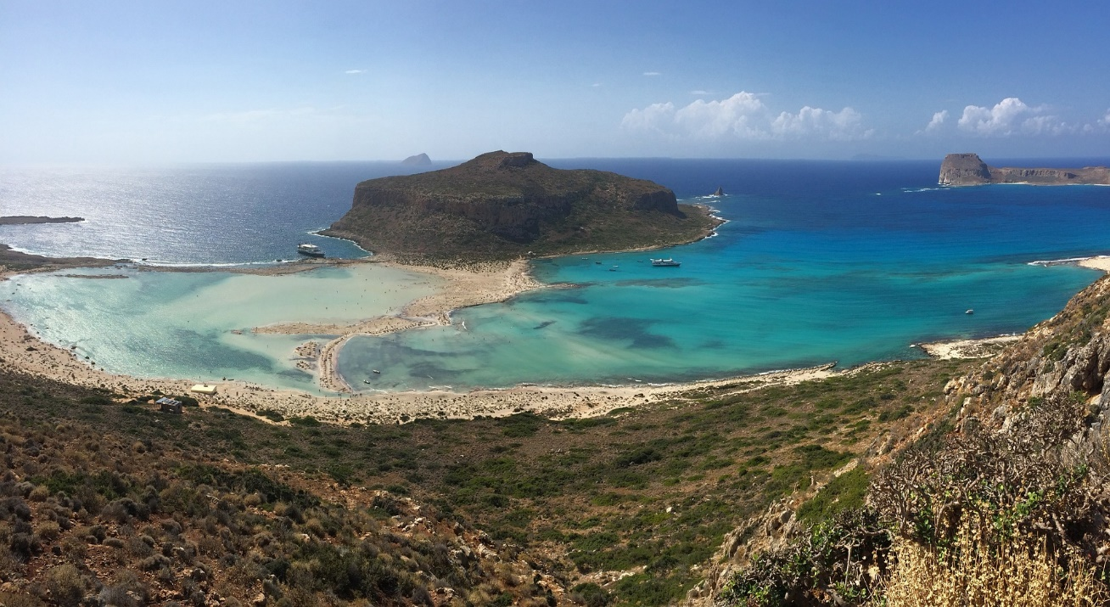
Case study of Crete
Crete is the largest island of Greece and the fifth largest of the islands that belong to the Mediterranean Sea. The island of Crete is a valuable part of the Greek economy. it is located at the southern end of the Aegean Sea and due to its strong geographical position it was a crossroads of cultures.

Slide 31
Case study of Crete: Dynamic and Sustainable Crete
The vision of the development plan for Crete within NSFR 2014-2020 is the following:
Dynamic and Sustainable Crete
Dynamic in the sense that it has a comprehensive plan to end the economic crisis, has made investments, has improved connections, and is export-focused in its dynamic sectors of the local economy:
Agro-alimentary
Cultural
Touristic
Environmental
Knowledge-based
Environmental sustainability: protecting and enhancing natural and cultural resources
Economically sustainable: The goal is to achieve sustainable development based on the features of the Region, including the enduring value of culture.
Sustainable in terms of society: paired with strategies to fight poverty and assistance for socially vulnerable groups.

Slide 32
Dynamic and Sustainable Crete Plan:
Addressing economic crisis
A comprehensive plan for the regional economy's recovery that focuses on maximizing innovation and scientific knowledge potential in an effort to increase the competitiveness of the established branches and broaden Crete's production base toward newly emerging, high added value sectors.
Establishment of Environmental Legal Framework
A legal framework that addresses Crete's significant environmental issues and challenges in order to promote sustainable development and the creation of new jobs.

Slide 33
Specific objectives
The Smart Specialization Strategy of the Region of Crete, in particular, strives to use the potential of innovation and scientific knowledge in order to:
Εnhance export-oriented sectors, revitalize the agro-alimentary sector, and raise awareness of the importance of Cretan nutrition, which is part of Crete's intangible cultural heritage.
accomplish the international market consolidation of a competitive cultural-tourism complex with original and distinctive elements
minimize Crete's reliance on traditional energy sources
shift towards the sustainable use of the island’s natural resources
5. make the most of what the water has to offer
6. build world-class educational and training programs for its human resources that will rely on the educational web of Crete.
7. create high-value production projects in emerging industries that will rely on Crete's educational web

Slide 34
Case study of Crete Conclusions (a)
The agro-alimentary complex is characterized by high degree of specialization because, according to the GDP, its contribution in various other branches and sectors is higher compared to that of the average GDP of the country. Thanks to the internationally recognized Cretan products that contribute to longevity, the export sector for the island of Crete showed an upward trend. Moreover, to the dynamics of this sector is added the contribution of relevant research bodies (hcmr, elgo, )through which business innovation is promoted.
Source: Pixabay

Slide 35
Case study of Crete Conclusions (b)
Regarding the cultural-touristic complex indicates a much larger percentage that the average of the country, in terms of overnight stays and visits to remarkable historical –cultural sites. Thus, it is deemed necessary to carry out several investments to improve the infrastructure and upgrade the tourist services provided. also, highlighting the cultural wealth of Crete, making use of modern technological structures, will contribute to attracting even more private investments
Source: Pixabay

Slide 36
Case study of Crete Conclusions (c)
As far as the environmental complex is concerned, a positive and efficient management of water and waste has been observed, but also great innovations in the field of energy saving. However imperative is the need to further develop systems for proper management and prevention of water and waste pollution, as well as systems that use different forms of renewable energy that are even more "friendly" to the environment.
Source: Pixabay

Slide 37
Case study of Crete Conclusions (d)
The complex of knowledge is an emerging and evolving branch, the people have a high form of innovation in the region of Crete, but minimal to quite limited financial resources. consequently, the aim is to attract businesses and capital from abroad, to promote collaborations in sectors with intense technological demand. the provision of the necessary financing for the strengthening of entrepreneurship in the first stages of its operation, in combination with the knowledge possessed by the research community of Crete, will contribute decisively to the successful implementation of the smart specialization strategy
Source: Pixabay

Slide 38
References
https://eur-lex.europa.eu/legal-content/EN/TXT/PDF/?uri=CELEX:02013R1303-20200718&rid=2
https://s3platform.jrc.ec.europa.eu/documents/portlet_file_entry/20125/Factsheet+%E2%80%93+What+is+Smart+specialisation.pdf/48da2521-e4bd-1c5f-6de9-17859b7ae427
https://wbc-rti.info/object/document/10971/attach/IISP_Report__A1_1_EU_Institutions_and_Initiatives-1.pdf
https://eua.eu/downloads/publications/report%20on%20joint%20eua-regio%20the%20role%20of%20universities%20in%20smart%20specialisation%20strategies.pdf
https://www.tandfonline.com/doi/abs/10.1080/00343404.2013.799769
https://publications.jrc.ec.europa.eu/repository/handle/JRC124478
https://www.oecd.org/sti/inno/smart-specialisation.pdf
http://www.pepkritis.gr/wp-content/uploads/2016/02/RIS-Crete-Translation-ENG.pdf
https://apothesis.lib.hmu.gr/bitstream/handle/20.500.12688/9313/DimakiPanagiota_ZacharioudakiAnnaMaria2020.pdf?sequence=1&isAllowed=y

Slide 39
Thank you!
@Regio.Digi.Hub

