Slide 1
Promoting Regional Development by building the capacity of the VET system

Slide 2
Understanding and applying Social Entrepreneurship principles

Slide 3
Disclaimer
The European Commission support for the production of this publication does not constitute an endorsement of the contents which reflects the views only of the authors, and the Commission cannot be held responsible for any use which may be made of the information contained therein.
Project Nº: 2021-1-RO01-KA220-VET-000028118

Slide 4
Consortium

Slide 5
01
What is Social Entrepreneurship and Social Entrepreneur?
02
Types of organizational models
03
6 P's of Social Entrepreneurial Enterprises
04
Skills for social entrepreneurs
Contetns
05
Social impact and social entrepreneurship
06
The role of social entrepreneurship for regional development
07
Social Enterprise as a Catalyst for Sustainable Local and Regional Development
08
Activities

Slide 6
01 - What is Social Entrepreneurship and Social Entrepreneur?
Social entrepreneurship is a growing trend, combining the ingenuity of business with the social mission. It is a way of doing business in an effort to make changes in the world through addressing social, cultural, or environmental issues.

Slide 7
01 - What is Social Entrepreneurship and Social Entrepreneur?
Social entrepreneurship is the process through which specific types of actors – the “social entrepreneurs” – create and develop organisations that may be either social enterprises or other types of organisations.
The concept of social entrepreneurship may be applied to organisations with different sizes, beliefs, goals and targets.
.

Slide 8
01 - What is Social Entrepreneurship and Social Entrepreneur?
And what does social entrepreneur mean?
A social entrepreneur is a person who pursues novel applications that have the potential to solve community-based problems. These individuals are willing to take on the risk and effort to create positive changes in society through their initiatives. Social entrepreneurs may believe that this practice is a way to connect you to your life's purpose, help others find theirs, and make a difference in the world (all while eking out a living).
Widespread use of ethical practices—such as impact investing, conscious consumerism, and corporate social responsibility programs—facilitates the success of social entrepreneurs.
.

Slide 9
01 - What is Social Entrepreneurship and Social Entrepreneur?
Watch the video and learn more about the social entrepreneurship and social entrepreneur.
https://www.youtube.com/watch?v=1ecKK3S8DOE

Slide 10
01 - What is Social Entrepreneurship and Social Entrepreneur?
Characteristics of social entrepreneurship
The individuals or organizations who practice social entrepreneurship develop, fund and implement opportunities to enhance social wealth in an innovative way. They start a business to make a difference.
These types of businesses share similar qualities such as:
Focus on solving a specific social, cultural, or environmental issue, and strategize innovative ways to find a solution.
Earn a profit and use a portion of that profit to support their mission.
Use feedback and community input to evolve and implement changes in the most suitable way possible.

Slide 11
01 - What is Social Entrepreneurship and Social Entrepreneur?
How social entrepreneurship differs from business entrepreneurship?
Social Entrepreneurship
All about collective efforts for society
Aims at producing goods and services that can serve the community and solve a problem
Focused on a solution-oriented approach to a social problem
Measures performance according to the impact made
The purpose is to promote their cause and improve the society
Business Entrepreneurship
More about the individual
Aims at producing goods and services
Focused on the market, demand and trends
Measures performance according to profits
The propose is to satisfy customer needs, excel and earn profits

Slide 12
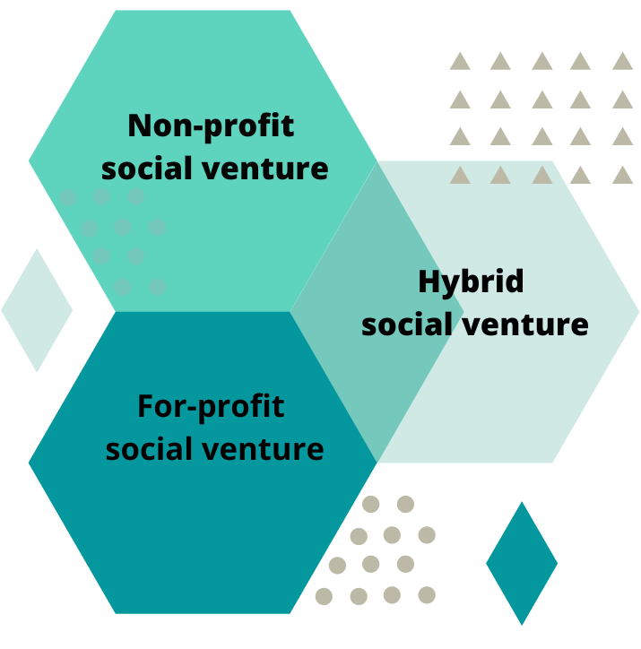
02 -Types of organizational models
Non-profit social venture: An organization without the goal of earning an income which uses all of its available resources in an innovative way to address social needs and challenges. Outside funding is required to run the venture, but is often mutually beneficial due to the fact that the philanthropic investors have a personal stake in the success of the venture.
For-profit social venture: An organization still focused on earning income, yet designed to impact change or solve a social problem. Social entrepreneurship ventures differ from traditional corporate businesses in that their focus is to grow the social endeavor rather than increase profit.
Hybrid social venture: A non-profit organization that is willing to generate revenue. It does so by blurring the lines between the non-profit and for-profit sectors, in order to maintain initiatives with social or community objectives. These organizations’ structures can vary depending on the degree of priority for their social and profit-based initiatives.

Slide 13
03 - 6 P's of Social Entrepreneurial Enterprises
As social entrepreneurs embark on turning their ideas into successes, they often work through the following six areas. Each of these categories are different resources, roadblocks, or stages a social entrepreneur must often encounter.

Slide 14
03 - 6 P's of Social Entrepreneurial Enterprises
1. What people the social entrepreneur wants to benefit? This is the first question that every social entrepreneur must answer. Without a clear vision of who he/she wants to serve, he/she will face difficulty in appropriately defining the scope of his/her enterprise.
People
Social Entrepreneurship
Sometimes, this is the people in their specific geographical region. Other times, this is people within a certain demographic (i.e. people with low income).
2. What is the most pressing problem that the people in the previous section face? Social entrepreneur tries to fix problems and more specifically, he/she must select the most pressing and significant problem, the solution of which will lead to a meaningful impact.
Problem

Slide 15
03 - 6 P's of Social Entrepreneurial Enterprises
3. How social entrepreneur plans to solve this problem? With the people and problem identified, a social entrepreneur must devise a plan to solve the problem. Social entrepreneurs not only strive to create a business plan to operate an entity, they must also determine how this type of entity will receive funding and remain financially sustainable. The social entrepreneur must also evaluate how external parties can help it achieve its social goals.
Plan
Social Entrepreneurship
4. A big challenge for any social entrepreneur is the lack of available resources to tackle the problem they wish to solve. Social entrepreneurs face many constraints - lack of enough money, lack of enough specialized knowledge or external forces that cannot be controlled. In this case, they should set their priorities in terms of what they are trying to solve, how they work and what expansion looks like.
Prioritize

Slide 16
03 - 6 P's of Social Entrepreneurial Enterprises
5. Social entrepreneurs often test out solutions in small markets before expanding, because resources are limited. This means creating prototype products, services, or processes. It also tests out how different funding and resources can help it achieve its goals.
Social Entrepreneurship
Prototype
During this stage, social entrepreneurs strive to gather information, rather than deliver full-fledged solutions.
6. After the prototyping stage, social entrepreneurs identify what went well and what didn't go well. This last step closes the full loop of activity, though a social entrepreneur should periodically evaluate each aspect and continually monitor for ways to better make their social change.
Pursue

Slide 17
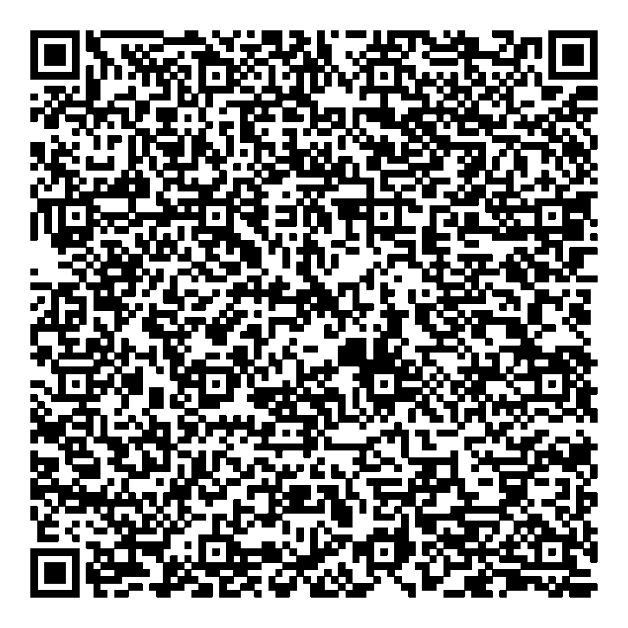
03 - 6 P's of Social Entrepreneurial Enterprises
Social Entrepreneurship
Scan the QR code and learn more about the 6 P's of Starting a Social Enterprise

Slide 18
04 - Skills for social entrepreneurs
According to Scott Sherman (2011), a social entrepreneur should have the following skills and abilities:
Leadership
Optimism
Grit
Resilience in the face of adversities, obstacles, challenges, and failures
Creativity and innovation
Empathy
Emotional and social intelligence
Which skills do you need to manage a social enterprise?
Do you have them?
Would it be more promising to work in a team combining all the skills?

Slide 19
04 - Skills for social entrepreneurs
Leadership. These people take initiative and action to solve problems (rather than complaining about what’s wrong).
Creativity and innovation. These people see new possibilities and think in unconventional ways. They see connections and patterns where few other people would imagine.
Optimism. These people are confident that they can achieve a bold vision, even when many other people doubt them. They have a strong sense of self-efficacy and a belief that they have control to change their circumstances.
Empathy. These people are able to put themselves in the shoes of others, and imagine perspectives other than their own; this is one of the most valuable qualities for understanding the needs of others whom they serve.
Grit. This is a combination of perseverance, passion, and hard work—the relentless drive to achieve goals, complete commitment to achieving their task.
Emotional and social intelligence. These people are excellent at connecting with others and building strong relationships.

Slide 20
04 - Skills for social entrepreneurs
Resilience in the face of adversities, obstacles, challenges, and failures. When things fall apart, these people rise to the occasion. They thrive in the most ferocious storms. They see failures as valuable feedback.
Social entrepreneurs must have exceptional networking and relationship-building abilities. When they connect and network with the on-ground people, they understand the segments of the fundamental problems and hence will be able to come up with better solutions. They need strong connections to build leverage and scale for their business ideas.

Slide 21
04 - Skills for social entrepreneurs
Building strong teams
For the success of the social enterprise it would be more promising to work in a team combining all the skills. That is why it is important to building strong team.
Building strong teams helps combine existing strengths and pool risks.
Three dimensions of suitability are important for any staff member of a social enterprise, and critical for high-responsibility positions:
Social mission fit
Cultural fit
Founder fit

Slide 22
04 - Skills for social entrepreneurs
Building strong teams
Social mission fit
Commitment to the mission and strong personal values are key to ensuring the new member of the management team will not readily compromise the mission.
Cultural fit
Social enterprises thrive in an ethical, transformational and empowering culture and leadership style, which foster the employees’ satisfaction, motivation, commitment and intention to stay. a good fit with the organizational culture and leadership style must not be underestimated, as it may not be a natural consequence of the social mission fit. A central aspect of culture should be everyone’s motivation to work towards the achievement of the mission instead of focusing on individual rewards such as power or financial compensation.

Slide 23
04 - Skills for social entrepreneurs
Building strong teams
Founder fit
The members of the management team need to be able to work together well with the founder in terms of personality, skills and attitude as well as loyalty to the founder and the founder’s achievements. To compose a strong and effective leadership team, senior managers should complement the particular strengths and weaknesses of the founder.

Slide 24
05 - Social impact and social entrepreneurship:
Facts and statistics
Main findings from the Global Entrepreneurship Monitor’s (GEM) social impact startups and social entrepreneurship activity research. The report is based on interviews with 167,793 adults in 58 economies, and is thus the largest comparative study of social impact startups and social entrepreneurship in the world.
The average prevalence rate of broad social entrepreneurial activity among nascent entrepreneurs in the start-up phase –are currently trying to start social entrepreneurial activity is 3.2%.
The average prevalence rate of individuals who are currently leading an operating social entrepreneurial activity is 3.7%.
Among 18- to 34-year-olds, there is a greater representation of nascent social entrepreneurs than nascent commercial entrepreneurs in Western Europe. However, in Eastern Europe there are more nascent commercial entrepreneurs than nascent social entrepreneurs in this age range.

Slide 25
05 - Social impact and social entrepreneurship:
Facts and statistics
One of the emerging themes in social entrepreneurship is measuring social impact. About half of those individuals who fit the broad definition of social entrepreneurs report that they put substantial effort into measuring the social and environmental impact of their social venturing activities.
About five in every 10 individuals involved in broad social entrepreneurship activity that is currently operational reinvest profits towards the social goals set by the activity, organisation or initiative.

Slide 26
05 - Social impact and social entrepreneurship:
Facts and statistics
Social entrepreneurs are visible to the wider population, with an average of 32% of the adult (age 18 to 64) population agreeing that they are often aware of enterprises that aim to solve social problems.
In general, social entrepreneurs tend to be quite optimistic in terms of growth aspirations. Patterns of size, use of volunteers and job expectations are fairly mixed across the globe.

Slide 27
06 - The role of social entrepreneurship for regional development
Social entrepreneurship is an important driving force for regional development. It occupies market niches where the policy makers fail to offer enough services and the market fails to make enough profits.
Social Entrepreneurship
Social entrepreneurship encourages the diffusion of good practices in local areas by:
reinvesting profits in geographical areas where they are created;
mobilizing local stakeholders and local resources;
creating an entrepreneurial culture;
linking activities to local needs;
sustaining activities in danger of disappearing because they are not profitable;
creating social capital.

Slide 28
06 - The role of social entrepreneurship for regional development
Social entrepreneurship is a buffer against crises for two reasons. The first is because of special rules /non-profit, surplus distribution, democratic governance/, it seeks longer-term strategies. The second is flexibility of working hours and wages, less hierarchy in pay, job stability /less turnover, retaining adult jobs, integrating women/ and continues to receive donations and voluntary work because people believe in it.
Social Entrepreneurship

Slide 29
07 - Social Enterprise as a Catalyst for Sustainable Local and Regional Development
Social economy theory uses social enterprise to respond to the needs of the new paradigm in local and regional development (LRD). In the context of LRD, scholars consider social enterprise a relatively new idea that provides sustainable goods and services. Social enterprises provide regions with necessary assets and social infrastructure, such as an understanding of the region or community based on the context of social enterprises. The following table presents the relationship between types of values and their functions in local and regional development. Simon Bridge and other authors discuss the role of social enterprises in local and regional development based on the implementation of these values. In business and entrepreneurship, implementation is related to the factors and values of local and regional development.
Social Entrepreneurship

Slide 30
07 - Social Enterprise as a Catalyst for Sustainable Local and Regional Development
Types of social enterprise values and their functions in local and regional development
Types of Values | Functions
Economic value | Produce goods and services; Foster enterprise and competitiveness; Create employment, especially for socially marginalized individuals and groups; Train people and help them find jobs ; Facilitate economic/social development with grants (e.g., from foundations) and low; interest loans (e.g., from credit unions)
Social value | Supplement public sector social services and address welfare state problems with solutions such as affordable childcare; Foster innovative services and introduce new or improved services (to be later adopted by the public sector); Provide alternative social service business models; Aid recovery by providing services to those whom other initiatives cannot or do not reach; Foster social inclusion, social cohesion, and social capital; Enhance civic involvement through volunteering
Regional value | Contribute to enterprises with low levels of private entrepreneurship; Create and manage workplaces; Facilitate land, structure, and resource ownership for community use; Provide local facilities in remote communities, such as shops and pubs; Refurbish old structures to preserve local history that could otherwise be lost to redevelopment; Provide local public amenity spaces

Slide 31
07 - Types of social enterprise values and their functions in local and regional development
Types of Values | Functions
Environmental/cultural/artistic value | Promote and practice environmental sustainability; Implement recycling systems when financial returns to the private sector is low; Facilitate artistic and sports activities.
Political value | Advocate for an equitable society, democratic participation, and involved citizenship; Facilitate stakeholder engagement and pluralism; Provide an alternative economic approach and show that business is for more than maximizing profit and personal enrichment; Provide an alternative model
Source:
79.pdf (uni-sz.bg)

Slide 32
Social entrepreneurship is an essential tool for the sustainable development and regional development, supporting or realizing a social cause. It is a partially profitable activity, a new type of business, oriented towards creating conditions for a better life for the population.

Slide 33
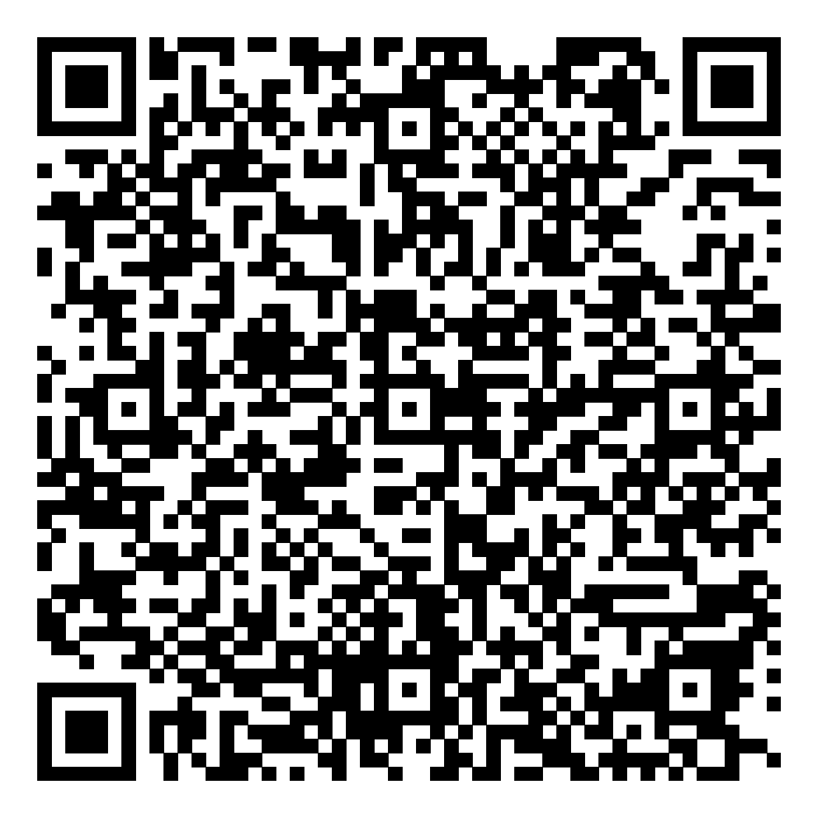
Activities
How to Become a Successful Social Entrepreneur?
Scan the QR code and learn more about how to become a successful social entrepreneur.
Where to start and how to get to scaling your solutions to drive impact?

Slide 34
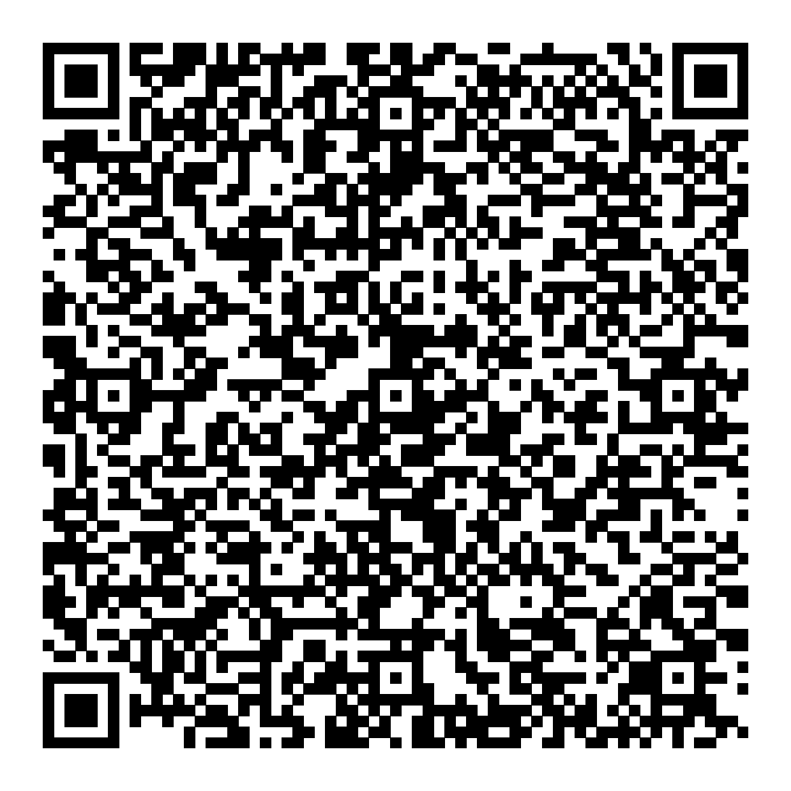
Activities
Six Ways To Approach Social Entrepreneurship At Your Organization
There are a lot of organizations that do great things.
Scan the QR code and get to know some of them and the lessons from each of them that you can apply in your organisation.

Slide 35
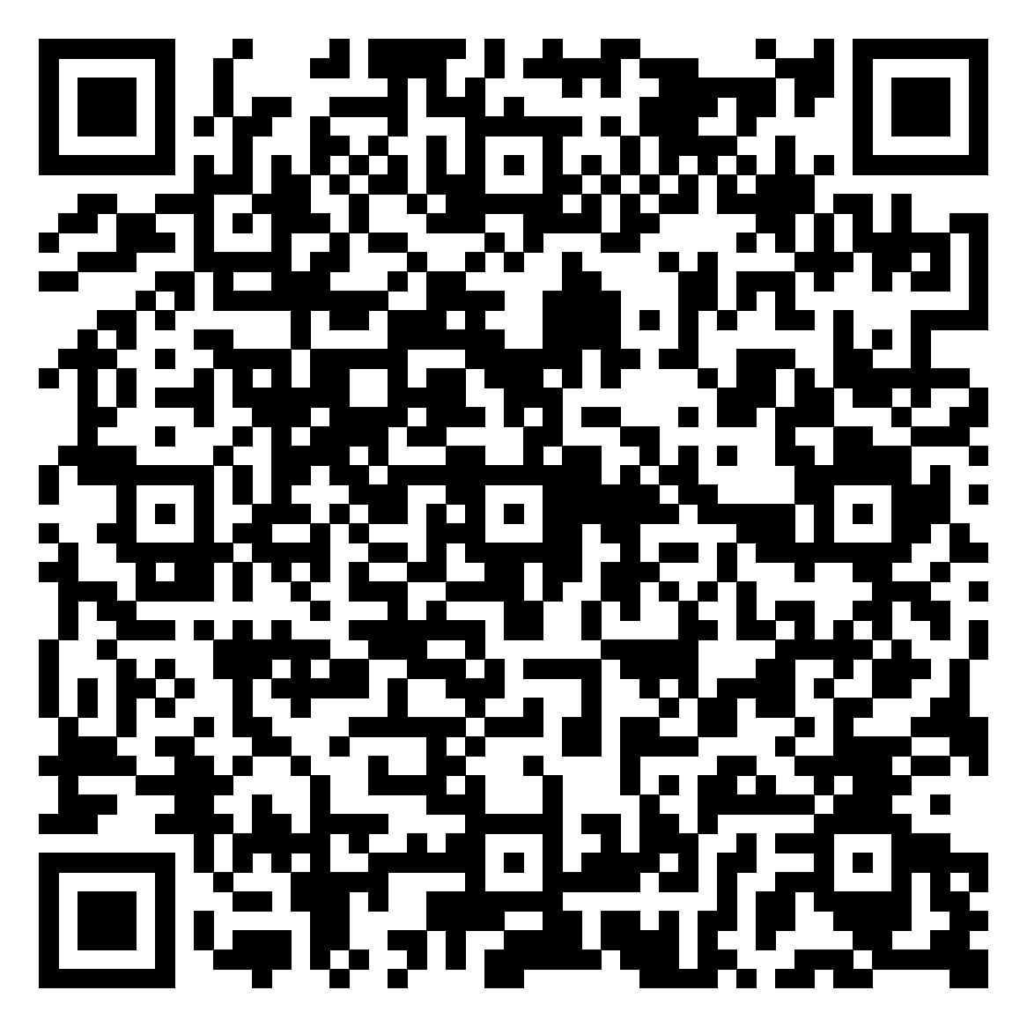
Activities
TRENDS IN SOCIAL ENTREPRENEURSHIP
Social entrepreneurship as a mindset has steadily gained momentum over the past two decades, and several trends are emerging in this field.
Scan the QR code and get to know the 5 trends that are gaining traction.
WHAT SOCIAL ENTREPRENEUR TRENDS ARE YOU EXPERIENCING?

Slide 36
Activities
How can we devise a social enterprise with the goal to improve an issue that concerns our community?
Group the participants according to their interest in a social issue/problem concerning their community.
Ask them to write down the social issue that concerns them in the centre of a large sheet of paper. Hand out to each student sticky notes and give them five minutes’ time to think about possible solutions to this particular problem or issue
Ask each team to discuss the proposed solutions and create a social enterprise which could offer a solution to the social issue at stake by means of a particular business activity.
Ask them to fill-in the profile of their social enterprise using the table on the next slide

Slide 37
Activities
How can we devise a social enterprise with the goal to improve an issue that concerns our community?
Social Enterprise’s Profile | Functions
Social Enterprise’s Name | Social problem
Area of implementation | Service/product description
Logo | Names of the group’s members

Slide 38
Activities
How can we create a social enterprise that solves a problem affecting our community?
Each group is invited to present their social enterprise and other participants should provide a feedback.

Slide 39
References
What is Social Entrepreneurship? Social Entrepreneurship Definition (wix.com)
Social Entrepreneur: Definition and Examples(investopedia.com)
Social entrepreneurship & Social enterprises(www.oecd.org)
Social Entrepreneurship: Definition, Types and Examples – Harappa
Social impact and social entrepreneurship: Facts and statistics (goodhere.org)
Teaching the Key Skills of Successful Social Entrepreneurs (ssir.org)
Social entrepreneurship – a tool for regional development
(PDF) Social Enterprise as a Catalyst for Sustainable Local and Regional Development (researchgate.net)
(PDF) Leadership in Social Enterprise: How to Manage Yourself and the Team (researchgate.net)

Slide 40
References
6 steps to becoming a successful social entrepreneur | World Economic Forum (weforum.org)
Six Ways To Approach Social Entrepreneurship At Your Organization (forbes.com)
Five Trends in Social Entrepreneurship(santafeinnovates.com)
LIFE SKILLS DEVELOPING SOCIAL ENTREPRENEURS (britishcouncil.gr)

Slide 41
Thank you!
@Regio.Digi.Hub

